Slide 1
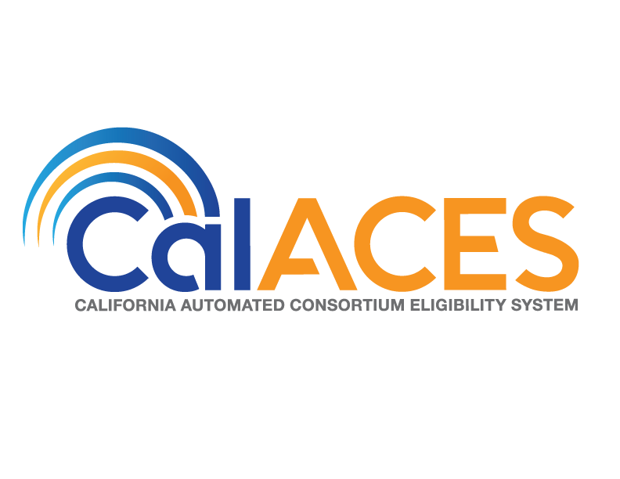
JPA Board of Directors and
Member Representatives Meetings
APPENDIX
June 22, 2018

Slide 2
Index
Slide Description | Slide Numbers
M & O Application and Operations Update – Policy Implementation | 3-6
CDSS MOUs | 7-8

Slide 3
M & O Application and Operations Update Policy Implementation
Item | Policy Effective Date | C-IV Status | LRS Status | Description – CalACES Implementation Effort
Child Support SB 380 2nd Draft ACL Received 6/8/2018 | 11/1/2018 | SCR Phase I 101374 Release 18.07 Phase II SCR 100390 Design Release 18.09 | SCR Phase I 202806 Release 18.07 Phase II SCR 200785 Design Release 18.09 | Effective November 1, 2018, a CalWORKs (CW) applicant or recipient will have the option to exclude a stepsibling or half-sibling from the AU in order to keep one hundred percent of any child support payments made on behalf of that child, as long as the following apply: The amount of child support received each month for that child is greater than the cash aid amount for the child; and Child support received for the child has been consistent. Any child support payments received pursuant to SB 380 would not be treated as income when determining CalWORKs eligibility or grant amounts. CDSS plans to release the final ACL by end of June 2018 C-IV/LRS Update: Phase I – Mass Mailer – Policy requires the informing notice to be mailed by 9/1/18. The tentative plan is to generate the mailer and send to print vendor by 8/27/18 to be mailed by 9/1/18. Phase II -The design team, consortium staff, and QA staff are working on documenting the requirements and the design.

Slide 4
M & O Application and Operations Update Policy Implementation
Item | Policy Effective Date | C-IV Status | LRS Status | Description – CalACES Implementation Effort
SAWS 1 PLUS Draft ACL/Form Received 3/5/18 | 7/1/2018 | SCR 100580 Analysis Release TBD | SCR 202458 Analysis Release TBD | CDSS was working on revising the SAWS 2 Plus to include additional programs, newly passed legislative requirements to track sexual orientation/gender identity (SOGI), incorporate the SAWS 2A SAR information and align with the CMS requirements for the health care program application requirements. As of December 2017, this effort is on hold. At the December SAWS policy meeting, CDSS informed SAWS that they are working on a modified version of the SAWS 2 PLUS which will only include five questions. The modified version is the SAWS 1 Plus. The first five questions of the streamlined SAWS 2 Plus application, now make up the State Automated Welfare Systems (SAWS) 1 Plus. The questions on the SAWS 1 Plus were revised to ensure compliance with relevant laws and regulations, as well as capture eligibility determinations for all impacted programs. Effective July 1, 2018 CWDs must use the new SAWS 1 Plus form in place of questions one through five (pages one and two) on the SAWS 2 Plus when applicants are applying for cash aid (CalWORKs, GA/GR, TCVAP, Entrant Cash Assistance, Refugee Cash Assistance) and/or if an applicant is applying for one or more programs (CalFresh and/or health care). Please note CAPI still requires form SOC 814 to be completed and expects to use the SAWS 1 Plus and SAWS 2 Plus in the near future. System change design efforts will begin when final policy is published. CDSS is expected to publish the SAWS 1 PLUS by 7/1/18.

Slide 5
M & O Application and Operations Update Policy Implementation
Item | Policy Effective Date | C-IV Status | LRS Status | Description – CalACES Implementation Effort
Add VUR Functionality for Non Assistance CalFresh (NACF) ACL 13-17 | 10/1/2013 | SCR 619 Analysis Release TBD | Implemented | No change since last meeting. CW/CF Committee High Priority CalFresh SCRs: Due to a waiver denial, CWDs must act on any NACF changes considered verified upon receipt (VUR). CDSS has drafted an ACIN to published the VUR chart (Mid Period Guide) and a Q&A. CDSS sent out the draft ACL on 2/8/18. C-IV Update: Design is pending receipt of CDSS policy Q&A. LRS Update: VUR was included in the initial implementation of the LRS System. Verification logic in LRS is different from C-IV and is automated. LRS verification logic is based on Report Date and Change Reason logic.

Slide 6
M & O Application and Operations Update Policy Implementation
Item | Policy Effective Date | C-IV Status | LRS Status | Description – CalACES Implementation Effort
MC RE Informational Packets for Application and Renewal MEDIL I 14-54 | 2014 | SCR 924 Analysis Release TBD | SCR 52371 Implemented Release 17.05 | No change since last meeting. Counties are required to provide the publications listed in this MEDIL to all households at the time of initial application when submitted to the county directly in person, by phone, by mail or through eNotification and at renewal. C-IV Update: The approach was to create three informational packets, one for applications and two for renewals. Due to the substantial increase in project operations cost and a shift in county postage cost, this item was discussed at PSC in 2017. OSI indicated there was no additional funding for this effort. To avoid the cost of mailing these packets, PSC sent a Consortium Request for Policy Clarification (CRPC) to CDSS and DHCS requesting the packets be posted to the recipient’s C4Y account and if a PDF link to each packet on C4Yourself (C4Y) would satisfy the policy requirement. Note: Due to the increase in volume that these automated packets will would create, the Project would have to restructure the contract with the print center vendor. PSC approved the following C-IV implementation approach: The counties will continue to manually mail the informational packets as described in MEDIL I-14-54 until such time that State funding can be secured. When State funding is available and DHCS updates the PUB 68, the C-IV Project will finalize the SCR and present it to the Correspondence Committee for review and approval. Per DHCS on 10/26/17 the revised PUB 68 has been revised and split into an English and Spanish version. A draft version of the PUB 68 was sent for stakeholder review on 12/8/17. LRS Update: The forms are available in the template repository for end users to manually distribute to participants with the exception of the brochures that are targeted for 17.09 implementation. Also, no decision has been made on posting the publications to the participant’s YBN account.

Slide 7
CDSS MOUs
Item | MOU Status | Purpose of the Data Request
Census | In Progress CDSS has been working with Census Bureau to resolve some concerns with the contract language. Note: Initial approved MOU expired on 6/30/17 | To provide CDSS the necessary and relevant California Work Opportunity and Responsibility to Kids (CalWORKs) and Supplemental Nutrition Assistance Program (SNAP) data to use in improving the U.S. 2020 Census and providing California with valuable data on program participation dynamics. The LRS and C-IV Projects will provide to CDSS specific CalWORKs and SNAP data from 2004 through 2019.
West Stat Study | Final CalACES Legal comments sent to CDSS in March. Final MOU to be approved at JPA meeting on 6/22/18. | To provide CDSS the necessary and relevant Supplemental Nutrition Assistance Program (SNAP) data to study and identify the major individual, household, and environmental barriers affecting SNAP households. In addition, to examine how these barriers vary by household demographics, economics and geography and determine how, if at all, these barriers can be accounted for in determining SNAP allotments. The LRS and C-IV Projects will provide to CDSS active CalFresh Recipients as of 10/31/17.
7

Slide 8
CDSS MOUs
Item | MOU Status | Purpose of the Data Request
Cross-System Analytic and Assessment for Learning and Skills Attainment (CAAL-Skills) | Pending | The purpose of the CAAL-Skills project is to develop a comprehensive, integrated, interoperable data system that measures and assesses program outcomes in a systematic and efficient manner. The data system’s overarching purpose will be helping the California Workforce Development Board (CWDB) (and its State Plan partners) meet statutorily mandated performance reporting requirements and align with Workforce Innovation and Opportunity Act (WIOA) of 2014 and AB 1336 requirements. Napa, Monterey, and Stanislaus are the pilot counties for this project. The C-IV Project will provide to CDSS specific CalWORKs and WTW data from July 2013 to June 2017. Draft MOU was received on 4/17/18 and is being reviewed by project and legal staff. Comment sent to CDSS on 5/17/18.

