Slide 1
CalACES
Project Steering Committee Meeting
January 18, 2018

Slide 2
Agenda
Call Meeting to Order
Public opportunity to speak on items not on the Agenda
Confirmation of Quorum, Webinar/Conference Call Logistics/Protocols and Agenda Review
Approve the Minutes of the December 07, 2017 Project Steering Committee Meeting and update of Action Items

Slide 3
CalACES/CalSAWS Planning Advance Planning Document (PAPD) Overview

Slide 4
Agenda
CalACES/CalSAWS PAPD Context
CalACES/CalSAWS PAPD Overview
Federal Approval Conditions
Workflow 1: Continue Migration Planning and Joint Development Activities
  Scope
  Schedule
  Team
Workflow 2: Conduct CalACES Alternatives Analysis and Cost Benefit Analysis
  Scope
  Schedule
  Team
Workflow 3: Conduct CalSAWS Planning and Analysis
  Scope
  Schedule
  Team
PAPD Total Budget Summary
PAPD Schedule Summary
Questions & Answers

Slide 5
PAPD Context
Federal Decisions and Direction
  No approval for CalACES Migration D&I to begin in January 2018 as planned
  Directed that CalACES Migration D&I must result in all 40 counties:
    Consolidating databases
    Moving to cloud services
    Consolidating data centers/hosting models
  Directed that formal Alternatives Analysis and Cost Benefit Analysis, including a risk assessment, be conducted to support further consolidation and determine timing/sequencing
  Required the inclusion of initial placeholder for CalSAWS planning effort and estimates to reflect the “big picture” for a 58-county SAWS in California
  Identified additional specific items to be analyzed including the SAWS Consolidated Portal
State and Consortia Involvement
  Determined that third party vendor would lead the effort
  Prepared multiple draft IAPDUs/PAPDs in late December 2017
  Shared with Federal partners and State stakeholders, and revised based on input
  Submitted Final PAPD on January 2, 2018
PAPD conditional approval received from FNS on January 5 and from CMS on January 9

Slide 6
Federal Approval Conditions
CMS and FNS Conditions
  Provide copies of the reports or assessments from the third-party work as they are completed
  Expects implementation of CalACES in 2020
  Expects the analysis results to be a significant asset to California and support a CalSAWS completion in 2023
  Affords three years of stabilization and migration for California to complete the CalSAWS migration by the end of 2023
  Provide a PAPDU by end of September 2018
Additional FNS Conditions
  Submit a revised CalACES Implementation Advance Planning Document (IAPD), which includes the governance structure for CalSAWS, by the end of May 2018
  Effective at the start of calendar year 2024 FNS will not reimburse California for the operation, maintenance or other costs for any other SNAP eligibility system or database

Slide 7
PAPD Overview
Nature and Scope of Activities
Personnel Resources
Proposed Schedule
Proposed Budget
Scope
Workflow 1
  Continue Migration Planning and Joint Development Activities
Workflow 2
  Conduct CalACES Alternatives Analysis and Cost Benefit Analysis
Workflow 3
  Conduct CalSAWS Planning and Analysis

Slide 8
Workflow 1: Continue Migration Planning and Joint Development Activities
Scope
  Process Alignment
  Change Management (Minimize Gaps)
  County Readiness
  Staff Recruitment
  Migration IAPD Updates
  Requirement Updates based on Technical Analysis Results
  Contract Negotiations and Amendments
Schedule
  January 2018 – June 2018
  Contingency July 2018 – September 2018

Slide 9
Workflow 1: Continue Migration Planning and Joint Development Activities
Team

Slide 10
Workflow 2: Conduct CalACES Alternatives Analysis and Cost Benefit Analysis
Scope
  Analyze options for CalACES hosting strategy
  Analyze options for CalACES datacenter consolidation
  Analyze options for CalACES database consolidation
  Analyze options for the SAWS New Shared Services e.g. Single SAWS Consolidated Portal
  Assess procurement options and develop Procurement Strategy Analysis Report
  Conduct Alternatives Analysis, including risk assessment
  Conduct Cost Benefit Analysis
  Develop Alternatives Analysis Cost Benefit Analysis Results and Recommendations Report
  Provide options for the redevelopment of roadmap to a single SAWS system and tactical near-term action plan for multiple work streams of CalACES and CalSAWS efforts

Slide 11
Workflow 2: Conduct CalACES Alternatives Analysis and Cost Benefit Analysis
WCDS/CalWIN Involvement
  Daily debrief calls beginning January 22, 2018
  Analyze options for the SAWS New Shared Services e.g. Single SAWS Consolidated Portal in February/March 2018
  Provide options for the redevelopment of roadmap to a single SAWS system and tactical near-term action plan for multiple work streams of CalACES and CalSAWS efforts in March 2018

Slide 12
Workflow 2: Conduct CalACES Alternatives Analysis and Cost Benefit Analysis
  Schedule
 | Tasks | Start Date | End Date
1 | Project Initiation | January-18 | January-18
2 | Analysis of C-IV and LRS Moving to Cloud Environment | January-18 | February-18
3 | Analysis of Database Consolidation | January-18 | March-18
4 | Analysis of Data Center/Hosting Consolidation | January-18 | March-18
5 | Prepare Analysis Results and Recommendations Report | March-18 | March-18
6 | Secure State Sponsor Approval of Analysis Recommendations | March-18 | March-18
7 | Secure Federal Sponsor Approval of Analysis Recommendations | March-18 | March-18
8 | As-Needed IAPDU for SFY 18/19 | March-18 | March-18
9 | Re-baseline Migration D&I Project Schedule and Budget | March-18 | March-18
10 | Prepare Revised IAPDU | April-18 | April-18
11 | Secure State Sponsor Approval for IAPDU | April-18 | May-18
12 | Secure Federal Sponsor Approval for IAPDU | April-18 | May-18
13 | Prepare Vendor Contract Amendment(s) as needed | March-18 | March-18
14 | Negotiate Vendor Contract Amendment(s) as needed | April-18 | May-18
15 | JPA, State and Federal Approval of Amendment(s) as needed | June-18 | June-18
16 | CalACES Analysis Schedule Contingency | Jul-18 | Sep-18

Slide 13
Workflow 2: Conduct CalACES Alternatives Analysis and Cost Benefit Analysis
Team
Technical Planning & Analysis and IAPDU | FTE | New/ Leveraged
C-IV Project Director/Manager – Tom Hartman | 1 | Leveraged
LRS Project Director/Manager – Laura Chavez | 1 | Leveraged
Migration Planning Manager – June Hutchison | 1 | Leveraged (Workflow 1)
QA Project Manager/Lead – Holly Murphy | 1 | Leveraged
QA Fiscal Analyst – Britt Carlsen | 1 | Leveraged (Workflow 1)
Senior Consultant – Betty Uzupis | 1 | New
QA Senior Technical Lead – Joe Hogan | 1 | New
QA Senior Technical Lead – Frank Ono, BK Sinha | 1 | New
Technical Contractor Services – McKinsey Consulting | Variable | New
Legal Counsel | 1 | New
Total | 8+

Slide 14
Workflow 3: Conduct CalSAWS Planning and Analysis
Scope
  Develop data conversion strategy, including data mapping and test data conversion
  Conduct business process/system functionality gap analysis between CalACES and CalWIN
  Perform analysis of county ancillary systems being used by WCDS counties and impact to CalSAWS
  Conduct analysis of opportunities of reusability in migration to CalSAWS
  Conduct analysis to support the development of a procurement strategy for the migration to CalSAWS
  Develop CalSAWS change management
Schedule
  CalSAWS Migration Planning & Analysis: July 2018 – December 2018
  CalSAWS Analysis Schedule Contingency: January 2019 – March 2019
  CalSAWS IAPD Development: April 2019 – June 2019

Slide 15
Workflow 3: Conduct CalSAWS Planning and Analysis
Team (Includes WCDS/CalWIN resources)
CalSAWS Migration Planning & Analysis Team | FTE
Project Director | 1
Technical Analyst | 1
Technical Analyst | 1
Business Analyst | 1
Business Analyst | 1
Contractor Services | Variable
Total | 5+

Slide 16
PAPD Budget Summary
PAPD Line Items | Migration Planning & LRS Joint Development | Technical Planning & Analysis and IAPDU | CalSAWS Migration Planning & Analysis | Total
Consortium Personnel | $1,348,887 | $186,480 | $604,800 | $2,140,167
Quality Assurance | $806,046 | $2,516,592 | $0 | $3,322,638
Contractor Services | $0 | $0 | $3,000,000 | $3,000,000
Legal Counsel | $0 | $272,000 | $0 | $272,000
Travel | $353,666 | $136,620 | $151,200 | $641,486
Total | $2,508,599 | $3,111,692 | $3,756,000 | $9,376,291
PAPD Line Items | Migration Planning & LRS Joint Development | Technical Planning & Analysis and IAPDU | CalSAWS Migration Planning & Analysis | Total With Contingency
Consortium Personnel | $2,291,437 | $279,720 | $1,209,600 | $3,780,757
Quality Assurance | $1,209,069 | $2,655,456 | $0 | $3,864,525
Contractor Services | $0 | $0 | $3,000,000 | $3,000,000
Legal Counsel | $0 | $340,000 | $0 | $340,000
Travel | $542,249 | $204,930 | $302,400 | $1,049,579
Total | $4,042,755 | $3,480,106 | $4,512,000 | $12,034,861
Cost Allocation*
Federal | State Welfare | State Health | County
$10,455,041 | $617,432 | $939,522 | $22,866
*Cost Allocation Plan must be updated based on Persons Count for 58 counties, and distribution of the county share must be determined. County Share is based on Total with Contingency

Slide 17
Schedule Update
PAPD Schedule
Key Tasks
1/2/18 – 6/30/18
7/1/18 – 9/30/18
7/1/18 – 12/31/18
1/1/19 – 3/31/19
Continue existing Migration Planning and Joint Development Tasks and Team
Contingency for existing Migration Planning and Joint Development Tasks and Team
CalSAWS Planning and Analysis
CalSAWS Planning and Analysis Contingency
Workflow 1: Continue existing Migration Planning and Joint Development
Workflow 2: Conduct CalACES Alternatives Analysis and Cost Benefit Analysis
Workflow 3: Conduct CalSAWS Planning and Analysis
CalACES Alternatives Analysis and Cost Benefit Analysis
Contingency CalACES Alternatives Analysis and Cost Benefit Analysis
1/2/18 – 6/30/18
7/1/18 – 9/30/18

Slide 18
Schedule Update
PAPD Schedule
Workflow 2 Key Tasks
1/8/18 – 1/18/18
1/18/18 – 3/31/18
3/15/18 – 3/23/18
4/1/18 – 5/31/18
Initiate project, develop work plan, develop Deliverable Expectation Documents , confirm roles and responsibilities, conduct kickoff meeting
Analyze migration to cloud, database consolidation and data center consolidation/hosting options
State and Federal Review and Approval of Alternatives Analysis & CBA
State and Federal Review and Approval of CalACES Migration D&I IAPDU
Workflow 2: Conduct CalACES Alternatives Analysis and Cost Benefit Analysis
Prepare draft and final CalACES Migration D&I IAPDU based on Alternatives Analysis recommendation
Prepare draft and final Alternatives Analysis and Cost Benefit Analysis Report
Contract Negotiations
3/15/18 – 4/30/18
4/1/18 – 5/31/18
3/1/18 – 3/31/18
Prepare Vendor Contract Amendment(s)
3/1/18 – 3/30/18

Slide 19

Questions & Answers

Slide 20
Technical Update
Please turn to handout 6-1 Technical Update

Slide 21
Migration Activities
CalACES Change Control Process Update

Slide 22
The Change Control Objectives
  Develop a single set of Project processes that strengthen the working relationship between the CalACES Project North and South staff.
  Work with Accenture to ensure the new SCR tracking tool, JIRA, is uniform to serve both projects.
  Review meetings and groups to determine which should be combined/discontinued and identify attendees.
  Provide an update of the CalACES Handbook, including updated processes, to the projects and counties.

Slide 23
The Change Control Accomplishments
Established Change Control Guiding Principles.
Created CalACES Enhancement Request (CER) form and corresponding process for the CalACES M&O Handbook.
Introduced a new System Change Request (SCR) tool, JIRA, which will be used by both projects. CalACES North Project went live on JIRA at the end of December 2017. CalACES South goes live on JIRA on 1/22/18.
Developed a CalACES SCR Design document.
Enhanced the SCR Prioritization process.
Enhanced process flows for CERs, SCRs, and Committee Escalation.
Alignment of the communication tools; e.g. CITs, Release Notes.

Slide 24
The Change Control Outstanding Items
Finalize the Analysts’ CER process.
Update the Analysts’ SCR Prioritization process.
Modify LRS Contract to:
  Remove the Director approval on all Application Software Modifications and/or Enhancement prior to the vendor beginning work.
  Remove the 10-day requirement for vendor to respond to M&E requests.
Update the C-IV and LRS Project signage to CalACES.

Slide 25
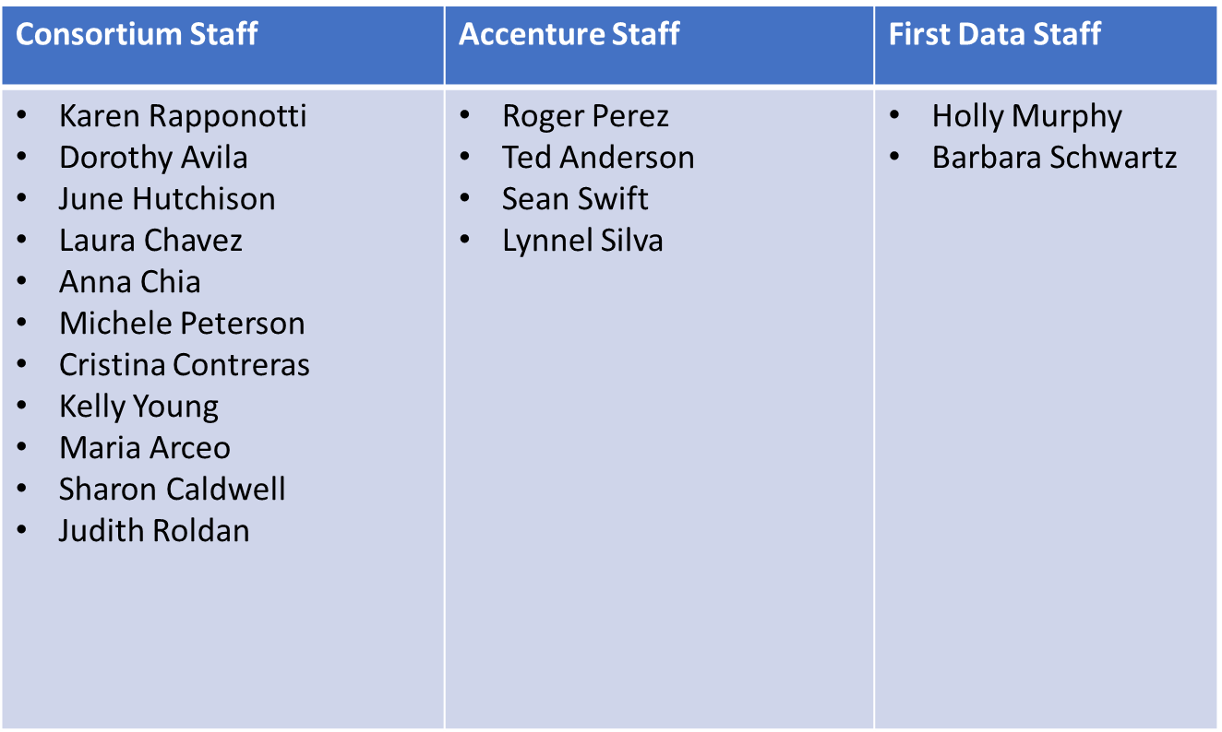
Change Control Team:

Slide 26
CalACES Budget Status

Slide 27
CalACES Budget Status
M&O was fully funded in the Governor’s Budget;
    SFY 17/18 (C-IV, LRS) and SFY 18/19 (CalACES)
LRS/C-IV Migration overfunded
Policy Changes:
Funded in Budget Year SFY 17/18
    ABAWD Automation
    Medi-Cal Automation (SB 1341)
    CalFresh Safe Drinking Water Pilot
    Continuum of Care Reform (CCR) - SAWS
    Inter-County Transfer Automation (SB 1339)
    Consumer Credit Reports (SB 1232)
    Overpayments-CalWORKs Reporting (AB 2062)
    Child Support (SB 380)
    Improving Participation for the Elderly and Disabled (IPED)
Funded in Budget Year SFY 18/19
    Medi-Cal Automation (SB 1341)
    Inter-County Transfer Automation (SB 1339)
Pending confirmation for breakout:
    Homeless Assistance Program (AB 236)
    Diaper Assistance (AB480)
    Veteran's Benefits (SB 570)
Pending confirmation for breakout:
    OCAT Integration
    Foster Care Eligibility Determination Solution (FCED)
The following were estimated but not funded:
    AB 214 Post Secondary Education: Student Hunger
    AB 557 CalWORKs: Victims of Abuse
    SB 282 Restaurant Meals Program

Slide 28
2017 CalACES Conference Feedback

Slide 29
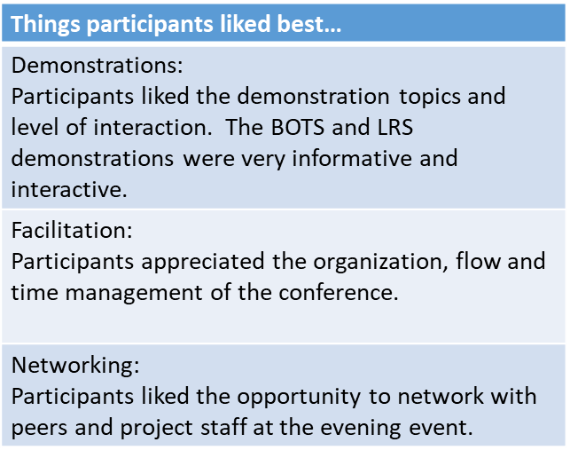
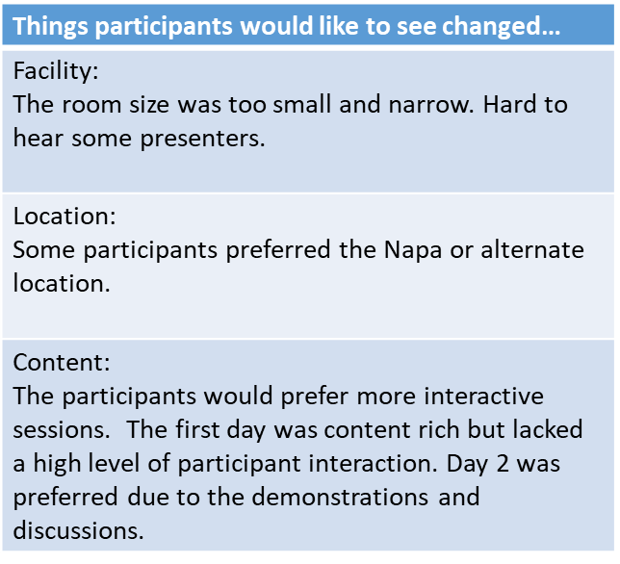
2017 Strategic Conference Feedback

Slide 30
M&O Application Update
Please turn to handout 10-1
JPA-PSC Policy Update 011818

Slide 31
State Update

Slide 32
Regional Updates/Sharing

Slide 33
Adjourn Meeting

