Slide 1
CalACES Data Purge Approach

Slide 2
Purpose and Agenda
The purpose of this meeting is to discussing the requirements around implementing a batch process to purge cases in C-IV, which can then be reused in LRS/CalACES. Initial development would be funded out of C-IV M&O
Topics will include:
Why - Policy requirements regarding the retention of welfare case data and the overall rules we could use based on these policies.
What – Discuss what data can be purged per the retention rules and what data has to be maintained indefinitely
When - How often would such a batch job run?
How – If we have time, we can start discussing implementation ideas

Slide 3
Why Now?
Adhere to Federal Law
LRS Pending SCR.
If implemented prior to Migration, will improve cutover time for C-IV to CalACES

Slide 4
Data Retention Policy
General Case:
In general, with some exceptions, policy states that welfare data can be purged three years (36 months) after the welfare case has been closed. Federal law requires that case records used as the basis for fiscal claims must be retained for a period of three years (36 months) from the date on which the state submits its final expenditure report to the federal Department of Health and Human Services (DHHS). MPP Section 23-353.6 further clarifies that, for the general case, a retention period of three and one-half years (42 months) is considered to meet the federal reporting requirement.
Manual of Policies and Procedures (MPP), Section 23-353, Introduction:
“Federal law (45 CFR 74.20) requires that case records which provide the basis for fiscal claims are to be retained for three years, starting on the day the state submits the last expenditure report to HHS for the period. In the case of supplemental expenditure reports this might require retention for a much longer period than three years.”
Manual of Policies and Procedures (MPP), Section 23-353.6:
“Unless a county has made or intends to make a supplemental expenditure report concerning specific cases which it wishes to purge or destroy, it may consider the retention period to be 3-1/2 years from the date a document was last needed to document eligibility or 3-1/2 years from the date the case was closed.”

Slide 5
Exceptions
The two general exceptions to the three and one-half years (42 month) data retention policy requirement are:
Time limit data
This data must be retained for the lifetime of the individual.
Not safe to assume WDTIP is permanent system of record for time limit data
Time limit-related data would need to be retained within CalACES.
Recovery accounts still subject to collections
Data must be retained until County no longer wishes to pursue collection activity on the account.
If a case has an open recovery account, none of the case data will be subject to a purge.

Slide 6
Other Exceptions
Other exceptions to the three and one-half years (42 month) data retention policy requirement include:
Warrant Registers – 5 – 15 years
Warrant registers are PDF reports which are associated with a county, not with a specific case. As they are not associated with case data in the C-IV System, warrant registers would not be subject to purging.
County Welfare Warrants – 5 years
County welfare warrants are not in the C-IV System, and would therefore not be subject to purging.
Criminal and Litigation-Related Records – Indefinitely, until all legal actions are concluded
We would need a specific flag type to allow workers to identify cases which need to be excluded from the purge process because they have pending or ongoing criminal or civil litigation (or really, for any other reason that the County wants to continue to retain a specific Case).

Slide 7
Other Exceptions (Cont.)
Additional exceptions exist for some programs:
AAP: Indefinite Retention (ACL 11-23)
Foster Care and Kin-Gap
Indefinite Retention for Native American children (California Child Welfare Services Manual of Policies and Procedures 31-075.21, Page 33.1)
Otherwise, retention is for three years from the date the State submits the last expenditure report to DHHS (Manual of Policies and Procedures, 23-353, Page 281)
Is there a reliable way to identify the Native-American FC/KG cases?
FC2 does not ask these questions
SAWS2, SAWS 1 includes questions about whether “the applicant or any member of their family” is a member of a Native American Tribe. SAWS1 typically completed as part of FC application.
PERS.MEM_OF_INDIAN_TRIB_IND likely indicates if a person is a member of an Native American Tribe. In C-IV, there are ~386 NULL values created between 1/2017 and 1/2018. But vast majority of PERS.MEM_OF_INDIAN_TRIB_IND columns created since 1/2017 are populated with “Y” or “N.”
Alternatively, could use Flags to indicate these should be retained indefinitely.

Slide 8
Data Purge Approach
Go Conservative?
Generally, data can be purged 42 months following the later of the date of case closure or the date of the state’s submission of its final expenditure report to DHHS
Proposed CalACES data purge approach would be to purge data four years (48 months) following the later of these two dates. I.e., we would only purge cases where all programs on the Case have been closed for at least four years.
In addition, we would also follow the exceptions noted on the previous slides (i.e., Not purge any cases flagged for retention, cases with investigations, cases with open recovery accounts).
Run Monthly?

Slide 9
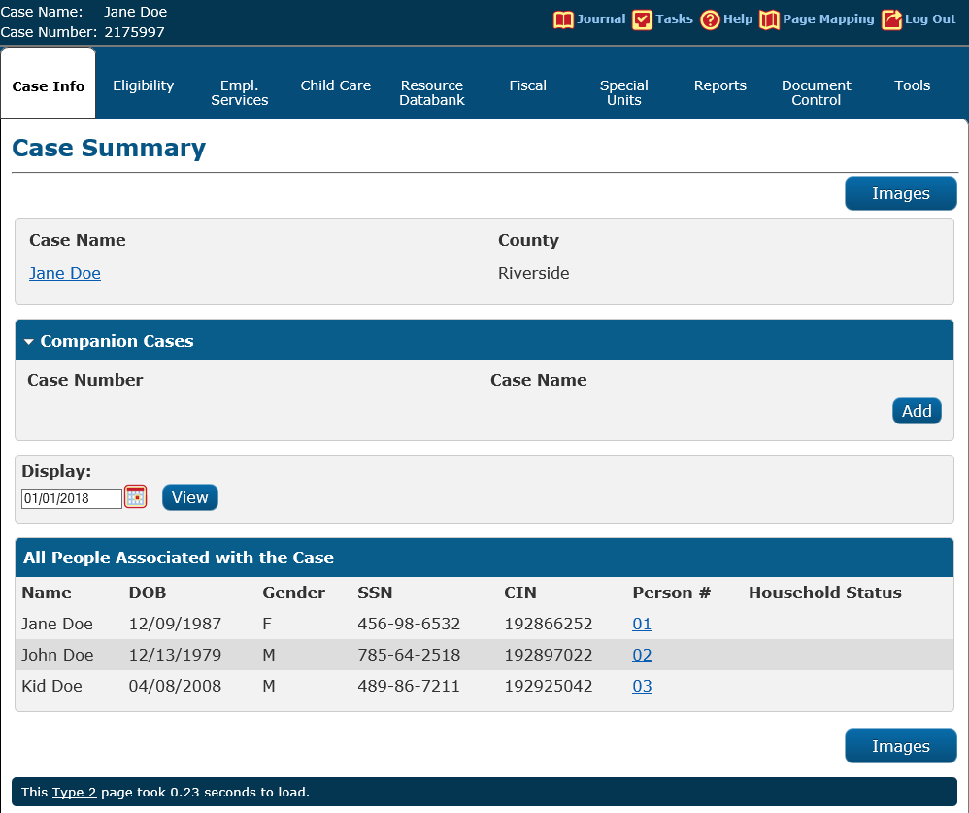
Data Purge Approach
What would get retained?
Case Name
Serial Number
Time Limit Data
High-level information about Persons associated with the Case:
Name
DOB
SSN
CIN
Gender

Slide 10
Data Purge Approach
What would get purged? A non-exhaustive list:
Case Data
Program data
EDBC data
Journal
Benefit History
Financial and Non-Financial data for Purgeable People (defined as someone who is only associated to Purgeable cases)
Tasks
Recovery Accounts
Correspondence
Verifications
IEVS
Images?
Others?

Slide 11
Number of Cases Affected (In C-IV, as of 10/26)
Approximately 5% of the Cases to Retain would be retained because they have an active recovery account. A very small fraction (less than 70K) would be kept because they are associated with an Investigation.
55% of Cases to Purge have ONLY People who are Purgeable (18% of total Case Universe)

Slide 12
Next Steps
Creation of a Unified Design Workgroup to create a System Change Request
Design would cover:
Purge Batch
Method for marking Cases to Retain
Solution for Imaging
Impacts to Portal
Solution for FC/KG
Finalizing time frame (42 months v. 48 months v. Something else?)

