Slide 1
CalSAWS Executive Leadership Meeting
CalSAWS Planning Strategy Update
May 3, 2018

Slide 2
Agenda
Governance
  Options for JPA Structure
    Regions and County Representation
    Voting
    Legal, Fiscal and Operating Mode
    State Involvement
  CalSAWS Leadership Team Decision Points and Timeline
CalACES/CalSAWS Analysis Update
  Leadership Message for Requirements Sessions
  Planning for Requirements Gathering Sessions – Confirm voting process
  User Labs Update
  Key Dates

Slide 3
CalSAWS Governance

Slide 4
Current CalACES JPA Structure
Board of Directors
  11 Directors
    7 C-IV Directors representing Regions 1 – 7
    4 LA Directors representing Region 8
  1 State Representative (non-voting seat)
  Quorum
  A minimum of 6 Board Directors or Alternate Directors from Regions 1 – 8
    Must include 2 Directors or Alternate Board Directors from Region 8
  Affirmative Votes
  A minimum of 6 Board Directors or Alternate Board Directors from Regions 1 – 8 which must include at a minimum:
    2 Directors or Alternate Board Directors from Region 8 and
    2 Directors from Regions 1-7
San Bernardino County serves as Fiscal Agent and Legal Counsel
  Legal Counsel transitions to independent entity in September 2018
Two Member Representative Meetings each Year
  Elections each June for Chair, Vice Chair and Secretary
  State Involvement: 1 non-voting seat on the Board of Directors currently filled by OSI Director

Slide 5
Governance: Regions and County Representation
Regions and County Representation
  Ensure county voices are heard in regional representative model
    Recognition that WCDS counties are used to 1 county, 1 vote: shift to regional model is a big change
  Ensure county groupings make sense: proximity, similar demographics, established relationships
  Ensure region size/number of counties is manageable: Adjust Regional Project Manager level of support as appropriate

Slide 6
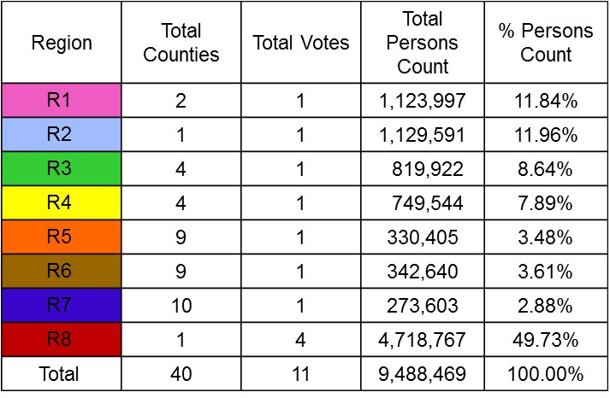
Current CalACES JPA Regional Structure – 8 Regions

Slide 7
Requirements
Leadership Message
Update on Requirements Planning

Slide 8
Leadership Message for Requirements Sessions
Approve Script
Confirm Speakers (Scott, Antonia, Barry, Ann)
Determine where and when each Director will record

Slide 9
Requirements Sessions: Confirm Voting Process
For each new or updated requirement a vote by show of hands of the CalWIN and CalACES County attendees will be taken
  CalWIN = 40 attendees
  (2 per county expected + 4)
  CalACES = 40 attendees
  (5 per each of 8 Regions)
Visual majority (at least 60% of the attendees) is needed to move an item forward
  If there is not a clear majority, then additional discussion toward resolution
    If not resolved, then the item will be escalated
Attendees that do not agree with the outcome always have the option of escalating the item

Slide 10
User Lab Update

Slide 11
ALL SURVEY RESULTS, Week 1 to 4
User Lab Participant Summary
Overview
Week
Focus
Survey Participants
  1-4 of 6
  Eligibility
  CalWORKs
  CalFresh
  ICT
  e-Apps
  CalHEERS
  93
  WTW
  Medi-Cal
  Child Care
  Resource Databank
Participants details
Role¹
Experience in years
Areas of specialization²
106
Other & NA
47
NA
<2
Technical Analyst
2-5
Business Analyst
Program Manager
10+
5-10
Supervisor
Eligibility Worker
Clerk
1
Other
Cal-WORKs
Medi-Cal
Cal-Fresh
Cal-HEERS
NA
Foster Care
Special
Invest.
Fiscal
1 Participants could select multiple roles 2 As a percentage of responses

Slide 12
ALL SURVEY RESULTS, Week 1 to 4
Weeks 1 & 2
Day 4 Question: How important do you feel each of the following are to a successful CalSAWS migration?
Week 3
Week 4
Not
Important
Somewhat
Important
Very
Important
Most
Important
Important
Adjusting to changes to CalWIN County business processes resulting from the new application
Proper training for how to use the new application
Opportunity for CalWIN County input to the requirements gathering
Maintaining or Improving Customer Experience

Slide 13
ALL SURVEY RESULTS, Week 1 to 4
Weeks 1 & 2
Day 4 Question: How effective did you find User Labs for each of the following?
Week 3
Week 4
Not
Effective
Somewhat
Effective
Very
Effective
Effective
Gain understanding of the target CalSAWS systems
Consistently effective understanding of CalSAWS and LRS
Consistently effective impact on capturing and sharing questions with Counties
Varying impact of LA & C-IV business process understanding (to be addressed with onsite County visits)
Improve understanding of how the CalWIN counties will participate in the CalSAWS migration process
Identify potential gaps from CalWIN for the CalSAWS migration process
Understand existing CalACES requirements and how LRS will be updated for CalACES
Improve understanding of existing LA & C-IV business processes
Gain firsthand knowledge of working in LRS
Understand how the CalSAWS system will support county business processes
Capture questions to share with your counties / teams

Slide 14
ALL SURVEY RESULTS, Week 1 to 4
User Lab Comments and Parking Lot Item Tracking
Proceeding phase 3
for resolution
780
total comments tracked
so far (218 duplicates)
290 comments will proceed to phase 3 for resolution
292
271
As of Tuesday May 2nd
102
87
28
15
13
Week 1
Week 2
Week 3
Week 4
Week 5
Week 6
Category
Ph3
Tot.
W1
W2
W3
W4
W5
Design Difference Identified: Difference between LRS and CalWIN that affects efficiency or functionality
Existing Requirements: Comments/opinions on existing CalACES requirements
Suggested Enhancement: CalWIN Participants have identified a suggested enhancement¹ to the system
N/A: retracted by the User or environment issue
Phase 3 (“Ph3”): Must move to phase 3 for resolution (if “no”, CalWIN/CalACES final review needed)
Suggested Enhancement
Yes
83
38
20
10
13
2
Design Difference
Yes
162
52
57
22
20
11
Existing CalACES
Requirement
Yes
45
22
9
8
4
2
No
66
32
11
14
5
4
Parking Lot - Resolved
No
174
40
62
37
31
4
Parking Lot - Pending
No
11
3
5
0
2
1
Duplicate
No
218
93
106
9
10
0
N/A
No
21
12
1
2
2
4
Total
780
292
271
102
87
28
1 Identified as an enhancement by Migration Planning Team and must be reviewed by CalWIN Project

Slide 15

Key learning we will leverage for Formal Requirement Gathering Sessions
Deploy surveys
Leverage Surveys to assess weekly performance and provide a base for feedback discussions
Cover priority situations
Include in requirement discussions both a “case task” view and a “case situation” view
Clarify
objectives
Clarify upfront source material, proposed discussion methodology, and expected output
Encourage gap discussions
Coach session leaders to foster discussion when a perceived gaps is mentioned
Use positive reinforcement
Share positive feedback (whenever available) as positive reinforcement with both Session leaders and participants

Slide 16
Key Upcoming Dates
May Deliverable Report
June Deliverable Report
July Deliverable Report
Topics Planned For Each Monthly Deliverable
CalWIN
Related
Draft factbase for:
  CalWIN business processes/ functionalities
  CalWIN ancillary systems
  CalACES requirements & cost validation
Emerging view of:
  CalWIN county business process & ancillary systems across CalWIN
  DD&I & M&O costs for CalACES & CalSAWS
  CalSAWS data conversion strategy
Final report on:
  CalWIN county business process & ancillary systems
  CalACES and CalSAWS implementation plan (including costs, sequencing, risks, migration plan, etc.)
CalACES/ CalSAWS Related
Target Timeline
Core Team Review
May 17 – May 23
June 21 – June 27
July 19 – July 25
Deliverable Review
Thursday, May 24
Thursday, June 28
Thursday, July 26
Completion of Stakeholder Review
Thursday, May 31
Thursday, July 5
Thursday, August 2
Project Sponsor Review & Signoff
Monday, June 11
Monday, July 16
Monday, August 13

Slide 17
Wrap-Up
Next Steps

Slide 18

Next Steps
Questions & Answers
Action Items
  Create non-confidential version of this presentation
Next Steps
  June 1 Meeting:
    Review CalSAWS Leadership Work Plan and Decision Points
    Continue discussions on regional models and voting structures
    Input from legal counsel
    CalACES/CalSAWS Project Status
    IAPD Update for Moving LRS to the Cloud

