Slide 1

JPA Board of Directors Meeting
September 27, 2018

Slide 2
Agenda
Call Meeting to Order
Public opportunity to speak on items not on the Agenda

Slide 3
Action Items

Slide 4
Board Action Items
Approve the Minutes of the August 23, 2018, CalACES JPA Board of Directors Meeting and update of Action Items
(a) Approve First Data C-IV Change Order CO-031 Migration Planning, Revision 4
(b) Approve First Data C-IV Contract Amendment No. Sixty-Three (references Change Order CO-031 Migration Planning, Revision 4 and updates to Exhibit A)
Approve Vavrinek, Trine, Day & Co (“VTD”) Contract for Financial Audit Services for fiscal years ending June 30, 2018, June 30, 2019 and June 30, 2020 with the option to extend two (2) additional one (1) year terms. .
Approve Davis Farr LLP contract for the annual SOC 1 Type 2 Report of the CalACES Joint Powers Authority for the fiscal years ending June 30, 2018 and June 30, 2019.
Approve Memorandum of Understanding between Welfare Client Data Services (WCDS) and CalACES for shared services effective 09/27/2018 until the formation of the CalSAWS Joint Powers Authority.

Slide 5
CalSAWS Leadership Team Update

Slide 6
CalACES/CalSAWS Planning Update

Slide 7
Pre-Consolidation Governance Workgroup (‘little g’) Update
Workgroup Objective
This cross consortia group, made up of deputies from the three SAWS are developing documentation to assist with the transition of adding CalWIN counties into the committee governance structure, to allow for 58-county (6 Regions) input into SCR designs.
To date, this workgroup is working to develop draft:
  Guiding Principles for CalSAWS Committees
  Regional Manager Roles and Responsibilities
  Proposed Committees
  Cross Walk – CalWIN and CalACES Change Governance
  2019 Side-by-Side Release Schedules
More to come at the Strategic Conference!

Slide 8
Ancillary Systems
Revised Approach Based on Contract Negotiations

Slide 9
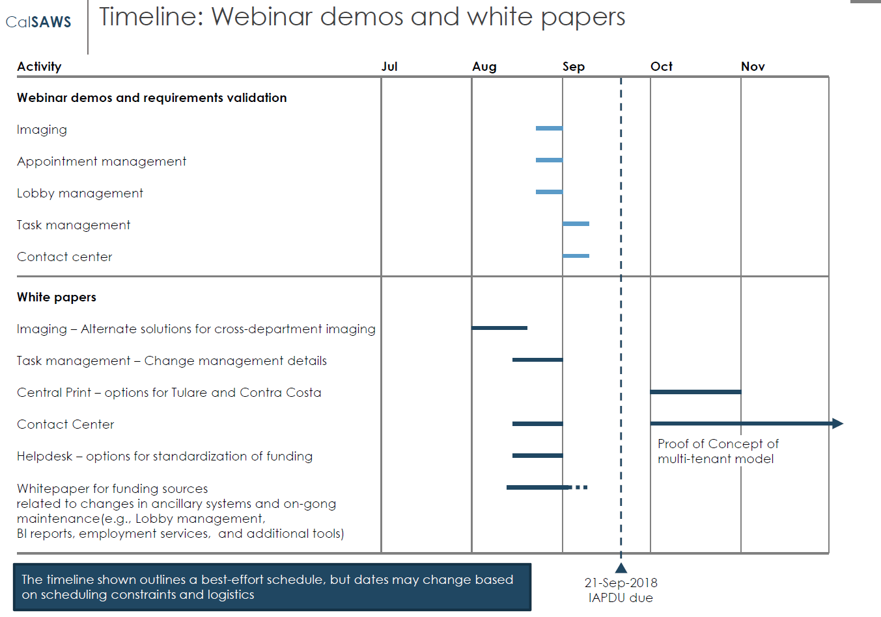
Ancillary Systems Decision Making Process
Review Major Topic Areas
  Imaging
  Appointment Management
  Lobby Management
  Task Management
  Call Center
Three-pronged Approach
  White Papers
  Webinar Demonstrations
  Functional Designs with Accenture
Timeline to be revised

Slide 10
Ancillary Systems: White Papers
White Paper Documentation for:
  Imaging
  Call Center
  Task Management (Draft)
White Papers include:
  Overview of current state
  Relevant Facts
  Alternatives Analysis by McKinsey
  Pros and Cons of each alternative
  Key Issues for Considerations
  Appendices with cost details

Slide 11
Ancillary Systems
Approach to Webinar Demonstrations:
  Demonstrate LRS as-is whenever possible
  Demonstrate/provide an overview of functionality captured in the requirements from CalWIN County visits
  Joint county/consortium approach
    LRS as-is will be presented by Consortium/County staff
    Complex ancillary requirements will be presented by individual counties, as needed
  Review requirements from CalWIN county visits to obtain county input
  Webinar schedule will be distributed via CIT to all counties
    Number of attendees is county determined – number of call-in lines per county limited to 3

Slide 12
Ancillary Systems: Modifications to Approach
Original Approach from McKinsey White Paper:
  “Sessions (Webinar Demonstrations) will be held to demonstrate the target state solution, explain and discuss requirements, and to validate the requirements for enhancement.”
Webinar Demonstrations will promote education and understanding
Functional Design Sessions from January – April 2019 will be used to finalize requirements
  Accenture will lead functional design sessions with the 58 Counties to finalize requirements for the following topics:
    Imaging
    Task Management
    Non-State Forms
    APIs for Lobby Management, Employment Services and Master Data set
    Conversion needs for CalWIN Ancillaries
    GA/GR

Slide 13
Ancillary Systems: Contact Center/HD Approach
Conduct Contact Center/HD Webinar as planned AND conduct requirements gathering sessions that will feed an IAPDU and resulting procurement
Considerations:
  The Call Center component of the Accenture agreement has been removed as it was cost prohibitive
  McKinsey is re-evaluating the current recommendation in Deliverable 10
Recommendation
  Competitively procure a Call Center software package for the California Counties

Slide 14
Ancillary Systems: Next Steps
Schedule Webinar Demonstrations:
  Plan for Early October for the first session
  Recommended schedule:
    Begin Early October with Imaging
    Follow in two/three week increments with:
      Task Management
      Appointment Management
      Lobby Management
      Call Center
Send corresponding White Papers 2 weeks prior to Webinar Demonstration
Feedback from these demonstrations will be captured and provided to CalSAWS leadership for review and further decision making

Slide 15
Prioritization of Design Gaps
DDCRs

Slide 16
Background
The C-IV system and the Leader Replacement System (LRS) continued to implement SCRs since side-by-side sessions were held in 2015; creating design differences, which were not reviewed and approved by all 8 Regions.
The list of C-IV and LRS SCRs implemented into the respective systems are from Release 13.12d -18.03.
The Migration Planning Team created a process to address these SCRs using a Design Difference Committee Review Form (DDCRF) to document the functionality of both systems and to capture the differences in design.
The appropriate committee reviews the DDCRF and makes a decision to accept the SCR as implemented or to create an SCR to address the design difference.
If the committee decides an SCR is required, the committee sets a priority of High, Medium or Low.
SPG then reviews the SCR and also ranks it along with all other current M+O SCRs

Slide 17
Continued Analysis to be completed
Next Steps:
Determine Approach for managing the DDCRs in M&O
Analyze number of items and number of Releases available to implement
Expectation that hours would be used from C-IV and LRS M&O to meet the need

Slide 18
Review Status of LRS Cloud
Proof of Concept

Slide 19
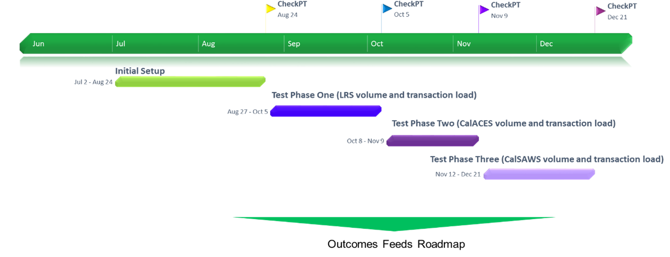
LRS Cloud POC - Timeline

Slide 20
Policy Implementation
September 27, 2018

Slide 21
Policy Implementation
Item | Policy Effective Date | C-IV Status | LRS Status | Description – CalACES Implementation Effort
Funding for Emergency Caregivers with Placement of Children and Non-Minor Dependents prior to Resource Family Approval ACL 18-75 | 7/1/2018 | SCR 101497 Design Release 19.01 | SCR 203634 Design Release 19.01 | Per ACL 18-33, all counties were required to provide the Short-Term, Interim payment (AB 110) to caregivers who had taken placement of a child prior to completing the Resource Family Approval (RFA) process between 3/30/18 and 06/30/2018. Effective July 1, 2018, all counties must provide a payment equivalent to the basic level rate for a resource family to the Emergency Caregiver (EC) of a child. However, unlike the Short-Term, Interim funding, the EC funding will be exclusively funded through the Emergency Assistance (EA) Program, aid code 5K. CalACES Update: Phase III - Long Term Funding for Emergency Caregivers with Placements of Children Prior to RFA Approval will include: Updating the eligibility rules to determine eligibility for the different types of EA funding Automating the pay code determination Automating the NOAs

Slide 22
Policy Implementation
CalFresh SSI Cash Out Reversal and Impact on ABAWD Phase II
CalFresh SSI Cash Out Reversal - Policy effective date will be between June 1, 2019 - August 1, 2019
ABAWD – CalACES Counties currently ‘waived’ through August 31, 2019. Unknown if waivers will be extended.
Impact to ABAWD Phase II, in order for CalACES to implement SSI Cash Out Reversal: Move ABAWD Phase II from 19.01 to 19.03 Reduce scope of automation for ABAWD Phase II for 19.03 to “must have’s” Create subsequent SCRs to further enhance ABAWD automation, after SSI Cash Out Reversal is implemented
Included in ABAWD Phase II (19.03): Eligibility determination of ABAWD, including mid-month Proration Updates to Data Collection to track common ABAWD Exemption reasons, and ABAWD Time Limit information Multiple updates to MEDS Batch jobs (Prorated months, ABAWD Calendar and Effective Dates) Updates to Batch Time Limit jobs Notices of Action (NOAs) to be placed in the Template Repository Assumes final and complete ABAWD policy received and Committee Design Approval by end of October 2018
ABAWD (To be implemented post-SSI Cash Out Reversal implementation): System determination if ABAWD Hours are ‘Met’ (includes Employment, Workfare, etc.). Impact – Workers will manually track hours met for non-exempt ABAWDs and update ABAWD Time Limit pages directly Automation of certain NOAs Impact – Workers will generate NOAs through the Template Repository for ABAWD countable/consecutive months Additional Data Collection updates to track Work Registration Exemptions Impact – Workers will manually update Time Limit exemption or select other existing exemption reason

Slide 23
Policy Implementation
Item | Policy Effective Date | C-IV Status | LRS Status | Description – CalACES Implementation Effort
CalFresh Ending Cash Out for SSI/SSP Recipients Policy ACL 18-90 ACL 18-91 ACL 18-92 | TBD | SCR 101471 Analysis Release 19.07 | SCR 203103 Analysis Release 19.07 | The Legislative budget bills include agreement to fund the SSI (Supplemental Security Income) Cash Out initiative which would reverse California’s current law that prohibits SSI and/or SSP (State Supplementary Payment) recipients from receiving CalFresh benefits. This policy contains several components which will be implemented no later than August 1, 2019. Ending Cash Out applies to three groups of individuals and/or households: Group 1 – SSI/SSP beneficiaries who are new CalFresh applicants who will no longer be precluded from CalFresh eligibility, as well as current CalFresh households who have an SSI/SSP member(s) who will be added to the case. Group 2 – Supplemental Nutrition Benefit (SNB) program: CalFresh households who have an excluded SSI/SSP member and as a result of this policy will experience a reduction in the CalFresh allotment once the SSI/SSP member and their income are added to the CalFresh household budget. Group 3 – Transitional Nutrition Benefit (TNB) program: CalFresh households who have an excluded SSI/SSP member and as a result of this policy will lose their eligibility to CalFresh benefits once the SSI/SSP member and their income are added to the CalFresh household budget. The legislature has agreed to hold these households harmless by supplementing their benefits via a new state-only program. - Continued on next slide -

Slide 24
Policy Implementation
Item | Policy Effective Date | C-IV Status | LRS Status | Description – CalACES Implementation Effort
CalFresh Ending Cash Out for SSI/SSP Recipients Policy ACL 18-90 ACL 18-91 ACL 18-92 | TBD | SCR 101471 Analysis Release 19.07 | SCR 203103 Analysis Release 19.07 | CDSS published ACLs 18-90, 18-91, and 18-92 on July 31, 2018. On August 13, 2018, CDSS kicked off the Reversing SSI Cash-Out Automation meetings. This group includes CDSS, CWDA, SAWS and the counties. The purpose of these meetings are to discuss questions related to the policy, implementation strategy, and automation timeline. These meetings are held bi-weekly through October at the CalACES North location. CalACES Update: The design for this change will be a solution that will work for 58 counties. The CalACES teams are continuing to meet and document system change recommendations. At the October CW/CF committee meeting the team will present the implementation approach and timeline. Over the course of documenting system change requirements the project teams will provide regular updates and request input on the system change recommendations from the CW/CF committee.

Slide 25
Policy Implementation
Item | Policy Effective Date | C-IV Status | LRS Status | Description – CalACES Implementation Effort
CalFresh Able-Bodied Adults without Dependents (ABAWDs) ACIN I-11-16 ACIN I-88-16 ACL 18-08 ABAWD Handbook | 1/1/2017 Fixed Clock 8/31/2019 Waiver Expires | SCR 7215 Phase II Design Release 19.03 | SCR 57971 Phase II Design Release 19.03 | Due to the California’s high unemployment rate, it’s anticipated that in 2018 only three counties (Santa Clara, San Mateo, and San Francisco) will be subjected to the ABAWD policy. Therefore, in September CDSS submitted another ABAWD waiver to exempt the remaining 55 counties through 2018. The ABAWD waiver was approved by FNS and is valid 9/1/2018-8/31/2019. The ABAWD Handbook was published on 1/26/18. The ABAWD handbook is a living document and version 2.0 is in progress. The critical items on which the State needs to provide direction are: NOAs/Forms, Exemptions including geographically waived areas, and the MEDS interface. In February CDSS kicked off the SAWS ABAWD Automation meetings. These meetings will address SAWS questions associated to automating the ABAWD policy. Considering the CalACES counties will continue to be on an ABAWD waiver until 9/1/2019, all the recent policy changes, and those that are in progress, the CalACES Project believes we need to move the ABAWD Phase II implementation to January 21, 2019. CDSS is in agreement with moving CalACES moving the ABAWD implementation to January 21, 2019. CalACES Update: The design team, consortium staff, and QA staff are working on documenting system changes and participating in the SAWS ABAWD Automation meeting with CDSS.

Slide 26
Policy Implementation
Item | Policy Effective Date | C-IV Status | LRS Status | Description – CalACES Implementation Effort
Child Support SB 380 ACL 18-82 | 11/1/2018 | SCR Phase I 101374 Release 18.07 Phase II SCR 100390 Design Release 18.09 priority sometime in October | SCR Phase I 202806 Release 18.07 Phase II SCR 200785 Design Release 18.09 priority sometime in October | Effective November 1, 2018, a CalWORKs (CW) applicant or recipient will have the option to exclude a stepsibling or half-sibling from the AU in order to keep one hundred percent of any child support payments made on behalf of that child, as long as the following apply: The amount of child support received each month for that child is greater than the cash aid amount for the child; and Child support received for the child has been consistent. Any child support payments received pursuant to SB 380 would not be treated as income when determining CalWORKs eligibility or grant amounts. The final ACL was published on August 1, 2018, which included the final CW 52. CalACES Update: Phase I – Mass Mailer was mailed on 9/14/18. For cases that become active after 9/14/18, Counties are responsible for manually mailing the CW 52. Phase II – Will implement changes to support excluding a stepsibling or half-sibling from the assistance unit in order to keep all child support payments The design team, consortium staff, and QA staff are working on documenting the requirements and the design. At the September CW/CF committee meeting the project presented the implementation approach and timeline. After the SCR is approved the project will check in with the committee at each meeting thereafter for progress updates as the SCR moves through build and test.

Slide 27
2018 CalACES Conference Update
(October 31, 2018 – November 2, 2018

Slide 28
Public Comment

Slide 29
Adjourn Meeting

