Slide 1
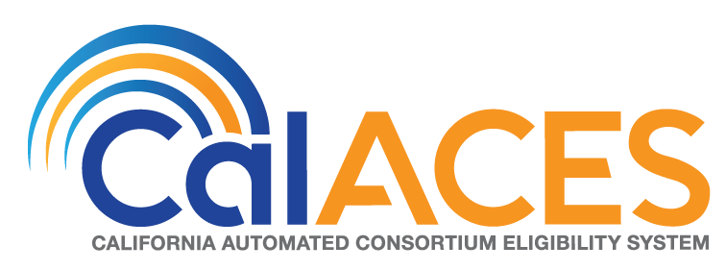
JPA Board of Directors Meeting
December 13, 2018

Slide 2
Agenda
Call Meeting to Order
Public opportunity to speak on items not on the Agenda
Approve the Minutes of the November 1-2, 2018 CalACES 2018 Annual Conference and JPA Board of Directors Meetings and update of Action Items

Slide 3
Action Items
4) (a) Approve Accenture C-IV Change Order CO-108 – Electronic Signature – Ongoing Operations
(b) Approve Accenture C-IV County Purchases and authorize the addition of funding to the FY 18/19 CalACES Project Budget
(c) Approve Accenture C-IV Contract Amendment No. 100 (references Change Order CO-108 – Electronic Signature – Ongoing Operations and updates to Exhibit A)
Approve RGS Amendment 23

Slide 4
Action Items
Approve contract with the Sacramento Public Library Authority to rent the Library Galleria in the amount of $2,580 for the joint meeting of the CalACES JPA Member Representatives and Board of Directors on June 28, 2019.
Approve delegation of authority to the CalACES Executive Director, with Legal Counsel review, to release the CalSAWS Quality Assurance (QA) Request for Proposals.
Approve delegation of authority to the CalACES Executive Director, with Legal Counsel review, to release the CalSAWS Online CalWORKs Appraisal Tool (OCAT) Request for Proposals.

Slide 5
Informational Items
5

Slide 6
CalSAWS Project Approval/Planning Status
IAPD Status
Project Staffing Discussions
6

Slide 7
CalSAWS Leadership Team Update
7

Slide 8
CalSAWS JPA Governance Update
Educational Webinars
8

Slide 9
Governance Education Webinars
Webinar Informational Sessions:
The goal of these sessions is to provide an overview of the JPA structure and to review changes to the existing JPA Agreement, Bylaws and MOU.
There are three sessions scheduled. Counties may attend any session as the information shared will be identical. However, counties are encouraged to attend with their current consortium affiliations as noted below:
November 29, 2018 from 10:00 a.m. to 11:30 a.m. – CalACES Consortium
December 13, 2018 from 10:00 a.m. to 11:30 a.m. – WCDS Counties
December 20, 2018 from 10:00 a.m. to 11:30 a.m. – Make up Session for all Counties
Who should attend:
It is strongly encouraged that all counties participate including the Director and County Counsel.
Reference:
CRFI 18-011 – Draft version of updated Joint Powers Authority (JPA) Agreement, Memorandum of Understand (MOU), and Bylaws were distributed for review.
CIT 063-18 – Webinar Sessions Announced

Slide 10
Governance Education Webinars
Next Steps
Begin as-needed conference calls of Attorney Working Group
Presentation of revised governance documents at California Health and Welfare Attorney Committee meeting (November 15)
Webinars/teleconferences for Directors, Staff and County Counsels (November-December 2018)
Comments from Counties no later than December 21 to allow for final review by Attorney Working Group
Final revisions to governance documents, in consultation with the Leadership Team (December 2018)
Revised governance documents go to CalACES Member Representatives and Board for approval (January 25, 2019)
Final JPA and MOU distributed to Counties for action by Boards of Supervisors (by January 31, 2019)
County approval process completed, executed JPA and MOU documents received by Consortium (May 15, 2019)
Joint Board and Member Representative meeting (WCDS Counties included at meetings)
  Current Member Representatives “concur” in new JPA and Bylaws
  Current Board approves new JPA, Bylaws, MOU
  Board elections by newly constituted Regions, to take effect July 1, 2019 (June 28, 2019)
Effective Date for revised JPA, Bylaws, MOU (July 1, 2019)

Slide 11
Contact Center Requirements Gathering
Contact Center Requirements Gathering Update
The goal of these sessions is for attendees to participate in a walkthrough of the C-IV centralized system functionality and review associated requirements and/or identified functionality gaps.
The CalSAWS Contact Center Requirements Gathering session will consist of a one-day session, beginning at 9:30 a.m. and ending at 4:30 p.m. on December 12, 2018. Lunch will not be provided; however, there is a cafeteria onsite. The session will take place in Roseville at the CalWIN/Hewlett Packard site in the Garden Suites. There is no registration fee for the session.
Reference - CRFI 18-014

Slide 12

Proposed Migration of 39 Counties Contact Center to Amazon Connect
The project is proposing Amazon Connect as the next generation for the 39 counties contact center solution.
KEY DRIVERS
The contact center solution for 39 counties is currently due for a hardware/software refresh.
By reallocating resources currently earmarked for upcoming SCR’s related to the Cisco refresh; this can result in reducing the level of effort required for migrating to an Amazon connect solution.
This solution would result in future cost savings for the 39 counties contact center solution as well as provide a platform for future innovation & enhancements.
KEY ADVANTAGES
100% cloud Based
Contact center As a Service
Modular & scalable
Secure & reliable
Pay as you go
Cisco
Amazon Connect
Next Steps
Task / Milestone | Tentative Timeframe
Schedule time with 14 Contact Center Counties | December 2018
Visit all 14 Contact Center Counties | December 2018
Present solution to PSC | February 2019
Project Kick off | March 2019

Slide 13
Cloud Proof of Concept Current Status
13

Slide 14
Status of Cloud Proof of Concept
What are the Objectives of the Cloud Proof of Concept (PoC)?
Determine viability of CalSAWS in the cloud from a cost, performance, and availability standpoint
Document blueprints of as-built infrastructure
Develop a roadmap for changes to enable CalSAWS in the cloud
The PoC does not end with a cutover to the cloud—it ends with a plan for a process to safely and securely transition to the cloud.

Slide 15
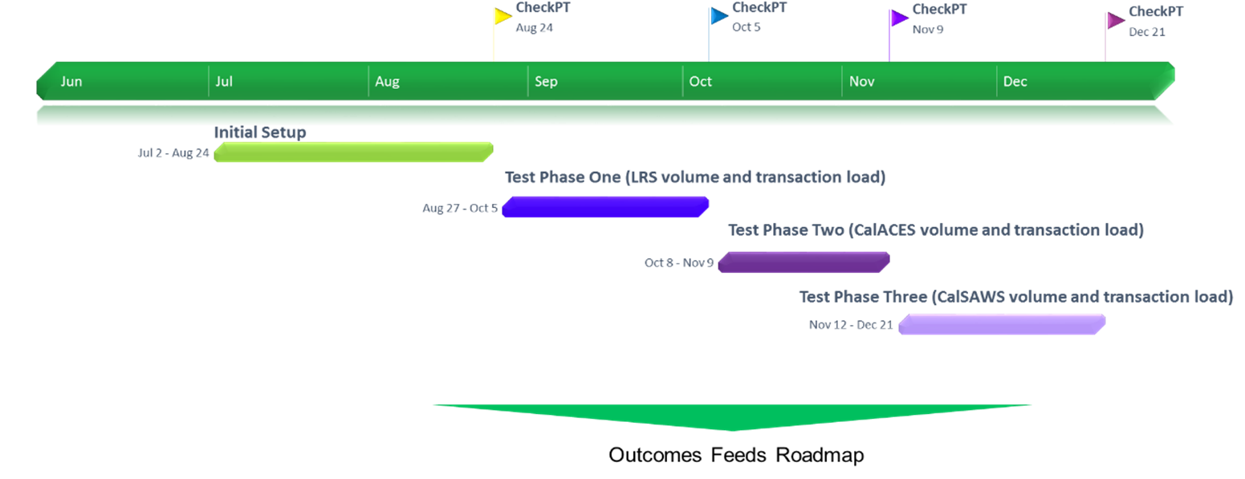
Status of Cloud Proof of Concept
How are we proving the concept of CalSAWS in the AWS Cloud?

Slide 16
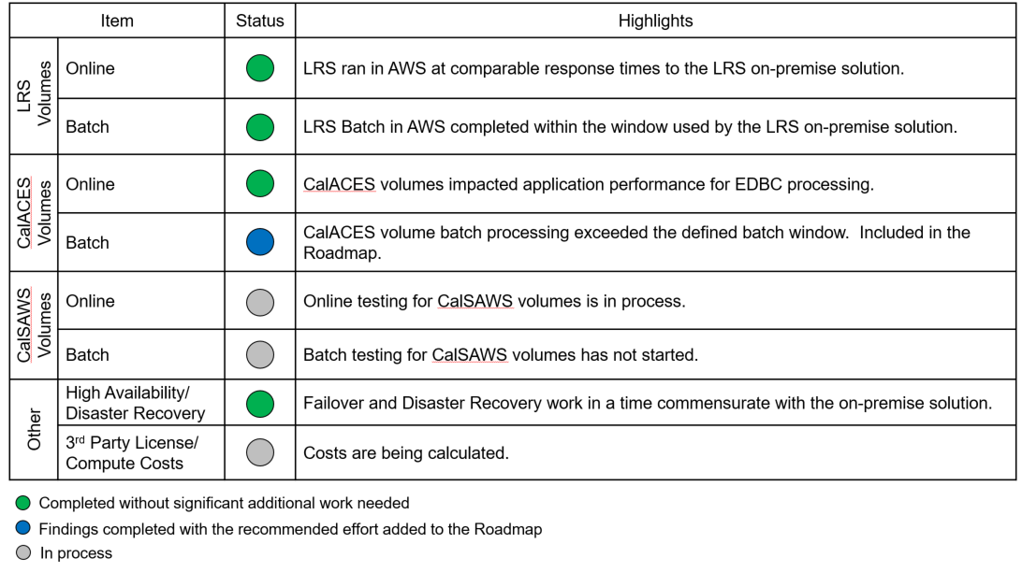
Status of Cloud Proof of Concept
What have we learned from the PoC so far?

Slide 17
Status of Cloud Proof of Concept
How is the Cloud Roadmap structured?
CalSAWS LRS Development
C-IV
Cutover
CalWIN Cutovers
Phase 1: Changes Required for LRS and move LRS to the Cloud
Phase 2: Changes Required for 40/58 County Scaling
Phase 3: Take Advantage of Advanced Cloud Features

Slide 18
Status of Cloud Proof of Concept
What are the next steps for cloud/PoC?
Continue testing performance at greater scale
Create the roadmap based on findings found during the PoC
Develop a change order for the Migration project based on the roadmap
  Consortium will contract with 3rd parties for required infrastructure
  Consortium will agree on scope of work with Accenture for changes required to enable LRS/CalSAWS in to the cloud
Execute a methodical process to safely move LRS/CalSAWS to the cloud

Slide 19
SFY 17/18 CalHEERS Interface Cost Claiming Issue Update
19

Slide 20
M&O Application & Policy Update
SSI Cash Out (Funding)
20

Slide 21
Policy Implementation
Item | Policy Effective Date | C-IV Status | LRS Status | Description – CalACES Implementation Effort
Funding for Emergency Caregivers with Placement of Children and Non-Minor Dependents prior to Resource Family Approval ACL 18-75 | 7/1/2018 | SCR 102237 Implemented Release 18.11 SCR 101497 System Test Release 19.01 | SCR 204665 Implemented Release 18.11 SCR 203634 System Test Release 19.01 | Per ACL 18-33, all counties were required to provide the Short-Term, Interim payment (AB 110) to caregivers who had taken placement of a child prior to completing the Resource Family Approval (RFA) process between 3/30/18 and 06/30/2018. Effective July 1, 2018, all counties must provide a payment equivalent to the basic level rate for a resource family to the Emergency Caregiver (EC) of a child. However, unlike the Short-Term, Interim funding, the EC funding will be exclusively funded through the Emergency Assistance (EA) Program, aid code 5K. CalACES Update: A Good Cause section is being added to the Foster Care License/Home Approval page New automated tasks to track Good Cause are being added Emergency Assistance (EA) fields are being added to the Foster Care Placement Authority Probation Court Order Two Pay Codes added in the Phase II SCR are being automated A new approval and discontinuance notice is being added to the template repository.

Slide 22
Policy Implementation
Item | Policy Effective Date | C-IV Status | LRS Status | Description – CalACES Implementation Effort
CalFresh Ending Cash Out for SSI/SSP Recipients Policy ACL 18-90 ACL 18-91 ACL 18-92 | 5/20/2019 | SCR 101471 Design Release 19.05 | SCR 203103 Design Release 19.05 | The Legislative budget bills include agreement to fund the SSI (Supplemental Security Income) Cash Out initiative which would reverse California’s current law that prohibits SSI and/or SSP (State Supplementary Payment) recipients from receiving CalFresh benefits. This policy contains several components which will be implemented no later than August 1, 2019. Ending Cash Out applies to three groups of individuals and/or households: Group 1 – SSI/SSP beneficiaries who are new CalFresh applicants who will no longer be precluded from CalFresh eligibility, as well as current CalFresh households who have an SSI/SSP member(s) who will be added to the case. Group 2 – Supplemental Nutrition Benefit (SNB) program: CalFresh households who have an excluded SSI/SSP member and as a result of this policy will experience a reduction in the CalFresh allotment once the SSI/SSP member and their income are added to the CalFresh household budget. Group 3 – Transitional Nutrition Benefit (TNB) program: CalFresh households who have an excluded SSI/SSP member and as a result of this policy will lose their eligibility to CalFresh benefits once the SSI/SSP member and their income are added to the CalFresh household budget. The legislature has agreed to hold these households harmless by supplementing their benefits via a new state-only program. - Continued on next slide -

Slide 23
Policy Implementation
Item | Policy Effective Date | C-IV Status | LRS Status | Description – CalACES Implementation Effort
CalFresh Ending Cash Out for SSI/SSP Recipients Policy ACL 18-90 ACL 18-91 ACL 18-92 | 5/20/2019 | SCR 101471 Design Release 19.05 | SCR 203103 Design Release 19.05 | CDSS published ACLs 18-90, 18-91, and 18-92 on July 31, 2018. On August 13, 2018, CDSS kicked off the Reversing SSI Cash-Out Automation meetings. This group includes CDSS, CWDA, SAWS and the counties. The purpose of these meetings are to discuss questions related to the policy, implementation strategy, and automation timeline. These meetings are held bi-weekly through October at the CalACES North location. CalACES Update: System changes for this effort will include: Update eligibility rules to determine SSI individuals eligible to CalFresh if they meet CalFresh eligibility requirements Add eligibility rules to determine the Supplemental Nutrition Benefit and the Transitional Nutrition Benefit Add the appropriate Notices of Action The SSI Cash Out SCR and design document was sent to the CW/CF Committee on 11/9/18. The Project met with the CW/CF Committee several times to review and discuss the SCR design before giving final SCR approval on 11/30/18.

Slide 24
Policy Implementation
Item | Policy Effective Date | C-IV Status | LRS Status | Description – CalACES Implementation Effort
CalFresh Ending Cash Out for SSI/SSP Recipients Policy ACL 18-90 ACL 18-91 ACL 18-92 | 5/20/2019 | SCR 101471 Design Release 19.05 | SCR 203103 Design Release 19.05 | Funding for CalACES Implementation: Background At the time of this update, additional funding for implementing Reversing SSI Cash Out system changes in C-IV and LRS is not available. CalACES decided to begin design and build prior to receiving confirmation of premise funds to meet the State’s directive to deploy SAWS automation by June 1, 2019. Design is targeted for approval by end of November 2018; Build is targeted to begin in December 2018. Funding Request and Next Steps In September 2018, CalACES submitted a premise funding request to CWDA for the Reversing SSI Cash Out system changes. CalACES expects to receive confirmation of additional premise funds by January 2019 at the latest, either via County allocation letters or the January Governor’s Budget. Contract amendments for the C-IV and LRS agreements to add Reversing SSI Cash Out are planned for the January 2019 JPA Board of Directors meeting following confirmation of premise funds. If premise funding is not available, the monthly 8,000 hours for M&E/Application Maintenance will be used for the Reversing SSI Cash Out system changes. Also, CalACES will work with the appropriate committees to re-assess release dates for other SCRs targeted through the 19.05 release to fit in the Reversing SSI Cash Out system changes.

Slide 25
Policy Implementation
Item | Policy Effective Date | C-IV Status | LRS Status | Description – CalACES Implementation Effort
CalFresh Able-Bodied Adults without Dependents (ABAWDs) ACIN I-11-16 ACIN I-88-16 ACL 18-08 ABAWD Handbook | 1/1/2017 Fixed Clock 8/31/2019 Waiver Expires | SCR 7215 Phase II Design Release 19.09 | SCR 57971 Phase II Design Release 19.09 | ABAWD implementation began in September 2018 for San Francisco, San Mateo, and Santa Clara. The remaining counties are on waiver until 8/31/19. In September, CDSS submitted another ABAWD waiver request to FNS for the time period 9/1/19-8/31/20. If the waiver is approved, three additional counties (Alameda, Contra Costa, and Marin) will be required to implement the ABAWD policy effective September 2019. The ABAWD Handbook was published on 1/26/18. The ABAWD handbook is a living document and version 2.0 is in progress. The critical items on which the State needs to provide direction are: Exemptions including geographically waived areas, and the MEDS interface changes. CalACES Update: The design team, consortium staff, and QA staff are working on documenting system changes and participating in the SAWS ABAWD Automation meeting with CDSS.

Slide 26
Policy Implementation
Item | Policy Effective Date | C-IV Status | LRS Status | Description – CalACES Implementation Effort
Child Support SB 380 ACL 18-82 | 11/1/2018 | SCR Phase I 101374 Release 18.07 Phase II SCR 100390 Implemented Release 18.11 priority on 11/29/18 | SCR Phase I 202806 Release 18.07 Phase II SCR 200785 Implemented Release 18.11 priority on 11/29/18 | Effective November 1, 2018, a CalWORKs (CW) applicant or recipient will have the option to exclude a stepsibling or half-sibling from the AU in order to keep one hundred percent of any child support payments made on behalf of that child, as long as the following apply: The amount of child support received each month for that child is greater than the cash aid amount for the child; and Child support received for the child has been consistent. The final ACL was published on August 1, 2018, which included the final CW 52. Recently, CDSS provided policy clarification that simplifies the process for calculating the amount of child support that would allow the child to be excluded from the assistance unit. This clarification has been shared with the committee. CalACES Update: Phase I – Mass Mailer was mailed on 9/14/18. For cases that become active after 9/14/18, Counties are responsible for manually mailing the CW 52. Phase II Changes: Update the Customer Options page to identify what child(ren) will be excluded from the Maximum Aid Payment (MAP) due to a full child support payment Update the CW EDBC to exclude the child(ren) who opted to receive the full child support payment Add the Approval, No Change, and Benefit Change Notices of Actions Update the Child Support interface to track children who opted to receive the full child support payment.

Slide 27
Policy Implementation
Item | Policy Effective Date | C-IV Status | LRS Status | Description – CalACES Implementation Effort
CalWORKs Outcomes and Accountability Review Cal-OAR | 7/1/2019 | SCR 102191 TBD | SCR 204569 TBD | The CalWORKs Outcomes and Accountability Review (Cal-OAR) is a process for reviewing the CalWORKS program statewide while taking into account county diversity. Its goal is to promote program accountability, continual quality improvement, and meaningful tracking of program participation and outcomes. Development of the review process is led by a statewide legislatively-mandated work group of stakeholders from state agencies, counties, advocacy groups, research teams, the legislature, and CalWORKs recipient populations. Cal-OAR workgroup is to establish a local accountability system that facilitates continuous improvement of county CalWORKs programs by collecting and disseminating data and best practices. Cal-OAR three main components to be developed by July 2019: Process and Outcome Performance indicators CalWORKs county self-assessment process CalWORKs county system improvement plan, including a peer review component. The three elements produced by the Cal-OAR work group will improve county access to meaningful, real-time data and will encourage cross-county examination. This will help counties improve their program management decisions and provide a mechanism for elevating county best practices. -Continued on next slide-

Slide 28
Policy Implementation
Item | Policy Effective Date | C-IV Status | LRS Status | Description – CalACES Implementation Effort
CalWORKs Outcomes and Accountability Review Cal-OAR | 7/1/2019 | SCR 102191 TBD | SCR 204569 TBD | CalACES Update: CalACES is participating in the Cal-OAR Data Collection & Automation subcommittee. This workgroup is charged with developing the set of measures to evaluate program performance. These measures will be reported to CDSS on a monthly basis, which will result in a new state report. This effort will also include revision to the WTW 25 report. The project is working on re-estimating this effort based updates to the CalOAR indicators. The estimate is due on 12/4/18.

Slide 29
Policy Implementation
Item | Policy Effective Date | C-IV Status | LRS Status | Description – CalACES Implementation Effort
CalHEERS - Verify Lawful Presence CH CR 92295 February 2019 |  | 100608 Build 19.02 | 201310 Build 19.02 | No Change since the last meeting The Department of Homeland Security (DHS) is upgrading the DHS Verify Lawful Presence (VLP) interface. Centers for Medicare and Medicaid Services (CMS), CalHEERS (CH) and CalACES must also be updated to continue to communicate to DHS for VLP. CH Change Request (CR) will update CH to use the updated CMS VLP interface. CalACES Update: System changes for this effort will include: Updates to CH eHit interface for VLP Creates a new CH VLP interface between CH and CalACES for VLP Provides a way to communicate when CH receives a VLP interface error code or when CH does not make a VLP call. When a case is pure MAGI, the VLP interface will reduce worker double data entry and the system will notify the workers from within CIV/LRS by auto-creating tasks when CH receives citizenship information from DHS. The CH JADs for this effort are complete and the MC committee approved the SCR on 10/31/18.

Slide 30
2018 CalACES Conference Debrief
30

Slide 31
Adjourn Meeting

