Slide 1
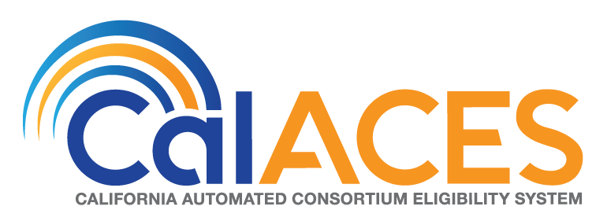
Project Steering Committee Meeting
December 6, 2018

Slide 2
Agenda
Call Meeting to Order
Agenda Review
Public opportunity to speak on items not on the Agenda

Slide 3
Action Items
Approve the Minutes of the October 18, 2018 Project Steering Committee Meeting and review of Action Items

Slide 4
Informational Items

Slide 5
Announce the Appointment of the new Region 7 PSC Representative
Yvonne Hawkes, Lassen County Program Manager

Slide 6
CalSAWS Conversion Approach
Conversion Objectives and Process
Record Retention Policy Discussion

Slide 7
C-IV Conversion to CalSAWS Objectives
Minimize Downtime During Cutover
Minimize Disruptions to County Staff
Convert Previous EDBCs to Continue Benefits
C-IV Conversion (to CalSAWS) Process
C-IV
Legacy
Data
CalSAWS
Record
Retention
Conversion
Open Programs
Programs Closed w/in 4 years of Cutover
All Time Limit Data
Open Recovery Accounts
Stage Legacy Data
Transform Legacy Data
Data Confirmation
Execute Data Discrepancy Reports
Execute Functional Tests

Slide 8
HISTORY: ISAWS Conversion to C-IV
Converted:
  The authorized benefit amount from ISAWS to roll benefits amounts (in C-IV) for converted cases until EDBC is ran
  14 months of Historical Data for all Open Cases
  13 months of Historical Data for all Cases Closed w/in the 4 Months Leading up to the Cutover
  Recovery Accounts with a balance other than 0 into C-IV
Cutover Window:
  Began on Thursday evening with Legacy System running Batch programs and Extracting Data
  Both Legacy (ISAWS) and Source (C-IV) Systems were Down for one business day (on Friday)
  Conversion Processes executed over the Weekend
  C-IV System was Up by Monday morning with the ISAWS data converted and respective Conversion Reports provided to County Staff
Day 1
Friday
Day 2
Saturday
Day 3
Sunday

Slide 9
HISTORY: LEADER Conversion to LRS
Converted:
  The authorized benefit amount from LEADER to roll benefits amounts (in LRS) for converted cases until EDBC is ran
  3 years of Historical EDBC Data for all Open Cases and Cases Closed w/in the 3 years Leading up to the Cutover
  All Closed Cases with Active Recovery Accounts or Investigations
  Closed Cases greater than 3 years converted as Shell Cases with Time Limit data
Cutover Window:
  Began on Friday evening with Legacy System running Batch programs and Extracting Data.
  Conversion Processes executed over the Weekend and into Monday (both LEADER and LRS Down for one business day).
  LRS System was Up by Tuesday morning with the LEADER data converted and respective Conversion Reports provided to County Staff.
Day 1
Saturday
Day 2
Sunday
Day 3
Monday

Slide 10
CalWIN Conversion to CalSAWS
Record Retention and Converted Data:
  Work with the CalWIN to confirm Data Mappings to CalSAWS Targeted Fields (in an effort) to meet agreed upon Conversion Objectives. For example:
    Develop Strategies to Minimize Downtime During Cutover Window
    Minimize Business Disruptions to County Staff
    Convert Previous EDBCs to Continue Benefits
Cutover Window:
Day 1
Day 2
Day 3

Slide 11
Data Retention Policy
General Policy
  In general, with some exceptions, policy states data can be retained until three years (36 months) after case closure.
  Federal law requires records used as the basis for fiscal claims must be retained for three years (36 months) from the date when the state submits its final expenditure report to the Dept of Health and Human Services (DHHS).
  MPP Section 23-353.6 further clarifies that, for the general case, a retention period of three and one-half years (42 months) is considered to meet the federal reporting requirement.
Manual of Policies and Procedures (MPP), Section 23-353, Introduction:
“Federal law (45 CFR 74.20) requires that case records which provide the basis for fiscal claims are to be retained for three years, starting on the day the state submits the last expenditure report to HHS for the period. In the case of supplemental expenditure reports this might require retention for a much longer period than three years.”
Manual of Policies and Procedures (MPP), Section 23-353.6:
“Unless a county has made or intends to make a supplemental expenditure report concerning specific cases which it wishes to purge or destroy, it may consider the retention period to be 3-1/2 years from the date a document was last needed to document eligibility or 3-1/2 years from the date the case was closed.”

Slide 12
Exceptions
Time Limit Data
  This data must be retained for the lifetime of the individual.
  Not safe to assume WDTIP is permanent system of record for time limit data
  Conclusion: Retain all Time Limit data.
Recovery Accounts still subject to collections
  Data must be retained until County no longer wishes to pursue collection activity on the account.
  Conclusion: Retain all cases associated with an open recovery account.

Slide 13
Exceptions
Warrant Registers
  Retain for 5-15 years
  Not associated to specific cases
  Conclusion: Retain all Warrant Registers.
Criminal and Litigation-Related Records –
  Retain indefinitely, until all legal actions are concluded
  Conclusion: As a starting point, look at retaining all cases associated with a special investigation record.
Foster Care, Kin-Gap, and Adoptions Assistance cases
  Various policies (e.g., ACL 11-15 for KG) point to indefinite retention for cases associated to these programs
  Conclusion: Retain all of these cases, regardless of status

Slide 14
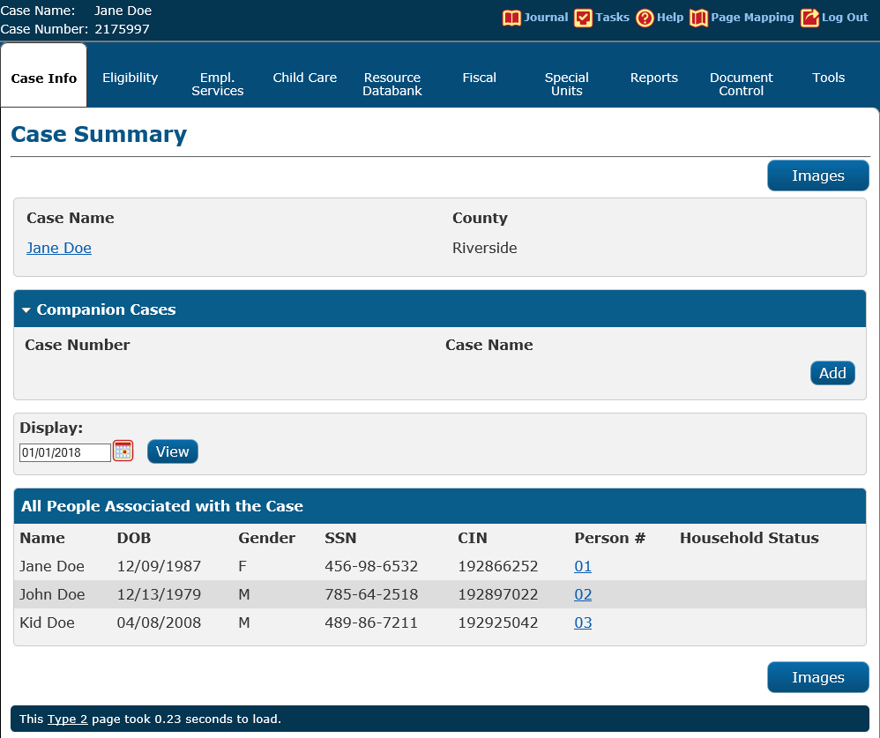
What to Retain
Retain shell of all cases. This would contain the following:
  High-level information about persons associated to the case, including Name, DOB, SSN, CIN.
  Case Name
  Serial Number
  Time Limit Data

Slide 15
What to Not Retain
A non-exhaustive list:
  Case data
  Program data
  EDBC data
  Journal
  Benefit History
  Financial/Non-Financial data for people (assuming they are only associated to cases not being retainined)
  Tasks
  Recovery Accounts
  Correspondence
  Verifications

Slide 16
Number of cases affected (in C-IV, as of 11/5)
For C-IV data, if we use the rules mentioned (extending the 42 months to 48 months), approximately 2/3 of cases would be retained.

Slide 17
Cloud Proof of Concept Current Status

Slide 18
Status of Cloud Proof of Concept
What are the Objectives of the Cloud Proof of Concept (PoC)?
Determine viability of CalSAWS in the cloud from a cost, performance, and availability standpoint
Document blueprints of as-built infrastructure
Develop a roadmap for changes to enable CalSAWS in the cloud
The PoC does not end with a cutover to the cloud—it ends with a plan for a process to safely and securely transition to the cloud.

Slide 19
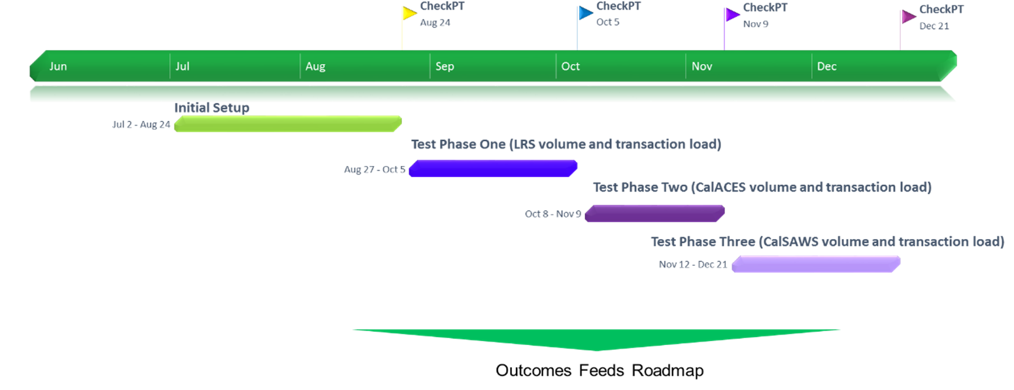
Status of Cloud Proof of Concept
How are we proving the concept of CalSAWS in the AWS Cloud?

Slide 20
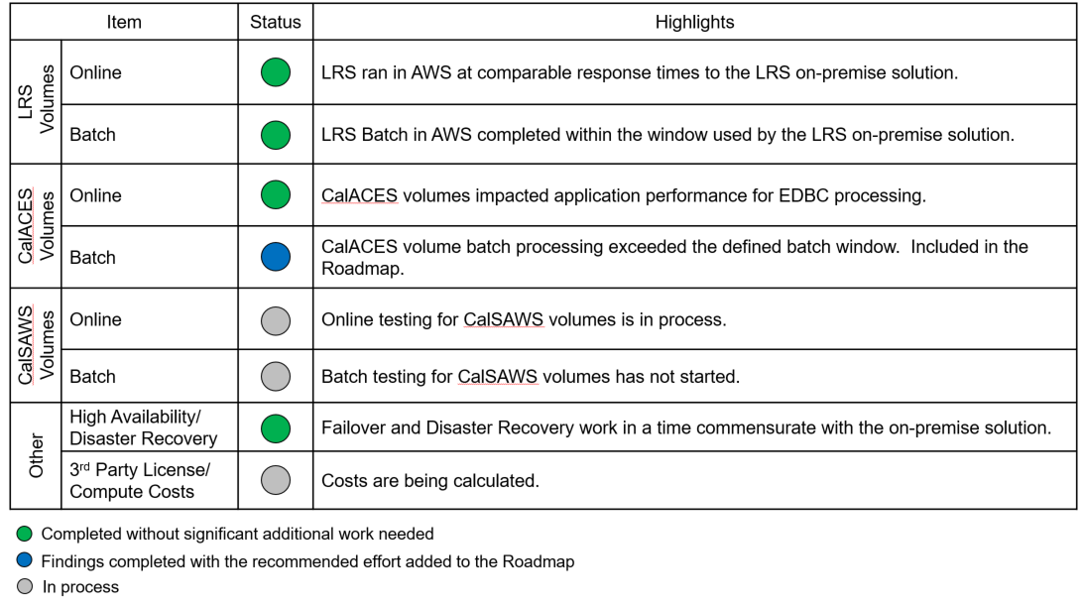
Status of Cloud Proof of Concept
What have we learned from the PoC so far?

Slide 21
Status of Cloud Proof of Concept
How is the Cloud Roadmap structured?
CalSAWS LRS Development
C-IV
Cutover
CalWIN Cutovers
Phase 1: Changes Required for LRS and move LRS to the Cloud
Phase 2: Changes Required for 40/58 County Scaling
Phase 3: Take Advantage of Advanced Cloud Features

Slide 22
Status of Cloud Proof of Concept
What are the next steps for cloud/PoC?
Continue testing performance at greater scale
Create the roadmap based on findings found during the PoC
Develop a change order for the Migration project based on the roadmap
  Consortium will contract with 3rd parties for required infrastructure
  Consortium will agree on scope of work with Accenture for changes required to enable LRS/CalSAWS in to the cloud
Execute a methodical process to safely move LRS/CalSAWS to the cloud

Slide 23
CalSAWS Governance Education Webinars

Slide 24
Governance Education Webinars
Webinar Informational Sessions:
The goal of these sessions is to provide an overview of the JPA structure and to review changes to the existing JPA Agreement, Bylaws and MOU.
There are three sessions scheduled. Counties may attend any session as the information shared will be identical. However, counties are encouraged to attend with their current consortium affiliations as noted below:
November 29, 2018 from 10:00 a.m. to 11:30 a.m. – CalACES Consortium
December 13, 2018 from 10:00 a.m. to 11:30 a.m. – WCDS Counties
December 20, 2018 from 10:00 a.m. to 11:30 a.m. – Make up Session for all Counties
Who should attend:
It is strongly encouraged that all counties participate including the Director and County Counsel.
Reference:
CRFI 18-011 – Draft version of updated Joint Powers Authority (JPA) Agreement, Memorandum of Understand (MOU), and Bylaws were distributed for review.
CIT 063-18 – Webinar Sessions Announced

Slide 25
Governance Education Webinars
Next Steps
Begin as-needed conference calls of Attorney Working Group
Presentation of revised governance documents at California Health and Welfare Attorney Committee meeting (November 15)
Webinars/teleconferences for Directors, Staff and County Counsels (November-December 2018)
Comments from Counties no later than December 21 to allow for final review by Attorney Working Group
Final revisions to governance documents, in consultation with the Leadership Team (December 2018)
Revised governance documents go to CalACES Member Representatives and Board for approval (January 25, 2019)
Final JPA and MOU distributed to Counties for action by Boards of Supervisors (by January 31, 2019)
County approval process completed, executed JPA and MOU documents received by Consortium (May 15, 2019)
Joint Board and Member Representative meeting (WCDS Counties included at meetings)
  Current Member Representatives “concur” in new JPA and Bylaws
  Current Board approves new JPA, Bylaws, MOU
  Board elections by newly constituted Regions, to take effect July 1, 2019 (June 28, 2019)
Effective Date for revised JPA, Bylaws, MOU (July 1, 2019)

Slide 26
Contact Center Requirements Gathering
Contact Center Requirements Gathering Update
The goal of these sessions is for attendees to participate in a walkthrough of the C-IV centralized system functionality and review associated requirements and/or identified functionality gaps.
The CalSAWS Contact Center Requirements Gathering session will consist of a one-day session, beginning at 9:30 a.m. and ending at 4:30 p.m. on December 12, 2018. Lunch will not be provided; however, there is a cafeteria onsite. The session will take place in Roseville at the CalWIN/Hewlett Packard site in the Garden Suites. There is no registration fee for the session.
Reference - CRFI 18-014

Slide 27
C-IV Contact Center Technical Update

Slide 28

Proposed Migration of 39 Counties Contact Center to Amazon Connect
The project is proposing Amazon Connect as the next generation for the 39 counties contact center solution.
KEY DRIVERS
The contact center solution for 39 counties is currently due for a hardware/software refresh.
By reallocating resources currently earmarked for upcoming SCR’s related to the Cisco refresh; this can result in reducing the level of effort required for migrating to an Amazon connect solution.
This solution would result in future cost savings for the 39 counties contact center solution as well as provide a platform for future innovation & enhancements.
KEY ADVANTAGES
100% cloud Based
Contact center As a Service
Modular & scalable
Secure & reliable
Pay as you go
Cisco
Amazon Connect
Next Steps
Task / Milestone | Tentative Timeframe
Schedule time with 14 Contact Center Counties | December 2018
Visit all 14 Contact Center Counties | December 2018
Present solution to PSC | February 2019
Project Kick off | March 2019

Slide 29
Review Procurements
OCAT
QA
Other Upcoming

Slide 30
OCAT Procurement Overview
Goal is to re-platform the existing OCAT functionality
Integrate the re-platformed OCAT with the SAWS
Eliminate duplicate data entry and data redundancy
Currently OCAT workgroup is reviewing and finalizing the RFP package
All comments formally responded to with disposition noted
Procurement assistance from Los Angeles County DPSS, Betty, and Dave
Procurement will be run through the San Bernardino ePro system and Purchasing Department

Slide 31
OCAT Procurement Update
Key Milestones
  OCAT RFP Release Date – Friday, Dec 14
  Vendors Conference – Monday, Jan 7
  Proposal Due Date – Friday, Feb 8
  Proposal Evaluation – Monday, Feb 11 – Thursday, Mar 28
  Orals/Key Staff Interviews – Tuesday, Feb 19 – Friday, Feb 22
  Prepare Vendor Selection Report – Friday, Mar 29 – Monday, Apr 8
  Vendor Selection Report Review & Approval – Tuesday, Apr 9 – Thursday, Apr 18
  Release Notice of Intent – Friday, Apr 19
  Negotiations & Approvals – Monday, Apr 22 – Tuesday, Jun 4
  OCAT Vendor Start Date – Monday, Jun 10

Slide 32
CalSAWS QA Procurement
QA vendor for CalSAWS DD&I and M&O
Completed review by State partners
Currently in review with Federal partners
  Submitted November 2, 2018
Planning on in-person and webinar bidders conference
Not using ePro for submission
Using OSI facilities and SharePoint

Slide 33
CalSAWS QA Procurement
Key Milestones
  QA RFP Release Date – Friday, Dec 14
  Vendors Conference – Monday, Jan 7
  Proposal Due Date – Friday, Jan 25
  Proposal Evaluation – Monday, Jan 28 – Wednesday, Mar 6
  Orals/Key Staff Interviews – Wednesday, Feb 27 – Friday, Mar 1
  Prepare Vendor Selection Report – Thursday, Mar 7 – Tuesday, Mar 19
  Vendor Selection Report Review & Approval – Tuesday, Mar 19 – Friday, Mar 22
  Release Notice of Intent – Monday, Mar 25
  Negotiations & Approvals – Tuesday, Mar 26 – Thursday, May 30
  QA Vendor Start Date – Monday, Jun 3

Slide 34
Upcoming Potential Procurements
CalWIN OCM, Training and Implementation Support
CalSAWS Contact Center
Consolidated Portal/Mobile App
FCED
Procurement Vendor for CalSAWS 58-County M&O Procurement
CalSAWS 58-County M&O Procurement

Slide 35
2018 CalACES Conference Debrief
HMIS – Can we add statewide tracking for homeless services/needs?
Request for Foster Care Summit
Suggestion – CalFresh should be its own committee

Slide 36
County Design Input
Refer to handouts:
Draft CalACES CDI Project Process.docx
Draft CalACES County Design Input Process.docx

Slide 37
SCR Prioritization Process Update

Slide 38
CalACES SCR Approach
Status and Next Steps
  Status
    Completed the roll out of the updated SCR approach to the Project Staff by October 17, 2018
    Conducted two SCR Overview webcasts for PPOCs, all committees, Workgroups and RPMS on November 13, 2018. Approximately 400 participants called into the webcast.
    The updated SCR approach was effective November 1, 2019. The remaining process to be rolled out is the formal County Design Input process. Drafted the County Design Input process. Expected rollout in January 2019.
  Upcoming:
    Continue to monitor and review the anomalies to the SCR scorecards
    Add County Request for Policy Clarification (CRPC) tracking in JIRA SCR Tracking Tool
    Update M&O Handbook
    Drafted County Design Input Project Process
    Drafted County Input Process

Slide 39
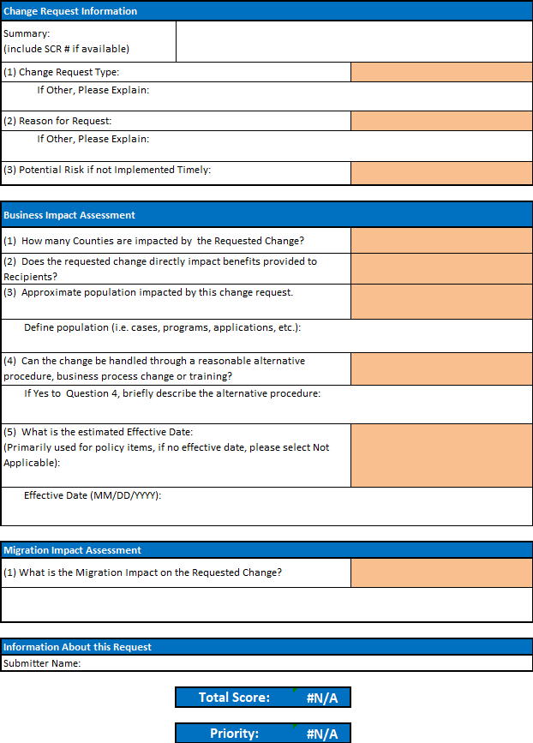
SPG Scorecard Update
  SPG scorecard six month pilot was rolled out in August of 2018.
  Since August, The following SCRs have been approved through SPG with scorecard results in the following priorities:
    CalACES North (82 SCRs):
      22 Critical
      30 High
      25 Medium
      5 Low
    CalACES South (109 SCRs):
      31 Critical
      56 High
      22 Medium
      0 Low
  In Progress - QA process to review the responses to questions and results of the scorecard.

Slide 40
SPG Scorecard Calculation Breakdown
3 Main Sections to the SPG Scorecard:
Change Request Information
    3 questions
    Each question weighted equally at 33% (3 questions x .33 = 1.00)
    Section has a 20% overall weighted score
Business Impact
    5 questions
    Each question weighted equally at 20% (5 questions x .20 = 1.00)
    Section has a 50% overall weighted score
Migration Impact
    1 question
    1 question weighted at 100% (1 question x 1.00 = 1.00)
    Section has a 30% overall weighted score
SPG Scorecard Priorities & Score Ranges:
SPG Scorecard Priorities
Min Range | Max Range | Priority | Definitions
85 | 100 | Critical | Work stoppage will occur and no alternative procedure exists OR Regulatory, Program Directive or Contractual Requirements will not be met.
70 | 84 | High | High impact to Caseload and/or Workers OR Alternative Procedure requires excessive time, cost and/or resources.
45 | 69 | Medium | Moderate impact to Caseload and/or Workers OR Alternative Procedure requires some increase in time, cost and/or resources.
0 | 44 | Low | Minimal impact to Caseload and/or Workers OR Alternative Procedure in place with minimal time, cost and/or resources. Also considered “nice to have” and are useful to pad out a release.

Slide 41
SPG Scorecard Calculation Breakdown
CHANGE REQUEST INFORMATION
1) Change Request Type:
o DSR (County) (0)
o Individual Data Change (15)
o Data Change (30)
o Enhancement (45)
o Operational (60)
o Policy Re-design (75)
o New Policy (100)
(2) Reason for Request:
o Other – Please Specify (0)
o County Specific Policy or Request (20)
o Operational Necessity (40)
o New Policy/Policy Redesign (60)
o Committee Priority (80)
o JPA/PSC Strategic Initiative (100)
(3) Potential Risk if not Implemented Timely:
o None (0)
o Resource Efficiency (15)
o System Performance (30)
o Potential Litigation (45)
o In Litigation/Court Judgment (60)
o Impact to Customer (75)
o Increased Error Rates (100)
BUSINESS IMPACT ASSESSMENT
(1) How many Counties are impacted by the Requested Change?
o 0 (20)
o 1 (40)
o 2 – 20 (60)
o 21 – 39 (80)
o 40 (100)
(2) Does the requested change directly impact benefits provided to Recipients?
o No (20)
o Yes (100)
(3) Approximate population impacted by this change request.
o 0 – 500 (20)
o 501 – 2,000 (40)
o 2,001 – 10,000 (60)
o 10,001 – 50,000 (80)
o 50,000+ (100)
(4) Can the change be handled through a reasonable alternative procedure, business process change or training?
o Yes (20)
o No (100)
(5) What is the estimated Effective Date:
o Not Applicable (0)
o Over a Year from Now (20)
o In 7 – 12 Months (40)
o In 4 – 6 Months (60)
o In 0 – 3 Months (80)
o Past Due (100)
MIGRATION IMPACT ASSESSMENT
(1) What is the Migration Impact on the Requested Change?
o Introduces a Significant Design Difference (15)
o Introduces a Minor Design Difference (30)
o No Impact - County/System Specific (45)
o Partially Closes a Design Difference (60)
o No Impact – Targeted for same release in C-IV/LRS (75)
o Closes a Design Difference (100)

Slide 42
SPG Scorecard Example
Example 1: Top Score 100
Weighting Average Calculation
Change Request Info (20%) | Value Entered | Line Item Score | Section % Multiplier | Section Score | Normalized Score
Change Request Type | New Policy | 100 | 33% | 33
Reason for Change Request | JPA/PSC Strategic Initiative | 100 | 33% | 33
Potential Risk if not Implemented Timely | Increased Error Rates | 100 | 33% | 33
Total |  | 300 | 100% | 100 | 20
Business Impact (50%) | Value Entered | Line Item Score | Section % Multiplier | Section Score | Normalized Score
Counties Impacted | 40 | 100 | 20% | 20
Benefits | Yes | 100 | 20% | 20
Population Impacted | 50,000+ | 100 | 20% | 20
Alternative Procedure | No | 100 | 20% | 20
Effective Date | Past Due | 100 | 20% | 20
Total |  | 500 | 100% | 100 | 50
Migration Impact (30%) | Value Entered | Line Item Score | Section % Multiplier | Section Score | Normalized Score
Design/Implementation | Closes a Design Difference | 100 | 100%
Total |  | 100 | 100% | 100 | 30
 |  |  |  | Total Score: | 100
 |  |  |  | Priority: | Critical

Slide 43
SPG Scorecard Example
Example 2: SCR CA-57452/CIV-10892: ACWDL 17-32 -ACWDL 17-32 - Add new Medi-Cal NOA fragments for Failure to Respond
Weighting Average Calculation
Change Request Info (20%) | Value Entered | Line Item Score | Section % Multiplier | Section Score | Normalized Score
Change Request Type | Policy Re-design | 75 | 33% | 25
Reason for Change Request | New Policy/Policy Redesign | 60 | 33% | 20
Potential Risk if not Implemented Timely | Increased Error Rates | 45 | 33% | 15
Total |  | 180 | 100% | 60 | 12
Business Impact (50%) | Value Entered | Line Item Score | Section % Multiplier | Section Score | Normalized Score
Counties Impacted | 1 | 40 | 20% | 8
Benefits | No | 20 | 20% | 4
Population Impacted | 50,000+ | 100 | 20% | 20
Alternative Procedure | No | 100 | 20% | 20
Effective Date | Past Due | 100 | 20% | 20
Total |  | 360 | 100% | 72 | 36
Migration Impact (30%) | Value Entered | Line Item Score | Section % Multiplier | Section Score | Normalized Score
Design/Implementation | No Impact - Targeted for same release in C-IV/LRS | 75 | 100%
Total |  | 75 | 100% | 75 | 23
 |  |  |  | Total Score: | 71
 |  |  |  | Priority: | High

Slide 44
Lunch

Slide 45
Frequency of Workgroup Meetings
How many times have the workgroups met in the last year?
Does tight coupling make sense for DCFS SCRs?

Slide 46
SFY 17/18 CalHEERS Interface Cost Claiming Issue Update

Slide 47
M&O Application & Policy Update
SSI Cash Out (Funding)
Change Reason

Slide 48
Policy Implementation
Item | Policy Effective Date | C-IV Status | LRS Status | Description – CalACES Implementation Effort
Funding for Emergency Caregivers with Placement of Children and Non-Minor Dependents prior to Resource Family Approval ACL 18-75 | 7/1/2018 | SCR 102237 Implemented Release 18.11 SCR 101497 System Test Release 19.01 | SCR 204665 Implemented Release 18.11 SCR 203634 System Test Release 19.01 | Per ACL 18-33, all counties were required to provide the Short-Term, Interim payment (AB 110) to caregivers who had taken placement of a child prior to completing the Resource Family Approval (RFA) process between 3/30/18 and 06/30/2018. Effective July 1, 2018, all counties must provide a payment equivalent to the basic level rate for a resource family to the Emergency Caregiver (EC) of a child. However, unlike the Short-Term, Interim funding, the EC funding will be exclusively funded through the Emergency Assistance (EA) Program, aid code 5K. CalACES Update: A Good Cause section is being added to the Foster Care License/Home Approval page New automated tasks to track Good Cause are being added Emergency Assistance (EA) fields are being added to the Foster Care Placement Authority Probation Court Order Two Pay Codes added in the Phase II SCR are being automated A new approval and discontinuance notice is being added to the template repository.

Slide 49
Policy Implementation
Item | Policy Effective Date | C-IV Status | LRS Status | Description – CalACES Implementation Effort
CalFresh Ending Cash Out for SSI/SSP Recipients Policy ACL 18-90 ACL 18-91 ACL 18-92 | 5/20/2019 | SCR 101471 Design Release 19.05 | SCR 203103 Design Release 19.05 | The Legislative budget bills include agreement to fund the SSI (Supplemental Security Income) Cash Out initiative which would reverse California’s current law that prohibits SSI and/or SSP (State Supplementary Payment) recipients from receiving CalFresh benefits. This policy contains several components which will be implemented no later than August 1, 2019. Ending Cash Out applies to three groups of individuals and/or households: Group 1 – SSI/SSP beneficiaries who are new CalFresh applicants who will no longer be precluded from CalFresh eligibility, as well as current CalFresh households who have an SSI/SSP member(s) who will be added to the case. Group 2 – Supplemental Nutrition Benefit (SNB) program: CalFresh households who have an excluded SSI/SSP member and as a result of this policy will experience a reduction in the CalFresh allotment once the SSI/SSP member and their income are added to the CalFresh household budget. Group 3 – Transitional Nutrition Benefit (TNB) program: CalFresh households who have an excluded SSI/SSP member and as a result of this policy will lose their eligibility to CalFresh benefits once the SSI/SSP member and their income are added to the CalFresh household budget. The legislature has agreed to hold these households harmless by supplementing their benefits via a new state-only program. - Continued on next slide -

Slide 50
Policy Implementation
Item | Policy Effective Date | C-IV Status | LRS Status | Description – CalACES Implementation Effort
CalFresh Ending Cash Out for SSI/SSP Recipients Policy ACL 18-90 ACL 18-91 ACL 18-92 | 5/20/2019 | SCR 101471 Design Release 19.05 | SCR 203103 Design Release 19.05 | CDSS published ACLs 18-90, 18-91, and 18-92 on July 31, 2018. On August 13, 2018, CDSS kicked off the Reversing SSI Cash-Out Automation meetings. This group includes CDSS, CWDA, SAWS and the counties. The purpose of these meetings are to discuss questions related to the policy, implementation strategy, and automation timeline. These meetings are held bi-weekly through October at the CalACES North location. CalACES Update: System changes for this effort will include: Update eligibility rules to determine SSI individuals eligible to CalFresh if they meet CalFresh eligibility requirements Add eligibility rules to determine the Supplemental Nutrition Benefit and the Transitional Nutrition Benefit Add the appropriate Notices of Action The SSI Cash Out SCR and design document was sent to the CW/CF Committee on 11/9/18. The Project met with the CW/CF Committee several times to review and discuss the SCR design before giving final SCR approval on 11/30/18.

Slide 51
Policy Implementation
Item | Policy Effective Date | C-IV Status | LRS Status | Description – CalACES Implementation Effort
CalFresh Ending Cash Out for SSI/SSP Recipients Policy ACL 18-90 ACL 18-91 ACL 18-92 | 5/20/2019 | SCR 101471 Design Release 19.05 | SCR 203103 Design Release 19.05 | Funding for CalACES Implementation: Background At the time of this update, additional funding for implementing Reversing SSI Cash Out system changes in C-IV and LRS is not available. CalACES decided to begin design and build prior to receiving confirmation of premise funds to meet the State’s directive to deploy SAWS automation by June 1, 2019. Design is targeted for approval by end of November 2018; Build is targeted to begin in December 2018. Funding Request and Next Steps In September 2018, CalACES submitted a premise funding request to CWDA for the Reversing SSI Cash Out system changes. CalACES expects to receive confirmation of additional premise funds by January 2019 at the latest, either via County allocation letters or the January Governor’s Budget. Contract amendments for the C-IV and LRS agreements to add Reversing SSI Cash Out are planned for the January 2019 JPA Board of Directors meeting following confirmation of premise funds. If premise funding is not available, the monthly 8,000 hours for M&E/Application Maintenance will be used for the Reversing SSI Cash Out system changes. Also, CalACES will work with the appropriate committees to re-assess release dates for other SCRs targeted through the 19.05 release to fit in the Reversing SSI Cash Out system changes.

Slide 52
Policy Implementation
Item | Policy Effective Date | C-IV Status | LRS Status | Description – CalACES Implementation Effort
CalFresh Able-Bodied Adults without Dependents (ABAWDs) ACIN I-11-16 ACIN I-88-16 ACL 18-08 ABAWD Handbook | 1/1/2017 Fixed Clock 8/31/2019 Waiver Expires | SCR 7215 Phase II Design Release 19.09 | SCR 57971 Phase II Design Release 19.09 | ABAWD implementation began in September 2018 for San Francisco, San Mateo, and Santa Clara. The remaining counties are on waiver until 8/31/19. In September, CDSS submitted another ABAWD waiver request to FNS for the time period 9/1/19-8/31/20. If the waiver is approved, three additional counties (Alameda, Contra Costa, and Marin) will be required to implement the ABAWD policy effective September 2019. The ABAWD Handbook was published on 1/26/18. The ABAWD handbook is a living document and version 2.0 is in progress. The critical items on which the State needs to provide direction are: Exemptions including geographically waived areas, and the MEDS interface changes. CalACES Update: The design team, consortium staff, and QA staff are working on documenting system changes and participating in the SAWS ABAWD Automation meeting with CDSS.

Slide 53
Policy Implementation
Item | Policy Effective Date | C-IV Status | LRS Status | Description – CalACES Implementation Effort
Child Support SB 380 ACL 18-82 | 11/1/2018 | SCR Phase I 101374 Release 18.07 Phase II SCR 100390 Implemented Release 18.11 priority on 11/29/18 | SCR Phase I 202806 Release 18.07 Phase II SCR 200785 Implemented Release 18.11 priority on 11/29/18 | Effective November 1, 2018, a CalWORKs (CW) applicant or recipient will have the option to exclude a stepsibling or half-sibling from the AU in order to keep one hundred percent of any child support payments made on behalf of that child, as long as the following apply: The amount of child support received each month for that child is greater than the cash aid amount for the child; and Child support received for the child has been consistent. The final ACL was published on August 1, 2018, which included the final CW 52. Recently, CDSS provided policy clarification that simplifies the process for calculating the amount of child support that would allow the child to be excluded from the assistance unit. This clarification has been shared with the committee. CalACES Update: Phase I – Mass Mailer was mailed on 9/14/18. For cases that become active after 9/14/18, Counties are responsible for manually mailing the CW 52. Phase II Changes: Update the Customer Options page to identify what child(ren) will be excluded from the Maximum Aid Payment (MAP) due to a full child support payment Update the CW EDBC to exclude the child(ren) who opted to receive the full child support payment Add the Approval, No Change, and Benefit Change Notices of Actions Update the Child Support interface to track children who opted to receive the full child support payment.

Slide 54
Policy Implementation
Item | Policy Effective Date | C-IV Status | LRS Status | Description – CalACES Implementation Effort
CalWORKs Outcomes and Accountability Review Cal-OAR | 7/1/2019 | SCR 102191 TBD | SCR 204569 TBD | The CalWORKs Outcomes and Accountability Review (Cal-OAR) is a process for reviewing the CalWORKS program statewide while taking into account county diversity. Its goal is to promote program accountability, continual quality improvement, and meaningful tracking of program participation and outcomes. Development of the review process is led by a statewide legislatively-mandated work group of stakeholders from state agencies, counties, advocacy groups, research teams, the legislature, and CalWORKs recipient populations. Cal-OAR workgroup is to establish a local accountability system that facilitates continuous improvement of county CalWORKs programs by collecting and disseminating data and best practices. Cal-OAR three main components to be developed by July 2019: Process and Outcome Performance indicators CalWORKs county self-assessment process CalWORKs county system improvement plan, including a peer review component. The three elements produced by the Cal-OAR work group will improve county access to meaningful, real-time data and will encourage cross-county examination. This will help counties improve their program management decisions and provide a mechanism for elevating county best practices. -Continued on next slide-

Slide 55
Policy Implementation
Item | Policy Effective Date | C-IV Status | LRS Status | Description – CalACES Implementation Effort
CalWORKs Outcomes and Accountability Review Cal-OAR | 7/1/2019 | SCR 102191 TBD | SCR 204569 TBD | CalACES Update: CalACES is participating in the Cal-OAR Data Collection & Automation subcommittee. This workgroup is charged with developing the set of measures to evaluate program performance. These measures will be reported to CDSS on a monthly basis, which will result in a new state report. This effort will also include revision to the WTW 25 report. The project is working on re-estimating this effort based updates to the CalOAR indicators. The estimate is due on 12/4/18.

Slide 56
Policy Implementation
Item | Policy Effective Date | C-IV Status | LRS Status | Description – CalACES Implementation Effort
CalHEERS - Verify Lawful Presence CH CR 92295 February 2019 |  | 100608 Build 19.02 | 201310 Build 19.02 | No Change since the last meeting The Department of Homeland Security (DHS) is upgrading the DHS Verify Lawful Presence (VLP) interface. Centers for Medicare and Medicaid Services (CMS), CalHEERS (CH) and CalACES must also be updated to continue to communicate to DHS for VLP. CH Change Request (CR) will update CH to use the updated CMS VLP interface. CalACES Update: System changes for this effort will include: Updates to CH eHit interface for VLP Creates a new CH VLP interface between CH and CalACES for VLP Provides a way to communicate when CH receives a VLP interface error code or when CH does not make a VLP call. When a case is pure MAGI, the VLP interface will reduce worker double data entry and the system will notify the workers from within CIV/LRS by auto-creating tasks when CH receives citizenship information from DHS. The CH JADs for this effort are complete and the MC committee approved the SCR on 10/31/18.

Slide 57
Change Reason Functionality
The C-IV Counties will inherit the LRS EDBC change reason functionality at migration to CalACES.
In LRS, change reasons are used to establish how Eligibility Determination and Benefit Calculation (EDBC) can apply data to program budgets. The change reason functionality applies to CalWORKs, CalFresh, CAPI, RCA, and LA County General Assistance programs.
Data collection associated to Change Reasons captures “when” and “how” that information was received by the County. This information allows the EDBC to determine the month in which the data can be applied to the program.

Slide 58
Change Reason Functionality
To close a gap and minimize conversion, the Change Reason section is being added to various C-IV data collection pages in March 2019. By collecting this information before migration, a history will be available after migration.
Note: C-IV EDBC functionality is not being changed to apply the change reason data to program budgets.
When change reason functionality is deployed to production, a Change Reason job aid and C-IV Functional Presentation (CFP) will be added to C-IV Online Help.
The new job aid and CFP will be distributed to the counties via CIT in January 2019.

Slide 59
State Update (OSI, CDSS & DHCS)

Slide 60
Review CalACES JPA Board Upcoming Activities
December 13, 2018 Board Meeting Agenda
January 25, 2019 JPA Board and Member Representatives Meetings –Webcast

Slide 61
Regional Updates/Sharing

Slide 62
Adjourn Meeting

