Slide 1
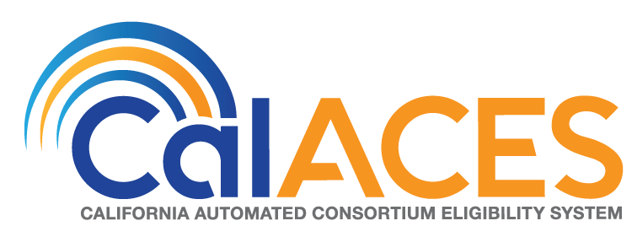
Project Steering Committee Meeting
February 21, 2019

Slide 2
AGENDA
Call Meeting to Order
Agenda Review
Public opportunity to speak on items not on the Agenda

Slide 3
Action Item

Slide 4
4. Approve the Minutes of the January 17, 2019 Project Steering Committee Meeting and review of Action Items

Slide 5
Informational Items

Slide 6
CalSAWS Project Approval/Project Start-Up Activities

Slide 7

Project Approval
CalSAWS DD&I Approval
  FNS Approval of CalSAWS DD&I
  CMS Approval of CalSAWS DD&I
  JPA Board Approval – 2/28/2019
  CalSAWS DD&I
  C-IV One Year Extension
  CalSAWS Cloud Bridging

Slide 8
CalSAWS Project First Six Months
Schedule may change depending on the outcome of the Functional Design Sessions.

Slide 9
Project Start-Up
Contract Amendment Preparation
JPA Board Approval – 2/28/19
Deliverable Process
Confirmed Deliverable Process
Confirmed Deliverable Expectation Document (DED) Template
Create Deliverable Template – In Progress
Drafted DED for Deliverable 1 – Work Plan Initial
Drafted DED for Deliverable 2 – Project Control Document (PCD) Initial
Draft DEL 1 Work Plan Initial
Draft DEL 2 – PCD Initial
Staffing
Posted Accenture positions
Interview and Staff – In Progress
Create Integrated Organization Chart
Orientation
Technology Enablement
CalSAWS.org email change - April
SharePoint Rebrand to CalSAWS - July
Transition Account/Domain Mgmt to Consortium – End of July (tentatively)
Project Management
Executive Director Communication Matrix
Project Management Calendar
Status Reports and Recurring Meetings cadence
Create CalSAWS DD&I Agenda, Minutes, PowerPoint templates
SharePoint Folder Structure
Update JIRA tool and load CalSAWS DD&I Requirements
CalACES North Suite 130 Facility Build Out
Received approval for Floor Plan
Execute Lease for Suite 130 - March
Develop Construction Designs – March
Develop and Submit Construction Permits – April
Complete Build Out - August
Other Start-Up Activities
Finalize Governance; small ‘g’ Transformation
Develop Advocate Involvement Approach
Technology Advisory Group

Slide 10


Project Start-Up
CalSAWS
March 4, 2019
Start Date
This Photo by Unknown Author is licensed under CC BY-SA-NC

Slide 11
CalSAWS Staffing Update
CalACES R1/CalSAWS R5 Regional Manager Recruitment

Slide 12
Staffing Update
Regional Manager Staffing Update:
Immediate opening in CalACES Region 1/CalSAWS Region 5 Regional Manager
Riverside County/Consortium Recruitment December/January
Call for Interview Panel members from CalACES/CalWIN
Panel Members included:
  Rocio Aguiniga, Riverside County – CalACES PSC Member
  Brian Clark, Orange County – CalWIN OPAC Member
  Mirna Lopez, San Diego County – CalWIN OPAC Member
  June Hutchison, CalACES Consortium
17 interviews conducted
Finalizing selection of preferred candidate(s)

Slide 13
Staffing Update
Next Steps (March – May 2019)
Finalize the transfer/slotting process
Confirm/adjust process with Leadership
Discuss the process with Consortium staff
Commence the process
Reconcile org chart/budget
Start county/public recruitments

Slide 14
CalSAWS Governance Status/Next Steps

Slide 15
CalSAWS Governance Status/Next Steps
CalSAWS Governance Status/Next Steps
Approval of the Final JPA and MOU by the JPA Board and Concurrence of the Member Representatives January 25, 2019.
Final JPA and MOU distributed to Counties for action by Boards of Supervisors on January 31, 2019.
Next Steps:
County approval process to be completed
  Counties to report back to the Consortium once the item is scheduled for a board meeting
Executed JPA and MOU documents must be received by Consortium May 15, 2019
Joint Board and Member Representative meeting (WCDS Counties included at meetings)
  Current Member Representatives “concur” in new JPA and Bylaws
  Current Board approves new JPA, Bylaws, MOU
  Board elections by newly constituted Regions, to take effect June 28, 2019
Effective Date for revised JPA, Bylaws, MOU June 28, 2019

Slide 16
Cloud Migration/Strategy to move
LRS Production to the Cloud
Status of Initial M&O Discussions

Slide 17
Cloud Proof of Concept
  Confirmed that LRS at LA County volumes can run in the AWS Cloud and meet performance SLAs
  Identified areas that do not meet SLAs when scaled to 40 & 58 county loads (EDBC, MEDS batch interface & CCSAS batch interface)
  Identified technical enhancements to meet performance requirements as well as opportunities for strategic enhancements to improve cost efficiency, reduce dependencies on proprietary software, and take advantage of innovative features within the AWS cloud

Slide 18
Cloud Enablement Approach & Schedule

Slide 19
Transitional Maintenance & Operations
LRS transition to AWS Cloud – November 2019
  Northrup Grumman through October 2023
  Software Licenses through October 2023
C-IV cutover to LRS/CalSAWS – September 2021
  Application Maintenance Hours
  Combined Production Operations with LRS
  Managed Counties
CalWIN rollout – January 2022 thru January 2023
  Application Maintenance
  Production Operations
CalSAWS stabilization period thru April 2023

Slide 20
Transitional Maintenance & Operations
Maintenance and Operations scope of services:
Application Maintenance
Technology Operations
  Architecture & DBAs
  Technology Support
  Operations
Production Operations (Data Centers, Network, Contact Centers)
Facilities
Print
Hardware/Software

Slide 21
Stakeholder Engagement Process Discussion

Slide 22
Stakeholder Engagement Process
Quarterly Meeting Held January 23, 2019
Agenda Items:
  Discussed customer facing technology and upcoming activities for:
  Customer Portal/Mobile
  Contact Center
  Lobby Management
  Imaging
User Centered Design
Stakeholder Education Presentation planned

Slide 23
Status of Procurements
OCAT
QA
Portal/Mobile

Slide 24
OCAT Procurement: Key Tasks and Timeframes
Key Milestones Extended to Account for 5 Proposals Received and to Accommodate Evaluation Team Availability
  OCAT RFP Release Date – Friday, Dec 14
  Vendors Conference – Monday, Jan 7
  Proposal Due Date – Friday, Feb 8
  Proposal Evaluation – Monday, Feb 11 – Wednesday, Apr 17
  Oral Presentations/Key Staff Interviews – Monday, Apr 8 – Wednesday, Apr 10
  Prepare Vendor Selection Report – Thursday, Apr 18 – Friday, Apr 26
  Vendor Selection Report Review & Approval – Monday, Apr 29 – Wednesday, May 8
  Release Notice of Intent to Award – Thursday, May 9
  Negotiations & State & JPA Approvals – Friday, May 10 – Friday, Jun 28
  OCAT Vendor Start Date – Tuesday, Jul 2

Slide 25
QA Procurement Key Tasks and Timeframes
Key Milestones Extended to Account for 5 Proposals Received
  QA RFP Release Date – Friday, Dec 14
  Vendors Conference – Monday, Jan 7
  Proposal Due Date – Friday, Feb 8
  Proposal Evaluation – Monday, Feb 11 – Wednesday, Mar 20
  Oral Presentations/Key Staff Interviews – Monday, Mar 18 – Wednesday, Mar 20
  Prepare Vendor Selection Report – Wednesday, Mar 27 – Monday, Apr 8
  Vendor Selection Report Review & Approval – Monday, Apr 8 – Friday, Apr 12
  Release Notice of Intent to Award – Friday, Apr 12
  Negotiations & State, Federal & JPA Approvals – Monday, Apr 15 – Friday, June 28
  QA Vendor Start Date – Monday, Jul 1

Slide 26
Other CalSAWS Potential Procurements
Consolidated Portal/Mobile App
CalWIN OCM, Training and Implementation Support
Contact Center (TBD)
FCED
Planning Vendor for CalSAWS 58-County M&O Procurement
CalSAWS 58-County M&O Vendor

Slide 27
Update on Amazon Connect and Discussion on Next Steps

Slide 28




39 County Solution - Features and Services
Predictive Handling (SB Only)
Visual IVR (SB Only)
No Change
3 Counties
Courtesy Call Back
Post Call Survey
Professional Voice
Talent
2 Counties
39 Counties
Features available to all 14 Counties
Call Routing
WFM & QA
Reporting
Web Chat & Click to Call
Fail Over Capabilities
No Change
Base Features available to all 39 Counties
IVR Self Service
(Document Status, Request Forms, Office hours and locations, Benefits information, Appointments)
Outbound Campaigns
Voice Authentication
No Change
Cisco
AWS
Notes:
Why Amazon Connect
- Multi Platform Integration cont
Multitenant
County has ability to shape the way they choose to provide customer service
Set hours of operations
Create queues
Create prompts
Create contact flows
Create routing profiles
Configure users
CCB, in a fashion the counties have requested
Short term HW savings avail; enables a shift to CalSAWS
Long term possibilities…AI, BOTs,

Slide 29
39 County Solution – Timeline to Amazon Connect
Wave 3 Go Live
All remaining CSCs, RCCs, and IVRs
Apr 1
Wave 1 Pilot Go Live
Wave 4 Go Live
Outbound Campaigns
Nov 12
Project Kickoff
Wave 2 Go Live
Aug 28
Mar 4
Jan 2
Mar
May
Jul
Sep
Nov
2020
Mar
May
Jul
2020
Mar 4
Plan
Apr 1
Apr 4
Technical Design
Jun 26
Jun 28
Technical Build
Jan 29
Aug 28
System Test
Feb 21
Mar 15
Technical Build
May 24
Mar 25
System Test
Jul 31
NOTE:
Goal is to complete the project by May of 2020 to avoid paying for software license renewals for the existing Cisco solution.
Through this effort there will be no design changes to the customer experience.
Notes:
Why Amazon Connect
- Multi Platform Integration cont
Multitenant
County has ability to shape the way they choose to provide customer service
Set hours of operations
Create queues
Create prompts
Create contact flows
Create routing profiles
Configure users
CCB, in a fashion the counties have requested
Short term HW savings avail; enables a shift to CalSAWS
Long term possibilities…AI, BOTs,

Slide 30











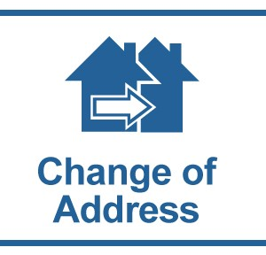

Cloud Opportunities
Automated Assistance for…
Multi Platform Integration
Mobile, Messaging Platform (e.g. SMS), Web
EBT Balance
Form Status
Information
Everyday consumer requests
Contact Center
Customer service
Multiple
Languages
Schedule
Appointment
Enterprise Productivity Automated
Streamline enterprise work activities and improve efficiencies
Card Replacement
Benefit Amount
Add Newborn
Add Person
Notes:
Why Amazon Connect
- Multi Platform Integration cont
Multitenant
County has ability to shape the way they choose to provide customer service
Set hours of operations
Create queues
Create prompts
Create contact flows
Create routing profiles
Configure users
CCB, in a fashion the counties have requested
Short term HW savings avail; enables a shift to CalSAWS
Long term possibilities…AI, BOTs,

Slide 31
Little “g” Updates
Committee Kick-off
Committee Structure

Slide 32
Committee Kick-off
After CalSAWS Roadshows
Topics include
  Overview of CalSAWS
  Regional Participation
  Voting
  Guiding Principles
  Software Development Life Cycle (SDLC)

Slide 33
Committee Structure
Current effort – Gather best practices from RMs
Regional Participation
  Propose 5 RCMs per committee
Voting
  Propose following JPA Voting structure

Slide 34
Automation Principles

Slide 35
Automation Principles
Background:
Three consortia each had automation processes and opportunities for input. With the establishment of CalSAWS, we are working together to establish a set of automation guidelines that will help to ground staff, counties and stakeholders in order to manage expectations and meet scheduled delivery dates, while continuing to encourage input and feedback.
Obtaining PSC leadership buy in and approval of a set of automation principles is imperative to effectively implement them with committees, work groups, and project staff.

Slide 36
Automation Principles
Objective:
To establish a set of automation principles for the project and committees that balance project priorities with the time and resources available to accomplish those priorities.

Slide 37
Automation Principles
Goals:
To deliver a consistent customer experience from county to county
To set consistent expectations between stakeholders, committees and project staff
To efficiently design timely and accurate solutions
To consider future maintenance efforts during design
To support county innovation by bringing the innovation to more counties
Notes:
Consistent experience from county to county
(Single portal, consistent language/terminology, lobby management, etc.)

Slide 38
Automation Principles
Suggested Principles:
Solutions support a singular interpretation of policy
Solutions work for counties of all sizes and resources
Solutions support multiple business processes where not enforced by policy (i.e. open vs. forced navigation)
Solutions account for future maintainability and system performance
  Allowing counties to maintain county specific data points (security, mileage rates, automated actions, etc.)
  Configurability, where appropriate, align with system maintainability and performance SLAs
Solutions may include a multi-phase approach to limit risk, potential impact, and/or meet stakeholder deadlines when appropriate
Solutions do not introduce a migration gap before CalSAWS implementation, unless otherwise agreed upon by Consortium Leadership
Solutions should avoid the introduction of redundant or duplicative functionality
Notes:
Speak to configurability not being used in lieu of coming to an agreement (old guiding principle from Side By Side sessions)

Slide 39
Automation Principles
Suggested Principles:
Consider alternative approaches when:
  Total count impacted are less than 1% of the Consortium volume for the given area (e.g. programs, tasks created, applications taken, issuances, etc.)
  There are viable alternatives available, for example:
    Changing an individual county business process
    Manual system functionality (e.g. manual EDBC, template repository, ad hoc reporting, etc.)
  Time required to utilize alternative does not cause undue hardship on the Counties (e.g. worker/customer/staffing issues or delayed processing)
  When the Counties (through the Committees) have not prioritized or requested the change
Notes:
Implement a phased approach if a significant volume of cases can be addressed with minimal effort; lower volume scenarios addressed later (subject to prioritization)
- Avoid “all or nothing” approach to designs

Slide 40
Automation Principles
Next steps
Feedback due by March 7th
PSC Approval in March
Communicate to Project Staff
Present to Committees

Slide 41
Federal Shutdown & CalFresh Benefits Issuance Status

Slide 42
Federal Shutdown & CalFresh Benefits Issuance Status
Background
Due to the federal shutdown that began on 12/22/2018, FNS instructed states to issue February SNAP benefits to most participants by 1/20/2019, in order to provide households with food benefits during the lapse in appropriations for SNAP. As a result, February CalFresh (CF) benefits were issued and available to most of the CF population in the 40 CalACES counties on 1/16/2019.
In order to lessen the impact and shorten the interval between the early issuance of February benefits and March benefits, FNS requested that states submit a mitigation plan.
Next Steps
On 2/9/2019, FNS issued an amended blanket waiver for March benefits that no household shall experience an interval between benefit issuances of more than 40 days. In partnership with stakeholders, CDSS decided on a plan to issue all March benefits on 3/1/2019, rather than the normal staggered issuance cycle of the 1st through the 10th of the month.

Slide 43
Federal Shutdown & CalFresh Benefits Issuance Status
Next Steps Continued
On the nights of 2/21 - 2/26, March CF benefits will be issued via the main payroll process. These benefits will have an availability date of 3/1/2019.
The following CF households will receive the early issuance:
  Households that DO NOT have SAR 7 or recertification due in February 2019
  Households with a SAR 7 or recertification due in February 2019 which are in a Completed status by February 18th
  Households with a SAR 7 in a Received status and is NOT processed by close of business February 18th
  Note: March issuances for households whose SAR 7s/recertifications are processed after 2/18/19 will follow the normal staggered issuance dates. State and fiscal reports will not be impacted due to the early issuance of March benefits.
  For more details on the CF early issuance for March, refer to CIT 0010-19.

Slide 44
Lunch

Slide 45
M&O Application & Policy Update
CalSAWS Roadshows
Draft ACLs
Recurring SCRs and County Enhancements
DDCRs

Slide 46

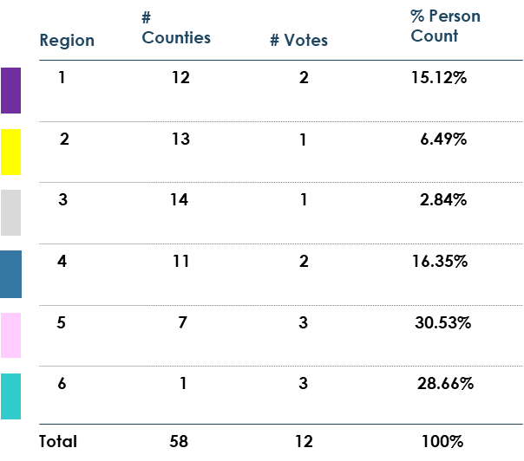
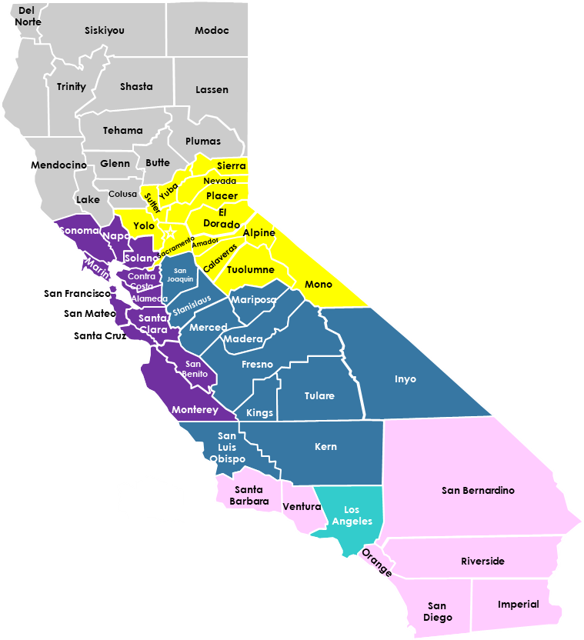
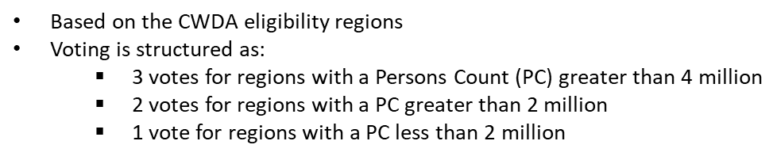
CalSAWS Roadshows

Slide 47

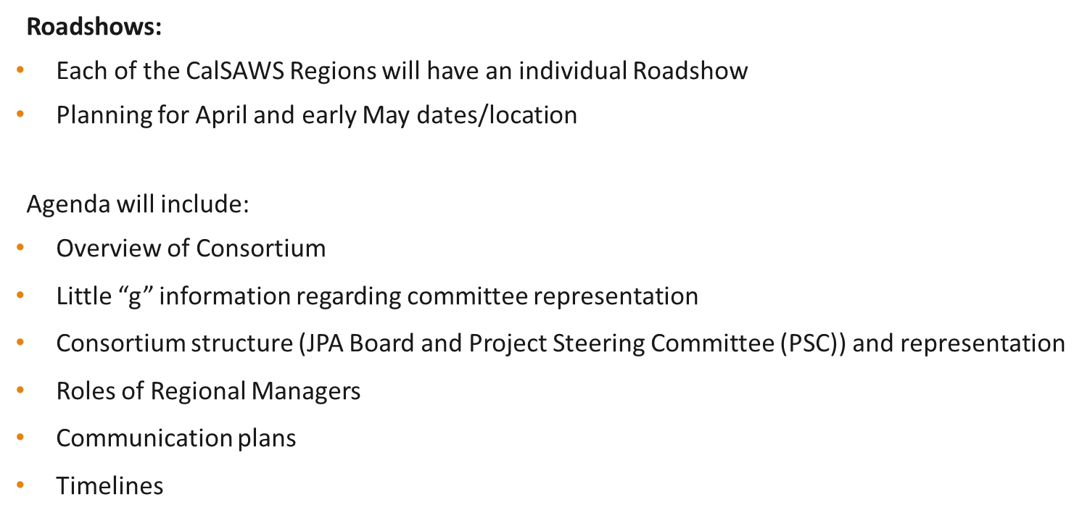
CalSAWS Roadshows

Slide 48
Draft ACLs
Current Process
SCR design may begin when the project receives the draft state policy letter (e.g., ACLs, ACWDLs), but does not finalize the design or implement changes until the final policy is published by the state.
The design for SCRs generally takes 4 to 6 weeks and may include the following:
  Complete system impact analysis
  Request policy clarification from the state
  Request confirmation from the state that there will not be any changes between the draft and the final letters
  Meet with the applicable committee to obtain their input on the design
  Update the design based on committee feedback
  Submit the SCR to the committee for approval
After the SCR is approved by the committee, the completion of the build and test phases can each take up to 2 months.
Partial implementation may occur to update standard values like Income Reporting Threshold (IRT) and SSA COLA using the draft state letter. Batch EDBC requirements and implementation timeline are not finalized until final policy is published by the state.
County Concern
Designing and implementing the SSA Cost of Living Adjustment (COLA) system changes based on the final state letter may cause implementation to occur after the policy effective date. Implementing after the policy effective date may result in increased manual processing for the counties.

Slide 49
Draft ACLs
Reasons the design of COLA SCRs are based on final published policy instead of federal policy or draft state letters include:
  Federal letters do not provide sufficient information for all programs. Design based on the federal letter may not be complete pending the state determination of following, which are included in the state policy letter:
      Medicare information for SSA COLA
      Pickle multiplier
      SSP amounts
      Utility allowance (SUA, TUA, LUA) for CalFresh COLA
  The state may need to modify state policy to account for federal changes
  State policy not finalized and may change between the draft and final letters

Slide 50
Draft ACLs
Risks
The risks associated to implementing system changes and running batch EDBC based on the federal letter or draft state policy letter if it differs from the final published state policy letter are:
  Incorrect Notices of Action
  Increased postage and print costs
  Overpayments/Over issuance and the manual processing required to address the recovery accounts
Scheduling Constraints
The project must consider the following when scheduling a batch EDBC process:
  Programs (e.g. CW, CF, MC) to be included in the batch EDBC process
  Execution time for queries to target the impacted cases
  Time to allow the print vendor to print notices and USPS to pick up
  10-day timely notice
  Main payroll dates, which are different between Prospective and Retrospective programs
  Impact on existing nightly Batch processing
  System test teams capacity to adequately test system changes
  Previously scheduled system changes/major releases

Slide 51
Draft ACLs
SAWS SSA COLA Notification Timeline:
CalACES Committee SSA COLA Review/Approval
Timeline:
SSA COLA Implementation Timeline:
Note: Design overlapped with Build because the changes were implemented with multiple SCRs. Build started while the design was still ongoing, and prior to committee review because production deployment expedited approval was authorized.
For CW/CF, manual processing was required for January 2019 benefit month to evaluate for potential overpayments/over issuances, due to 10-day noticing requirements. To avoid manual processing for January 2019 benefit month, implementation would have needed to occur in early December 2018, which means final policy is needed in September 2018.
10/29/2018 | SAWS was notified that the Feds posted a letter
11/8/2019 | Draft ACWDL (DHCS) received
11/19/2018 | Draft ACL (CDSS) received
12/10/2018 | Final ACL/ACWDL published
1/8/2019 | Batch EDBC memorandum meeting
1/9/2019 | Submitted to the committees for approval
1/16/2019 | Committee approved the SCR
11/26/2018 - 1/9/2019 | SCR Design (See note)
12/27/2018 | Expedited Production Deploy approval
12/20/2018 - 1/14/2019 | Build (See note)
12/26/2018 - 1/14/2019 | Test (See note)
1/12/2019 | Implementation: Code table updates, data change, and batch EDBC (February benefit month)

Slide 52
Draft ACLs
  Design and Implementation
  The project will continue to follow the current process in which SCR design may begin once the state distributes the draft letter. Partial implementation may occur to update standard values like Income Reporting Threshold (IRT) and SSA COLA using the draft state letter.
  The batch EDBC requirements and implementation timeline will not be finalized until the state distributes the final letter.

Slide 53
CalACES Enhancements
  A series of potential enhancements have been identified to assist in system maintenance. Areas of focus include:
  Allowing users to make updates to the system that have been historically done through reoccurring maintenance SCRs.
  Providing an alternate way to authorize issuances outside of the traditional EDBC and Payment Request process.

Slide 54
Reoccurring SCRs
Batch Calendar
  County Holidays
  “Important” Batch Dates
    Main Payroll
    10 Day
    Batch Discontinuances
    COLA Runs
Issuance Thresholds
School District Zip Codes
FC Clothing Allowance Threshold

Slide 55
Batch Calendar Enhancements
  Phase I (CA-201813/CIV-100040)
    New Admin List Page (read only)
    New Admin List Detail Page (read only)
    Update Batch Framework
    ~500 hours*
  Phase II
    Allow users to add/edit/remove county holidays
    New batch job or process to project future federal holidays
    ~700 hours*
    *High level estimate only. Estimate includes design, build, and test. Final detailed estimate may vary.

Slide 56
Issuance Threshold Enhancements
  New Admin Page to administer program issuance thresholds by County
  Updates to EDBC Summary
  Updates to Payment Request
  ~400 hours*
*High level estimate only. Estimate includes design, build, and test. Final detailed estimate may vary.

Slide 57
School District Zip Codes Enhancements
  New Admin List Page
  New Admin List Detail Page
  Updates to School Lunch batch job
  ~300 hours*
*High level estimate only. Estimate includes design, build, and test. Final detailed estimate may vary.

Slide 58
FC Clothing Allowance Enhancements
  Create Framework to allow automated actions to be used to opt in to batches and set batch parameters.
  Create automated actions for the clothing allowances.
  Automated actions will allow users to set clothing allowance thresholds by age.
  Update the clothing allowance batches to utilize automated actions.
  ~600 hours*
*High level estimate only. Estimate includes design, build, and test. Final detailed estimate may vary.

Slide 59
Auxiliary Payments Enhancements
  Allow users to generate issuances outside of the existing EDBC or Payment Request process.
  Framework can be used to expedite the implementation of new policy or county specific payments.
  Create New Auxiliary Payments Authorization Page.
  Payments could be reoccurring or one-time based on the payment type.
  Additional reporting would be created to track auxiliary payments.
  ~3000-4000 hours*
*High level estimate only. Estimate includes design, build, and test. Final detailed estimate may vary.

Slide 60
DDCR Process
C-IV + LRS SCRs
(13.12d – 18.03)
Committee Review and Prioritization
SCR updated in JIRA
Analysis conducted to determine design differences
SCRs are routed to committee for decision and prioritization
Committee outcome is documented in JIRA and SCR scorecard is attached

Slide 61
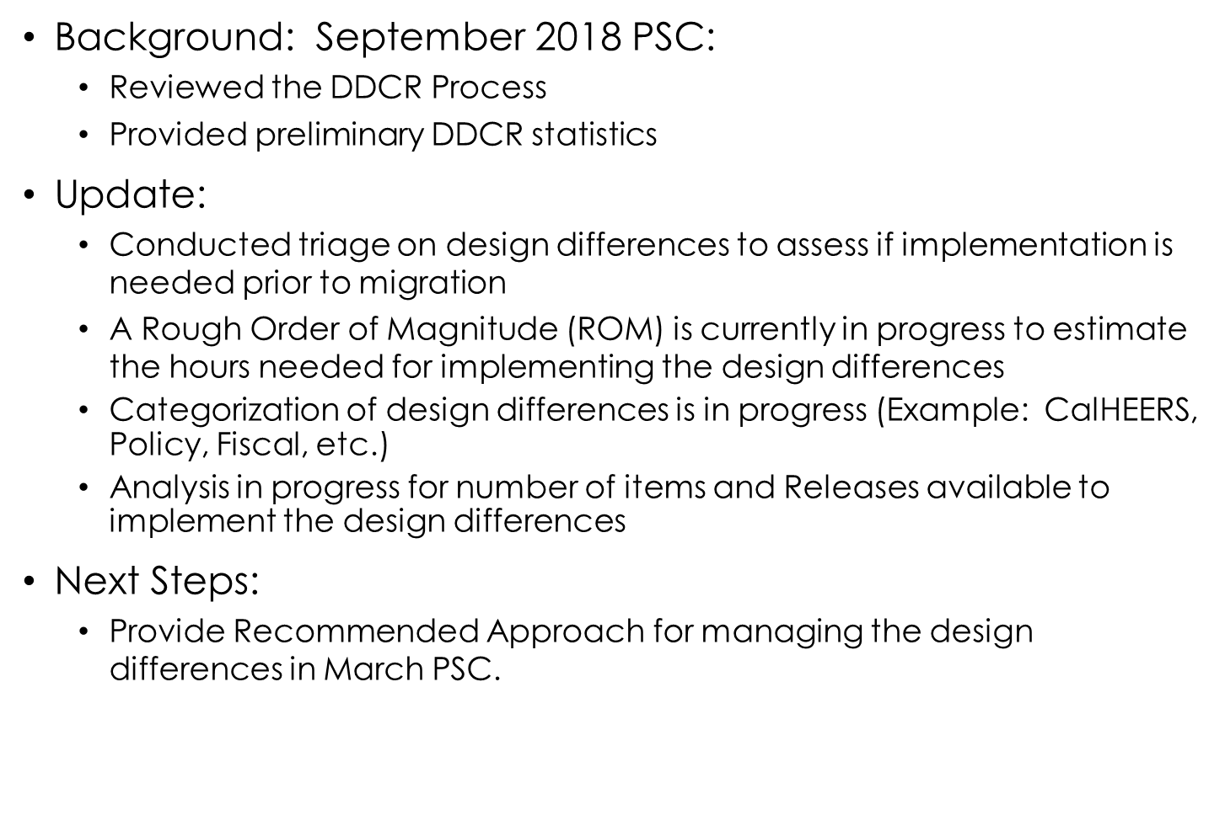
Background/Update/Next Steps

Slide 62
Policy Update
Item | Policy Effective Date | C-IV Status | LRS Status | Description – CalACES Implementation Effort
Funding for Emergency Caregivers with Placement of Children and Non-Minor Dependents prior to Resource Family Approval ACL 18-75 | 7/1/2018 | SCR 102237 Implemented Release 18.11 SCR 101497 Implemented Release 19.01 SCR 102912 New Release TBD | SCR 204665 Implemented Release 18.11 SCR 203634 Implemented Release 19.01 SCR 205913 New Release TBD | Per ACL 18-33, all counties were required to provide the Short-Term, Interim payment (AB 110) to caregivers who had taken placement of a child prior to completing the Resource Family Approval (RFA) process between 3/30/2018 and 06/30/2018. Effective July 1, 2018, all counties must provide a payment equivalent to the basic level rate for a resource family to the Emergency Caregiver (EC) of a child. However, unlike the Short-Term, Interim funding, the EC funding will be exclusively funded through the Emergency Assistance (EA) Program, aid code 5K. For more information refer to ACL 18-75. Aid code 5L will be used to identify the emergency caregiver placements that are not eligible to federal foster care funding and they are not eligible to emergency assistance funding. MEDS is working on implementing this aid code, the tentative availability date is 3/1/2019. CDSS met with SAWS on 1/29/2019 to provide an update on the Continuum Care Reform (CCR) policy and discuss some potential changes to CCR Level of Care (LOC) rates. A draft ACL was shared with the counties on 1/17/2019. The draft ACL clarifies the implementation of the LOC rates for all FFA placements. Implementation of the LOC rates for all other placement types is delayed until further notice.

Slide 63
Policy Update
Item | Policy Effective Date | C-IV Status | LRS Status | Description – CalACES Implementation Effort
CalWORKs Implementation of SB 726 Draft ACL received 12/27/2018 | 7/1/2019 | CIV-102502 New Release TBD | CA-205172 New Release TBD | SB 726 will increase the threshold for which CalWORKs overpayment recovery is pursued, and implement an expungement process for CalWORKs overpayments, as specified. In addition, SB 726 aligns the CalWORKs and CalFresh programs by allowing a mass overpayment to be expunged if it resulted from major systemic error or negligence, as defined by the California Department of Social Services (CDSS). The CalWORKs overpayment threshold will be increased from $35 to $250 and CWDs shall not demand collection of any non-fraudulent overpayments totaling less than $250 from the individual(s) responsible for the CalWORKs overpayment if they are no longer aided under the CalWORKs program. SB 726 also implements a new CalWORKs expungement process for non-fraudulent overpayments. On 1/10/2019, CDSS met with SAWS to discuss SAWS automation timeline and cost. During this meeting CDSS clarified the policy related to persons no longer on aid to mean, no longer on aid in any county in California. Additionally, CDSS mentioned there would be approximately three NOAs for this policy. SAWS has not seen the NOAs because they are still in progress. CalACES provided an updated cost estimate to CDSS on 1/21/2019.

Slide 64
Policy Update
Item | Policy Effective Date | C-IV Status | LRS Status | Description – CalACES Implementation Effort
CalFresh Ending Cash Out for SSI/SSP Recipients Policy ACL 18-90 ACL 18-91 ACL 18-92 | 6/1/2019 | SCR 101471 Build Release 19.05 SCR 102555 (eICT) New Release 19.07 | SCR 203103 Build Release 19.05 SCR 205294 (eICT) New Release 19.07 | CDSS published ACLs 18-90, 18-91, and 18-92 on July 31, 2018. On August 13, 2018, CDSS kicked off the Reversing SSI Cash-Out Automation meetings. This group includes CDSS, CWDA, SAWS and the counties. The purpose of these meetings are to discuss questions related to the policy, implementation strategy, and automation timeline. These meetings are held bi-weekly through October at the CalACES North location. CalACES Update: System changes for this effort will include: Update eligibility rules to determine SSI individuals eligible to CalFresh if they meet CalFresh eligibility requirements Add eligibility rules to determine the Supplemental Nutrition Benefit (SNB) and the Transitional Nutrition Benefit (TNB) Add the appropriate Notices of Action The Project met with the CW/CF Committee several times to review and discuss the SCR design before giving final SCR approval on 11/30/2018. eICT Updates and the NOAs associated to ICTs are scheduled for implementation in July 2019. MEDS will have the TNB aid code OH and will be available for testing no later than 2/25/2019. The EBT benefit types for SNB and TNB will be available for testing no later than 2/25/2019.

Slide 65
Policy Update
Item | Policy Effective Date | C-IV Status | LRS Status | Description – CalACES Implementation Effort
CalFresh Able-Bodied Adults without Dependents (ABAWDs) ACIN I-11-16 ACIN I-88-16 ACL 18-08 ABAWD Handbook | 1/1/2017 Fixed Clock 8/31/2019 Waiver Expires | SCR 7215 Phase II Design Release 19.09 | SCR 57971 Phase II Design Release 19.09 | ABAWD implementation began in September 2018 for San Francisco, San Mateo, and Santa Clara. The remaining counties are on waiver until 8/31/2019. In September, CDSS submitted another ABAWD waiver request to FNS for the time period 9/1/2018-8/31/2019. If the waiver is approved, three additional counties (Alameda, Contra Costa, and Marin) will be required to implement the ABAWD policy effective September 2019. The ABAWD Handbook was published on 1/26/2018. The ABAWD handbook is a living document and the DRAFT version 2.0 was sent to stakeholders for review on 1/25/2019. The critical items on which the State needs to provide direction are: Exemptions including geographically waived areas, and the MEDS interface changes. CalACES Update: The project has resumed working on the ABAWD design. The design period is Jan-April. A design kick off meeting with the CW/CF committee was held on 1/14/2019 and bi-weekly design touch point meetings with the committee have been scheduled. The design team, consortium staff, and QA staff continue to participate in the SAWS ABAWD Automation meeting with CDSS.

Slide 66
Policy Update
Item | Policy Effective Date | C-IV Status | LRS Status | Description – CalACES Implementation Effort
CalWORKs Increase to the Maximum Aid Payment Levels ACL 18-124 | 4/1/2019 | SCR 102238 Implemented Release 19.01 SCR 102190 System Test Release 19.02 SCR 102239 Approved Release 19.02 | SCR 204642 Implemented Release 19.01 SCR 204567 System Test Release 19.02 SCR 204727 Approved Release 19.02 | AB 1811 authorized a ten percent increase to the CalWORKs Maximum Aid Payment (MAP) levels effective 04/01/2019. This policy also requires the CWDs to send the TEMP 2250 to all CW recipients informing them of the MAP increase no later than 02/15/2019. Automation Updates: TEMP 2250 Informing Notice were mailed to all active CalWORKs(CW) participants to inform the changes to the Maximum Aid Payment(MAP) levels on 02/07/2019. The counties are responsible for sending the TEMP 2250 manually for CW cases active after 02/07/2019. C4Youself - In the Announcement section a message about the 10% grant increase with a link to the TEMP 2250 will display from 03/01/2019 – 04/30/2019. Your Benefits Now - The TEMP 2250 form was added to the list of viewable documents under the Electronic Notices page. The updated CW MAP values will be available in the systems on 02/14/2019. Batch EDBC for CW and CalFresh (CF) will need to be run for the April benefit month. Tentative run date is 3/9/2019. Batch Memorandum call is scheduled for 2/27/2019. The C-IV System will be down on 3/9/2019 to process Batch EDBC for the CW MAP increase. Note: LRS will be up but performance will be reduced while batch is running. Case lists associated to the Batch EDBC process will be available on the CalACES Web Portal on 3/11/2019.

Slide 67
Policy Update
Item | Policy Effective Date | C-IV Status | LRS Status | Description – CalACES Implementation Effort
CalWORKs Outcomes and Accountability Review Cal-OAR | 7/1/2019 | SCR 102191 New Release TBD | SCR 204569 New Release TBD | The CalWORKs Outcomes and Accountability Review (Cal-OAR) is a process for reviewing the CalWORKS program statewide while taking into account county diversity. Its goal is to promote program accountability, continual quality improvement, and meaningful tracking of program participation and outcomes. Cal-OAR’s three main components to be developed by July 2019: Process and Outcome Performance indicators CalWORKs county self-assessment process CalWORKs county system improvement plan, including a peer review component. The three elements produced by the Cal-OAR work group will improve county access to meaningful, real-time data and will encourage cross-county examination. This will help counties improve their program management decisions and provide a mechanism for elevating county best practices. On 2/5/2019, the counties and SAWS received the DRAFT Cal-OAR ACL, modified indicator requirements, and a proposed recommendation for transmitting the Cal-OAR data to CDSS. CDSS has scheduled Cal-OAR automation touch point meetings with SAWS. On 2/6/2019, SAWS received a request from OSI to provide an updated cost estimate based on the draft ACL and modified indicator requirements.

Slide 68
Policy Update
Item | Policy Effective Date | C-IV Status | LRS Status | Description – CalACES Implementation Effort
CalHEERS - Verify Lawful Presence CH CR 92295 February 2019 |  | SCR 100608 In Production Release 19.02 | SCR 201310 In Production Release 19.02 | The Department of Homeland Security (DHS) is upgrading the DHS Verify Lawful Presence (VLP) interface. Centers for Medicare and Medicaid Services (CMS), CalHEERS (CH) and CalACES must also be updated to continue to communicate to DHS for VLP. CH Change Request (CR) will update CH to use the updated CMS VLP interface. CalACES Update: System changes for this effort will include: Updates to CH eHit interface for VLP Creates a new CH VLP interface between CH and CalACES for VLP Provides a way to communicate when CH receives a VLP interface error code or when CH does not make a VLP call. When a case is pure MAGI, the VLP interface will reduce worker double data entry and the system will notify the workers from within CIV/LRS by auto-creating tasks when CH receives citizenship information from DHS. The CH JADs for this effort are complete and the MC committee approved the SCR on 10/31/18. C-IV: The DRAFT job aid was sent via CIT to the counties on 1/18/2019. C-IV Functional Presentation (CFP) is available in Online Help from 2/11/2019. LRS: The DRAFT job aid was sent sent via CIT to the county on 1/18/2019.

Slide 69
Policy Update
Item | Policy Effective Date | C-IV Status | LRS Status | Description – CalACES Implementation Effort
Notice of Action Requirements at Annual Renewal or Change in Circumstance Final ACWDL received on 01/10/2019 ACWDL 19-03 | 7/1/2019 | SCR 100708 Design in Progress Release 19.09 | SCR 202724 Design in Progress Release 19.09 | In accordance with Federal Regulations, counties are required to send a Notice of Action to MAGI beneficiaries who have no change in their eligibility or level of benefits at annual renewal or when an eligibility determination at change in circumstance results in resetting the annual renewal date. In the draft ACWDL it states that SAWS must make all necessary programming changes to automate the use of the MAGI and Non-MAGI NOA snippet language included within this ACWDL no later than six months after the release of this ACWDL. The final ACWDL was published on 1/10/2019. CalACES Update: The design team along with consortium staff and QA are working on documenting the design for this SCR.

Slide 70
State Update (OSI, CDSS, & DHCS)

Slide 71
Review Upcoming CalACES Board Activities
February 28, 2019 JPA Board Meeting

Slide 72
Regional Updates/Sharing

Slide 73
Adjourn Meeting

