Slide 1
September 13, 2019
JPA Board of Directors Meeting

Slide 2
Agenda
Call Meeting to Order
Public Opportunity to speak on items NOT on the Agenda. Public comments are limited to no more than three minutes per speaker, except that a speaker using a translator shall be allowed up to six minutes.
Note: The public may also speak on any Item ON the Agenda by waiting until that item is read, then requesting recognition from the Chair to speak.
Confirmation of Quorum and Agenda Review.

Slide 3
Action Items

Slide 4
Action Items
Approval of the Minutes and review of Action Items of the August 16, 2019 CalSAWS JPA Board of Directors.
Approval of the Accenture C-IV Amendment package, which includes requests for:
Approval of C-IV Accenture Change Order CO-108 – Electronic Signature – Ongoing Operations, Revision 1
Approval of C-IV Accenture Change Order CO-110 – Central Contact Center Platform Covered California Expansion Maintenance
Approval of C-IV Accenture Change Order CO-111 – Ongoing Production Operations for County Sites and Support Renewals
Approval of C-IV Accenture Change Order CO-112 – Text Message Notifications – Ongoing Operations
Approval of C-IV Accenture Amendment 104 (References Change Order Co-108, Revision 1, Change Order CO-110, Change Order CO-111, Change Order CO-112, and updates to Exhibit A and Extension Two Cost Schedules)

Slide 5
Action Items
Approval of Accenture LRS Base Agreement Amendment 16, and an increase to the CalSAWS JPA Project Budget to accommodate Disaster CalFresh services and premise funding. Amendment 16 includes:
  Updates to the Maximum Contract Sum
  Updates to Exhibit C
Approval of ClearBest Change Order 01, which includes:
  Updates to Attachment D – Cost Schedules
  Updates to Attachment I – Staff Resumes
  Updates to Attachment L – QA Role Definition for Non-Key-Staff
  ClearBest Agreement Change Order 01 (Includes ClearBest OCAT Statement of Work; Deliverable Date Adjustments; and references updates to Attachments D, I, and L)

Slide 6
Action Items
Approval and ratification of DXC Technology Services LLC Assignment, Novation and Consent Agreement contingent on approval from Alameda and receipt of the signed Assignment Agreements from Alameda, Santa Clara, San Francisco, and Yolo counties by September 30, 2019.
Approval and ratification of Infosys Public Services, Inc. Assignment, Novation and Consent Agreements contingent on approval from Alameda and receipt of the signed Assignment Agreements from Alameda and Santa Clara counties by September 30, 2019.
Approval and ratification of the California State Association of Counties Assignment, Novation and Consent Agreements contingent on approval from Alameda and receipt of the signed Assignment Agreements from Alameda, Santa Clara, San Francisco, and Yolo counties by September 30, 2019.

Slide 7
Action Items
11. Approval of the Privacy and Security Agreement between the California Department of Social Services (CDSS) and the California Statewide Automated Welfare System (CalSAWS).
12. Approval of the Medi-Cal Privacy and Security Agreement between the Department of Health Care Services (DHCS) and the California Statewide Automated Welfare System (CalSAWS).
13. Approval of RGS Amendment 28, which includes the rate for the Business Consultant position.
14. Approval of the Memorandum of Understanding (MOU) between the California Statewide Automated Welfare System (CalSAWS) and the State of California Department of Social Services (CDSS) to provide California Work Opportunity and Responsibility to Kids (CalWORKs) and CalFresh data of Monterey, Napa, and Stanislaus (Pilot Counties) for use by the Cross-system Analytics and Assessment for Learning and Skills Attainment (CAAL-Skills) project.

Slide 8
Informational Items

Slide 9
CalSAWS JPA Quarterly Fiscal Report

Slide 10
CalSAWS JPA Quarterly Fiscal Report
Overview
CalSAWS DD&I and Premise for 58 Counties
(OCAT & Undocumented 19-25)
1
Actuals to Date
Based on Vendor Invoices & County Claims
Projections (Estimates to Complete)
Estimated Costs for Future Months
Estimate at Completion (EAC)
Actual Costs Plus Estimated
Total Allocation/Budget
Amount Allocated by Line Item for the Approved Budget
Balance
Difference Between EAC and Budget
Negative balance is under budget
Positive balance is over budget
% Expended to Date (Actuals)
Percent of Actuals to Date Divided by the Budget
% EAC to Budget
Percent of EAC Divided by the Budget
2
3
CalWIN M&O and Premise for 18 Counties
4
5
C-IV M&O and Premise for 39 Counties
6
LRS M&O and Premise for 1 County
7

Slide 12
CalSAWS JPA Quarterly Fiscal Report
Consortium Personnel

Slide 13
CalSAWS JPA Quarterly Fiscal Report
Change Budget

Slide 14
CalSAWS JPA Quarterly Fiscal Report
Contract Obligations

Slide 15
CalSAWS Staffing and Statistics

Slide 16
CalSAWS Staff Recruitment
Accepted Positions = 51
Unfilled Positions = 21
21 candidates are county employees
30 candidates will be employed through RGS or CSAC, and include seven county employees who elected to retire/resign from their county
Declined offers or lack of qualified candidates
Open positions include Fiscal, Procurement, Training, Conversion, and Product Owners

Slide 17
CalSAWS Staff Recruitment
Status & Statistics
PMO
Customer Engagement
PMO Manager (1 Filled)
Fiscal/Contract Manager (1 Not Filled)
Fiscal/Contract Analyst (4 of 5 Filled)
Procurement Manager (1 Not Filled)
Procurement Analyst (2 Not Filled)
Customer Engagement Manager (1 Filled)
Regional Manager (5 Filled)
Change Management Lead* (2 Filled)
Training Manager* (1 Filled)
Trainer* (3 of 9 Filled)
Common Services/Procurement
Technical Operations
Procurement Support* (1 Not Filled)
Help Desk Manager (1 Filled)
Help Desk Analyst (1 Filled)
Cloud Manager (1 Filled)
Cloud Analyst (2 Filled)
Information Security Officer (1 Filled)
Project IT Manager (1 Filled)
Security Technical Analyst (1 of 2 Filled)
Technical Operations Manager (1 Filled)
Technical/Security Analyst (3 Filled)
Conversion Lead* (1 Filled)
Conversion Analyst* (8 of 12 Filled)
Application Development/Test
Business Analyst* (6 of 6 Filled)
Policy, Design, and Governance
Product Owners* (5 of 9 Filled)
CalWIN M&O Back-Fill
Business Analysts (3 of 3 Filled)
*Limited-term positions

Slide 18
Online CalWORKs Appraisal Tool (OCAT) Overview and Status

Slide 19
OCAT Background
Overview
Supports the Welfare-to-Work (WTW) employment services program
Provides a standardized tool for gathering client information
Creates an appraisal of client strengths and barriers to support a path to self-sufficiency
Objective
Replicate existing solution in AWS
Interfaces with SAWS (CIV, LRS, CalWIN)
Cloud native technology
Improved efficiency and maintainability
Notes:
Remove

Slide 20
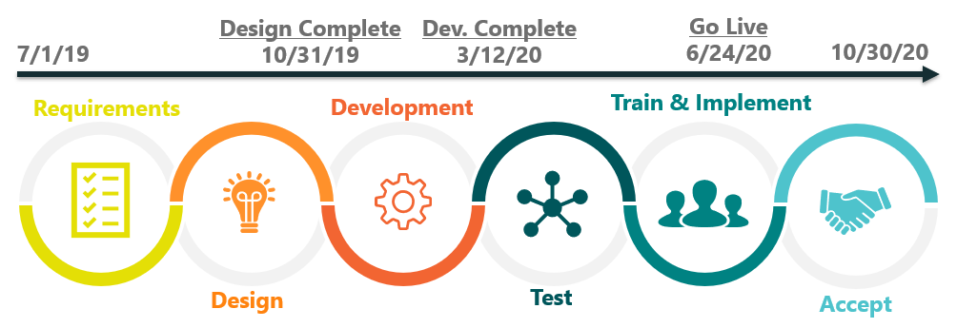
OCAT Lifecycle
Timeline
Activities
Work Plan
Requirements
Standards
Infrastructure
Security plan
App. Design
Tech. design
Interface spec.
Data model
Administration
DevSecOps
User Interface
Connectivity
Partner integration
Business Rules
Reporting
Automation
System tests
Regression
Partner testing
UAT
Training
Imp. Readiness
Cutover
Performance verification
Notes:
Functional Design Points
Imaging Completed all six regional Imaging Functional Design sessions
GA/GR Functional Design sessions started on June 24th
Task Management Functional Design sessions started on June 24th
Non-State Forms review and evaluation continues
Application Program Interfaces (APIs) Planning continues
Ancillary System Conversion sessions Planning continues
PMO
Submitted final set of LRS Agreement Exhibit W - Cloud Enablement & Interim M&O to OSI for State and Federal review.
Completed draft CalSAWS Implementation Advance Planning Document Update (IAPDU) for State review
Continued to scale and enhance CalSAWS Communications Management activities
Technical Architecture and Cloud Bridge
Completed transfer of LRS WCC (forms) and Data Warehouse data migration to the AWS Cloud (non-production environment); Began to export C-IV data to Snowball
Continued testing and fine tuning of Oracle parameters for Oracle 18c to determine opportunities for further performance enhancement
CDSS and DHCS completed review of the CalSAWS security documentation, and have submitted it to SSA for review. SSA approval is required prior to moving SSA data into production use in a cloud hosted infrastructure.
Conversion
Continued elaboration of the Accenture / DXC approach to the CalWIN Data Conversion
Began executing data mapping and build activities for both the C-IV and CalWIN data models to the CalSAWS target system

Slide 21
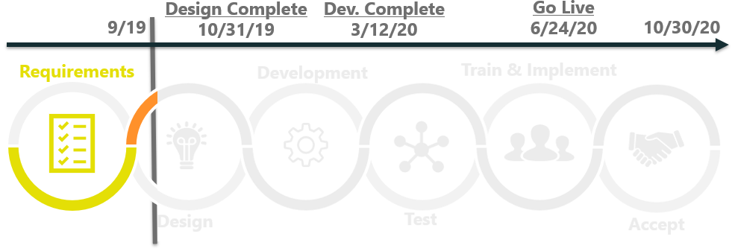
OCAT Lifecycle
Progress
Key Accomplishments
Completed requirements validation
Created a draft application design
Documented the draft interface control specification
Developed the logical data model
Obtained AWS accounts for development
Notes:
Functional Design Points
Imaging Completed all six regional Imaging Functional Design sessions
GA/GR Functional Design sessions started on June 24th
Task Management Functional Design sessions started on June 24th
Non-State Forms review and evaluation continues
Application Program Interfaces (APIs) Planning continues
Ancillary System Conversion sessions Planning continues
PMO
Submitted final set of LRS Agreement Exhibit W - Cloud Enablement & Interim M&O to OSI for State and Federal review.
Completed draft CalSAWS Implementation Advance Planning Document Update (IAPDU) for State review
Continued to scale and enhance CalSAWS Communications Management activities
Technical Architecture and Cloud Bridge
Completed transfer of LRS WCC (forms) and Data Warehouse data migration to the AWS Cloud (non-production environment); Began to export C-IV data to Snowball
Continued testing and fine tuning of Oracle parameters for Oracle 18c to determine opportunities for further performance enhancement
CDSS and DHCS completed review of the CalSAWS security documentation, and have submitted it to SSA for review. SSA approval is required prior to moving SSA data into production use in a cloud hosted infrastructure.
Conversion
Continued elaboration of the Accenture / DXC approach to the CalWIN Data Conversion
Began executing data mapping and build activities for both the C-IV and CalWIN data models to the CalSAWS target system

Slide 22
OCAT Deliverables Status
Completed
DEL # | DELIVERABLE NAME | STATUS | NEXT MILESTONE
1 | Project Control Document |  | FDEL Approved 8/21/19
2 | Work Plan (initial) |  | FDEL Approved 8/21/19
3 | Monthly Status Report (initial) |  | FDEL Approved 8/21/19
In Progress
DEL # | DELIVERABLE NAME | STATUS | NEXT MILESTONE
4 | Requirements Traceability Matrix |  | FDEL Approved 9/9/19 (est.)
5 | General Design Document |  | DDEL Submitted 9/16/19 (est.)
6 | Technical Design Document |  | FDED Approved 9/18/19 (est.)
8 | Master Test Plan |  | FDED Approved 8/26/19 (est.)
9 | Test Weekly Status Report (initial) |  | FDED Approved 8/26/19 (est.)
Note: Task & Deliverable completion required coordination with the Consortium, CDSS, and the WTW committee

Slide 23
OCAT Deliverables Status
Upcoming
DEL # | DELIVERABLE NAME | STATUS | NEXT MILESTONE
7 | Application/SAWS Interface |  | DDED Submitted 2/18/20 (est.)
10 | Training Plan |  | DDED Submitted 11/1/19 (est.)
11 | Training Materials |  | DDED Submitted 2/4/20 (est.)
12 | System Documentation |  | DDED Submitted 3/13/20 (est.)
13 | Performance Verification and Final Acceptance |  | DDED Submitted 6/30/20 (est.)
14 | Transition Plan |  | DDED Submitted 11/2/20 (est.)
Note: Task & Deliverable completion required coordination with the Consortium, CDSS, and the WTW committee

Slide 24
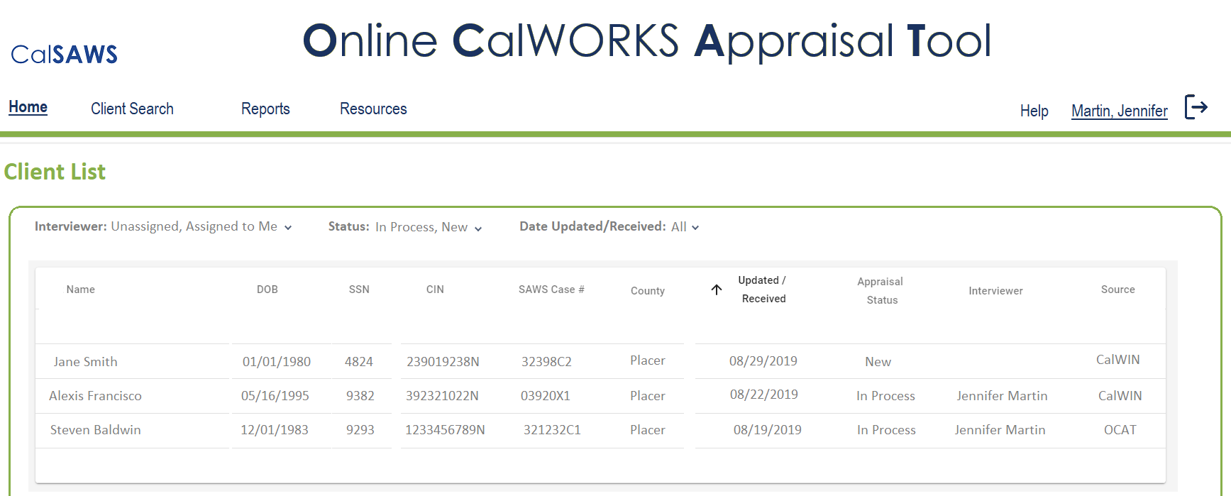
OCAT Design (Tentative)
Home Page Example
Notes:
The CalSAWS Business Architecture was approved by the Consortium. The final requirement will be captured in the upcoming LRS Documentation updates.
We will monitor updates to the LRS Documentation toward the mitigation of Risk 216.

Slide 25
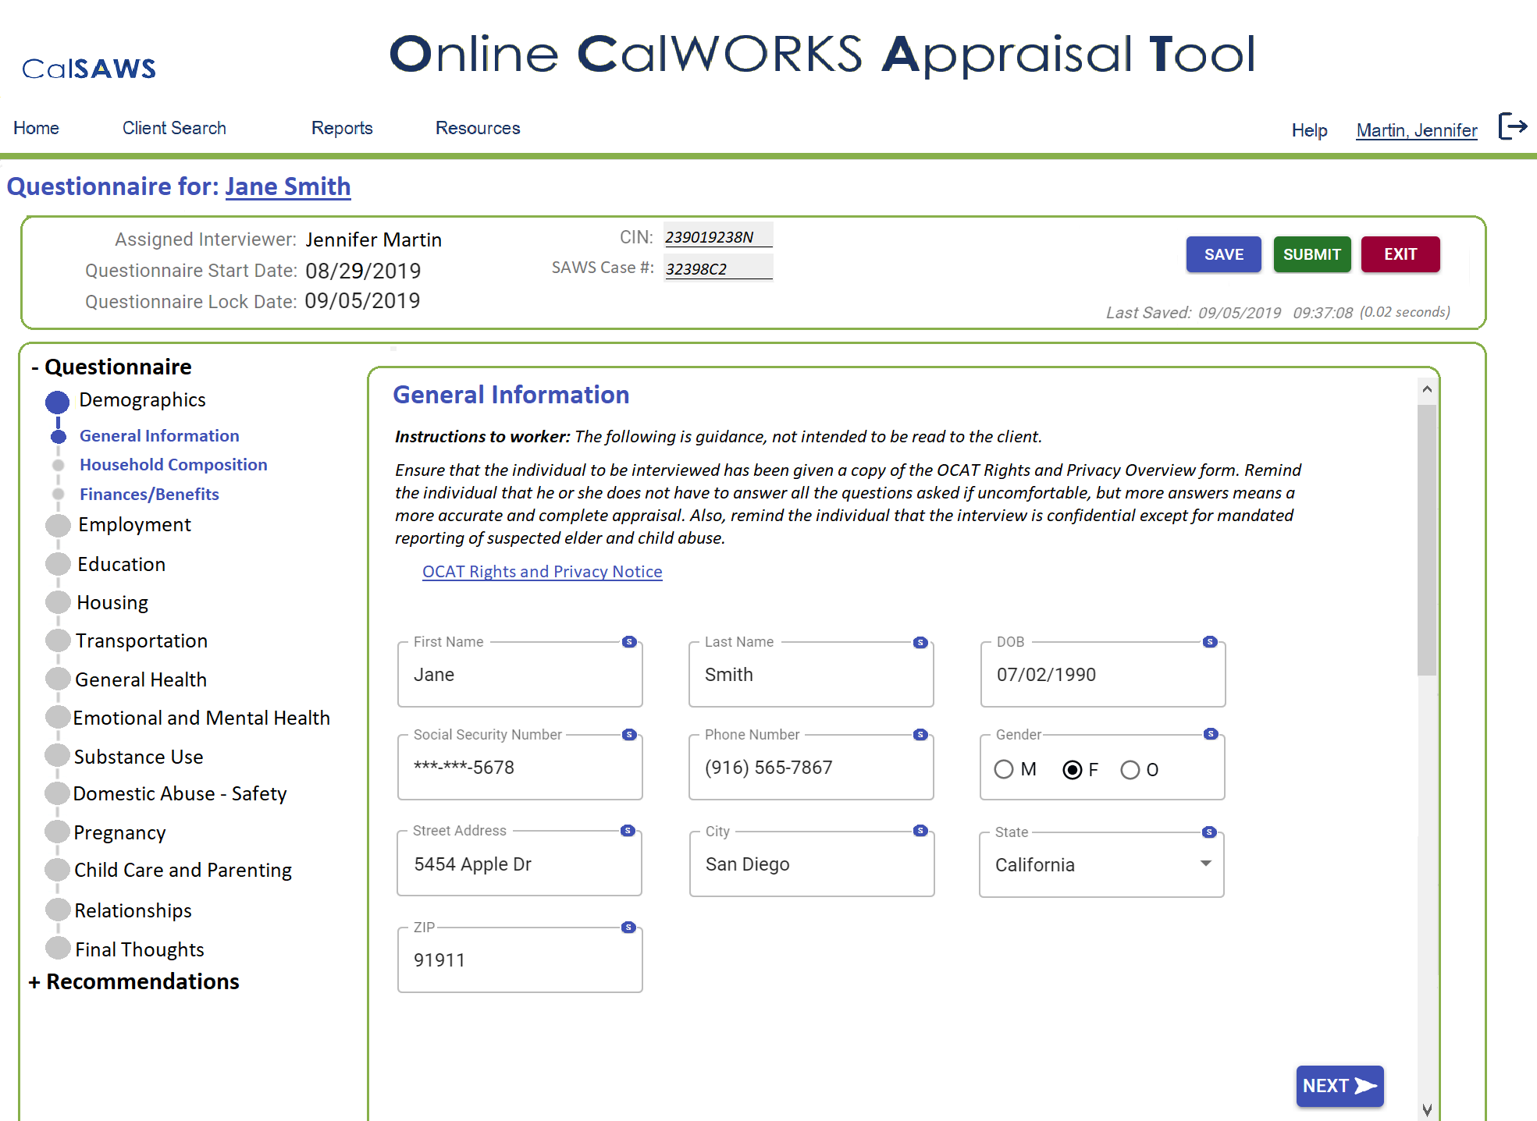
OCAT Design (Tentative)
Questionnaire Example
Notes:
The CalSAWS Business Architecture was approved by the Consortium. The final requirement will be captured in the upcoming LRS Documentation updates.
We will monitor updates to the LRS Documentation toward the mitigation of Risk 216.

Slide 26
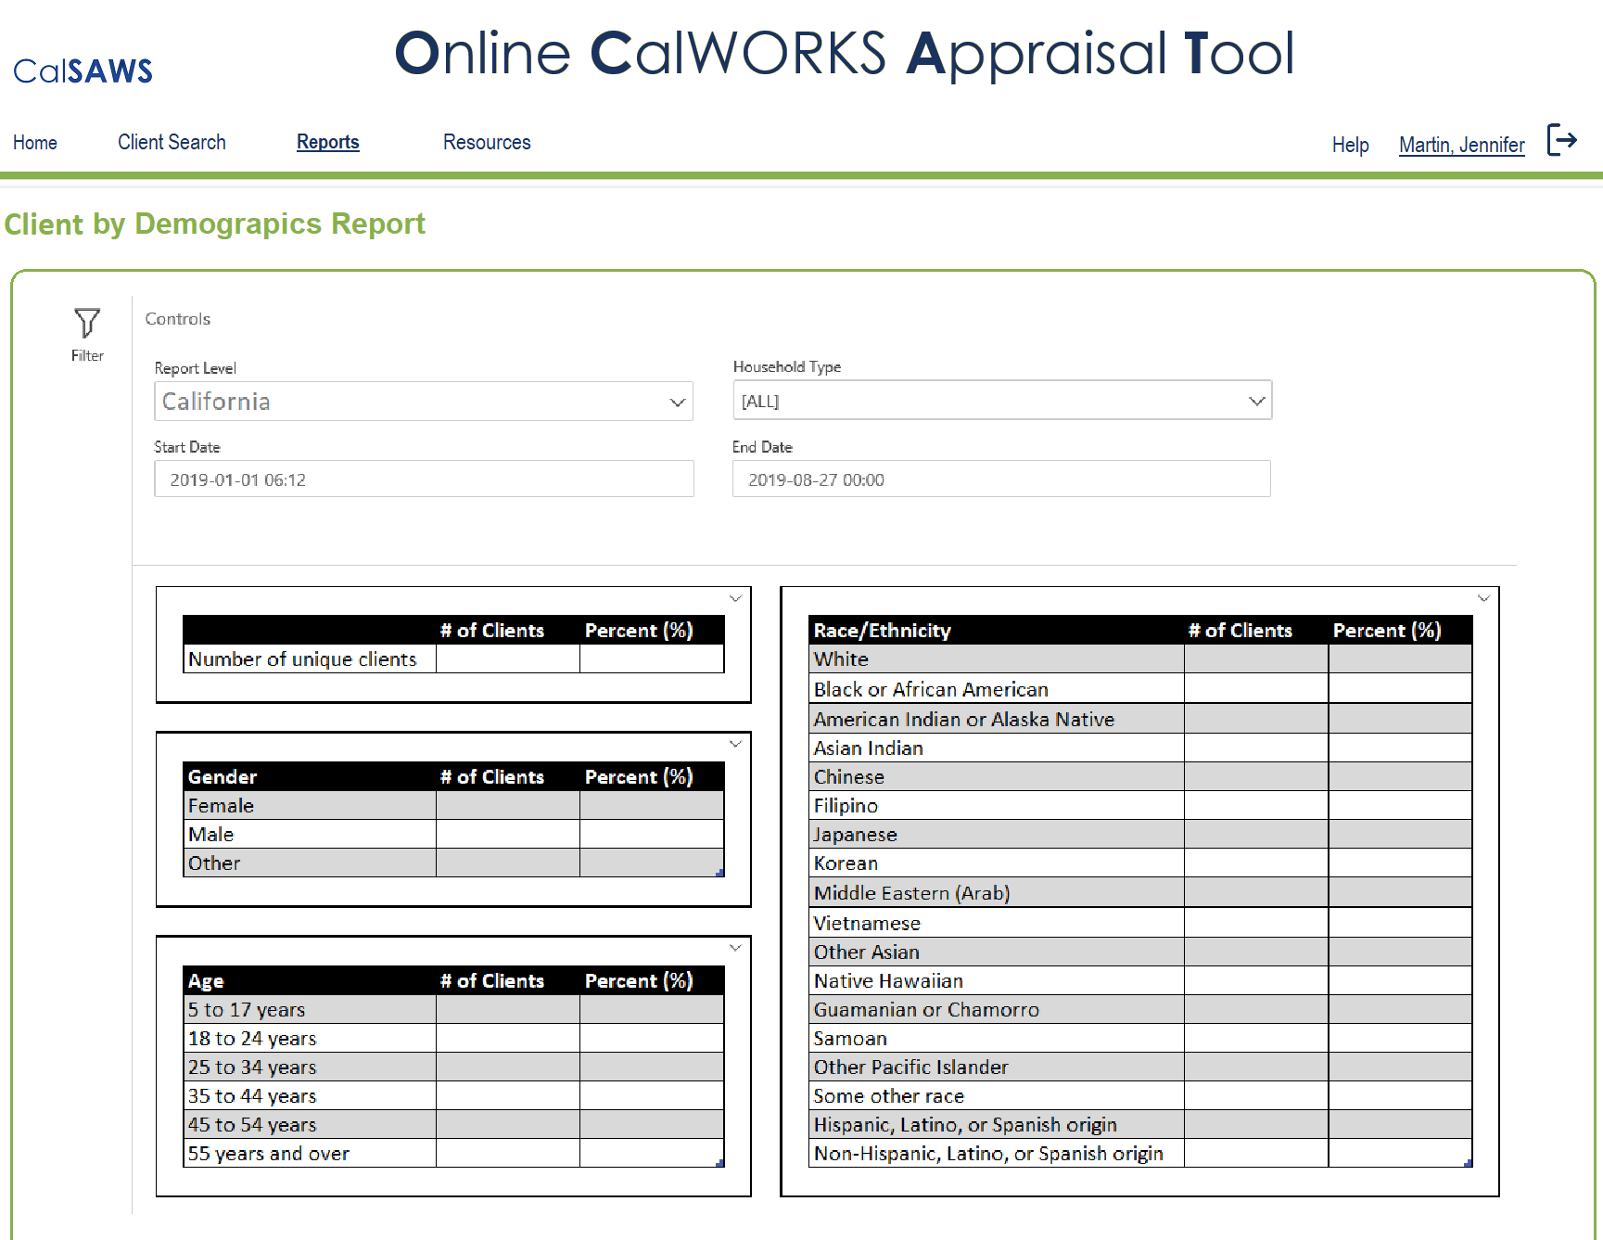
OCAT Design (Tentative)
Report Example
Notes:
The CalSAWS Business Architecture was approved by the Consortium. The final requirement will be captured in the upcoming LRS Documentation updates.
We will monitor updates to the LRS Documentation toward the mitigation of Risk 216.

Slide 27
CalSAWS Data Retention Policy Update

Slide 28
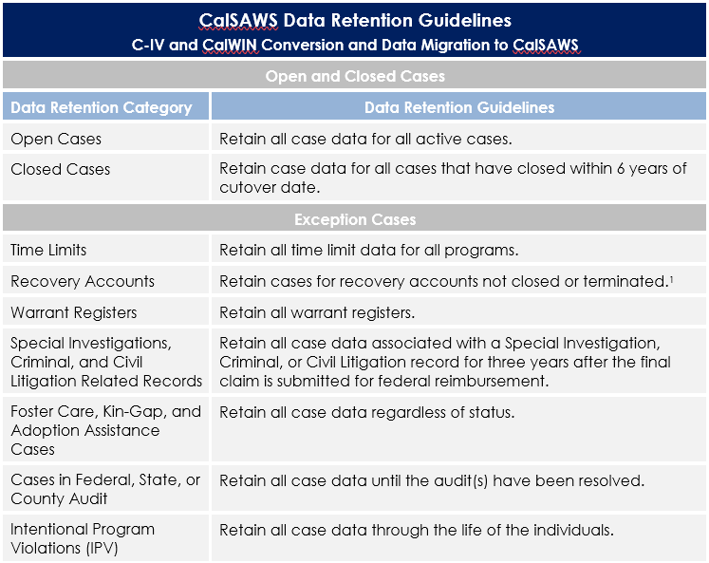
Proposed Data Retention Policy
Seeking, from the CalSAWS Project Steering Committee (PSC) members, the Approval of the CalSAWS Conversion Data Retention Guidelines, listed below and further described in the CalSAWS Data Retention Policy. If Approved, Legacy systems (C-IV and CalWIN) will adhere to these when extracting systems data for the Conversion team purposes of migrating systems data to CalSAWS.

Slide 29
Proposed Data Retention Policy
Federal and State Regulatory Compliance Check/Traceability
The guidelines, in the slide above, have been referenced to and compliant with the Federal and State Regulations documented below as of August 2019.
Federal and State Regulatory Compliance Check/Traceability:
  Federal Law (45 CFR 164.528)
  Federal law (45 CFR 75.361)
  Federal law (45 CFR Section 164.316)
  Welfare and Institutions (W&I) Code, Section 10851 (a)
  CDSS Manual of Policies and Procedures (MPP), Operations Section 23-353.6
  All County Letter (ACL) No. 15-26
  All County Letter (ACL) No. 11-23
  All County Letter (ACL) No. 11-08
  All County Letter (ACL) No. 11-15
  All County Welfare Directors Letter (ACWDL) No. 07-13
  MEDI-CAL ELIGIBILITY PROCEDURES MANUAL, Section 2G

Slide 30
M&O Application and Operations Update

Slide 31
Policy Update
Foster Care/Kin-GAP California Necessities Index (CNI)
Policy Effective Date & State Letter Reference | C-IV/LRS Status | CalWIN Status | Implementation Details
7/1/2019 ACL 19-70 | SCR CIV-100485/CA-206310 Implemented Release 9/7/19 SCR CIV-103141/CA-206317 System Test Release 9/7/19 | PPM #51505 Implemented 7/8/19 | ACL 19-70 introduced a 4.15% California Necessities Index (CNI), which adjusted the rates related to the Kinship Guardianship Assistance Payment Program (Kin-GAP)and Foster Family Agencies (FFAs) placements. CalSAWS Update: Update the FC and KG rate values in C-IV and LRS. Run batch EDBC on the impacted FC and KG cases on 9/7/19. C-IV System downtime is not required. E-mail notification will be sent to the counties on Monday 9/9/19 after the list of cases not processed by batch is posted to the web portal. Batch EDBC memorandum call with the counites was held on 8/28/19. The batch EDBC memorandum provides details on the batch EDBC process, timeline, and county action for cases not processed by batch EDBC. CalSAWS County Business Impact: Manually process the cases not processed by the batch EDBC. CalWIN Update: Updated FC and Kin-Gap rate values COLA process run on 7/7 and 7/8 to update value. CalWIN County Business Process Impact: Manual process cases not authorized during COLA batch run.

Slide 32
Policy Update
CalWORKs Maximum Aid Payment (MAP) Increase
Policy Effective Date & State Letter Reference | C-IV/LRS Status | CalWIN Status | Implementation Details
10/1/2019 ACL 19-73 | SCRs CIV-103092; CA-206231 Implemented Release 19.07 priority on 8/15/19 SCRs CIV-103090; CA-206229 System Test Release 19.07 priority on 9/14/19 SCRs CIV-104521; CA-209326 Implemented Release 19.07 Priority on 8/15/19 | PPM #51852- Design COLA run 9/2/19 PPM #52240- Implemented 8/20/19 | The MAP increase applies to all CalWORKs cases, regardless of whether the Assistance Unit (AU) lives in Region One or Region Two and regardless of the AU’s Exempt or Non-Exempt status. The counties are to treat the grant increase as a mandatory county-initiated mid-period action for Semi Annual Reporting (SAR) and Annual Reporting/Child Only (AR/CO) cases. CalSAWS Updates: Sent the mail mass mailer to all active CW recipients on 8/14/19. Updated the CW MAP values and added the new MAP increase Notice of Action fragment which were implemented on 8/15/19. Run batch EDBC on the impacted CW and CF cases on 9/14/19. CIV System downtime is required. System downtime notification was sent to the counties on 8/9/19. E-mail notification will be sent to the counties on Monday 9/16/19 after the list of cases not processed by batch is posted to the web portal. Batch EDBC memorandum call with the counites was held on 8/28/19. The batch EDBC memorandum provides details on the batch EDBC process, timeline, and county action for cases not processed by batch EDBC. CalSAWS County Business Impact: Manually process the cases not processed in the batch EDBC -Continued on Next Slide-

Slide 33
Policy Update
CalWORKs Maximum Aid Payment (MAP) Increase
Policy Effective Date & State Letter Reference | C-IV/LRS Status | CalWIN Status | Implementation Details
10/1/2019 ACL 19-73 | SCRs CIV-103092; CA-206231 Implemented Release 19.07 priority on 8/15/19 SCRs CIV-103090; CA-206229 System Test Release 19.07 priority on 9/14/19 SCRs CIV-104521; CA-209326 Implemented Release 19.07 Priority on 8/15/19 | PPM #51852- Design COLA run 9/2/19 PPM #52240- Implemented 8/20/19 | CalWIN Update: Sent the mail mass mailer to all active CW recipients 8/20/2019. Update the CW MAP values and add the new MAP increase Notice of Action text. Run batch EDBC on the impacted CW and CF cases on 9/2/19. Counties informed of TEMP2250 mass mailing via county information transmittal, CIT #08-4417 Counties will be informed of the MAP increase update the week prior to 9/2/19 via county Information transmittal that includes instructions to review list of cases that were not authorized in batch. Conference call with counties pre- and post-batch run CalWIN County Business Process Impact: Manually process the cases not processed in the batch EDBC

Slide 34
Policy Update
CalFresh Cost of Living Increase
Policy Effective Date & State Policy Reference | C-IV/LRS Status | CalWIN Status | Implementation Details
6/1/2019 ACIN I-54-19 | SCR CIV-100442/CA-58614 Implemented on 8/23/19 SCRs CIV-103090; CA-206229 System Test Release 19.07 Priority on 9/14/19 | PPM #51853 Scheduled 9/9/2019 | The United States Department of Agriculture, Food and Nutrition Service (FNS) has issued the Federal Fiscal Year (FFY) 2020 Cost-of-Living Adjustments (COLAs) for the period of 10/1/19, through 9/30/20. This update also includes the new Standard Utility Allowance (SUA), Limited Utility Allowance (LUA), and Telephone Utility Allowance (TUA) amounts. CalSAWS Update: Update the C-IV and LRS with the applicable CalFresh (CF) values Update the applicable values on C4Y and YBN Update the C-IV System COLA NOA. The LRS NOA remains unchanged Run batch EDBC on the impacted CW and CF cases on 9/14/19. C-IV System downtime is required. System downtime notification was sent to the counties on 8/9/19. E-mail notification will be sent to the counties on Monday 9/16/19 after the list of cases not processed by batch is posted to the web portal. Batch EDBC memorandum call with the counites was held on 8/28/19. The batch EDBC memorandum provides details on the batch EDBC process, timeline, and county action for cases not processed by batch EDBC CalSAWS County Business Impact: Manually process the cases not processed in the batch EDBC -Continued on Next Slide-

Slide 35
Policy Update
CalFresh Cost of Living Increase
Policy Effective Date & State Policy Reference | C-IV/LRS Status | CalWIN Status | Implementation Details
6/1/2019 ACIN I-54-19 | SCR CIV-100442/CA-58614 Implemented on 8/23/19 SCRs CIV-103090; CA-206229 System Test Release 19.07 Priority on 9/14/19 | PPM #51853 Scheduled 9/9/2019 | CalWIN Update: COLA batch process to run September 7 and 8. Update CalFresh allotment tables and deductions. CalWIN County Business Impact Manually process the cases not processed during the COLA batch run.

Slide 36
Policy Update
Able-Bodied Adults Without Dependents (ABAWD)
Policy Effective Date & State Policy Reference | C-IV/LRS Status | CalWIN Status | Implementation Details
1/1/2017 Fixed Clock 8/31/2019 Waiver Expires ACIN I-11-16 ACIN I-88-16 ACL 18-08 ABAWD Handbook | SCRs CIV-7215; CA-57971 Phase II System Test Release 19.09 | PPM #46539- Implemented 8/2018 PPM #47411- Implemented 8/2018 PPM #52324- Review TBD PPM #51360 Implemented Aug 12, 2019 PPM #52397 Design R60 (2/20) | ABAWD implementation began in September 2018 for San Francisco, San Mateo, and Santa Clara. The remaining counties are on waiver until 8/31/2019. In September, CDSS submitted another ABAWD waiver request to FNS for the time period 9/1/2018-8/31/2019. If the waiver is approved, three additional counties (Alameda, Contra Costa, and Marin) will be required to implement the ABAWD policy effective September 2019. The ABAWD Handbook version 2.0 draft was sent to the counties for review on 7/1/19. CalSAWS Update: Marin County staff will attend an ABAWD functionality demo and click through at the CalSAWS North location on 8/12/19. A CIV functional presentation is being created for the changes being introduced in the September release. Phase II changes include the following: Updates to ABAWD exemption logic Updates to Count persons as ABAWD in a partial month Provide a manual way for case workers to indicate whether the ABAWD work requirement was met Add a task and batch EDBC closure for ABAWD that does not meet work requirement and has no other exemption, good cause, etc. Provide a way to track whether an ABAWD regained eligibility by meeting the work requirement -Continued on Next Slide-

Slide 37
Policy Update
Able-Bodied Adults Without Dependents (ABAWD)
Policy Effective Date & State Policy Reference | C-IV/LRS Status | CalWIN Status | Implementation Details
1/1/2017 Fixed Clock 8/31/2019 Waiver Expires ACIN I-11-16 ACIN I-88-16 ACL 18-08 ABAWD Handbook | SCRs CIV-7215; CA-57971 Phase II System Test Release 19.09 | PPM #46539- Implemented 8/2018 PPM #47411- Implemented 8/2018 PPM #52324 Review TBD PPM #51360 Implemented Aug 12, 2019 PPM #52397 Design R60 (2/20) | Add new ABAWD MEDS codes, calendar, and transactions Updates to Time Limit data collection pages New NOAs and forms Update the Stat 47 report CalSAWS County Business Impact: Train staff on changes to system functionality. CalWIN Update: •Modify CalWIN to turn off the ABAWD Waiver functionality for Alameda and Contra Costa as of 9/1/2019. •Suppress the FX60 transactions until new criteria for starting the ABAWD time clock is programmed. •Modify CalWIN to start the ABAWD time clock for non-exempt ABAWD individuals. Run special job to re-transmit FX20 and FX60 MEDS transactions once change is implemented. CalWIN County Business Impact Counties will not have ABAWD information in MEDS when FX60 is suppressed. Receiving ABAWD counties will have to obtain Countable/Consecutive clock information from sending counties for ICTs.

Slide 38
Policy Update
Medi-Cal Expansion for Young Adults
Policy Effective Date & State Policy Reference | C-IV/LRS Status | CalWIN Status | Implementation Details
1/1/2020 Draft ACWDL Received on 6/7/19 Draft NOAs Received on 7/1/19 | SCRs CIV-103662; CA-206941 System Test Release 19.09 SCRs CIV-104022; CA-208241 Build Release 19.09 SCRs CIV-103874; CA-207950 Committee Review Release 19.11 Priority | PPM #51191- Phase 1 Design R58B (9/19) PPM #51703- Phase 2 Design R59 (11/19) | Building upon SB 75 the Governors budget proposes to expand full-scope Medi-Cal coverage to eligible young adults aged 19 through 25 regardless of immigration status, starting no sooner than 7/1/19. However, DHCS proposed a 1/1/20 effective date. CalHEERS eHIT changes for this policy are scheduled for implementation on 9/23/19 (19.9 release). CalSAWS Updates: Notice of action changes Aid code rule changes to account for the increased age limit Update existing monthly batch process Run batch EDBC for the impacted Medi-Cal cases -Continued on Next Slide-

Slide 39
Policy Update
Medi-Cal Expansion for Young Adults
Policy Effective Date & State Policy Reference | C-IV/LRS Status | CalWIN Status | Implementation Details
1/1/2020 Draft ACWDL Received on 6/7/19 Draft NOAs Received on 7/1/19 | SCRs CIV-103662; CA-206941 System Test Release 19.09 SCRs CIV-104022; CA-208241 Build Release 19.09 SCRs CIV-103874; CA-207950 Committee Review Release 19.11 Priority | PPM #51191- Phase 1 Design R58B (9/19) PPM #51703- Phase 2 Design R59 (11/19) | The effort to turn on young adult expansion eHIT functionality and process a one-time batch EDBC run is tentatively scheduled for mid November. Batch EDBC memorandum call with the counites will be scheduled for early November. The batch EDBC memorandum provides details on the batch EDBC process, timeline, and county action for cases not processed by batch EDBC. The on-going monthly batch process will re-evaluate individuals for Medi-Cal due to aging out of young adult expansion aid codes. The first time this batch needs to run will be in January 2020 for February 2020 benefit month. CalSAWS County Business Impact: Train staff on changes to system functionality Manually process the cases not processed in the batch EDBC -Continued on Next Slide-

Slide 40
Policy Update
Medi-Cal Expansion for Young Adults
Policy Effective Date & State Policy Reference | C-IV/LRS Status | CalWIN Status | Implementation Details
1/1/2020 Draft ACWDL Received on 6/7/19 Draft NOAs Received on 7/1/19 | SCRs CIV-103662; CA-206941 System Test Release 19.09 SCRs CIV-104022; CA-208241 Build Release 19.09 SCRs CIV-103874; CA-207950 Committee Review Release 19.11 Priority | PPM #51191- Phase 1 Design R58B (9/19) PPM #51703- Phase 2 Design R59 (11/19) | CalWIN Update: Phase 1: Notice of action changes Aid code rule changes to account for the increased age limit Batch triggers inserted for applicable cases for 1/2020 effective date Phase 2: Batch EDBC run will be scheduled for early November to identify individuals meeting the new criteria and grant full scope eligibility. Notice of Action snippets for Non-MAGI, such as MC 239P, MC 239Q and MC 239S CalWIN County Business Impact Exception lists will be provided for county action for cases not processed by the batch run.

Slide 41
Readiness for CalSAWS Cloud Migration in R6 on 10/15/19

Slide 42
Pathway to Green Light
Quality Assurance (QA) Teams to facilitate* Green Light Meeting and predecessor activities
Project Integrated Readiness Status:
Weekly Meetings
Stakeholder Green Light Orientations:
Green Light Process 101, Declaration of Roles and Responsibilities
Pre-Green Light:
Readiness Status
Green Light:
No surprises; Obtain Go/No-Go Decision
*Note: QA, Consortium, and Accenture collaborate to Achieve Green Light

Slide 43

On the Path to Green Light
Points of Readiness
Thursday, August 15, 2019
PSC Presentation on Cloud Exit Criteria
Begin Project Integrated Readiness Status Meetings
Tuesday, September 10, 2019
(Weekly)
Regional Manager Green Light Orientation
Monday, September 16, 2019
Wednesday, September 18, 2019
LA County Representatives Green Light Orientation
Monday, September 23, 2019
State Representatives Green Light Orientation

Slide 44
On the Path to Green Light
Points of Readiness & Approval
Wednesday, October 2, 2019
Pre-Green Light Meeting
Green Light Meeting
Wednesday, October 9, 2019
Final Pre-Deployment Green Light Approval
Friday, October 11, 2019
Saturday, October 12, 2019
Deployment Activities – Primary Assessment
Sunday, October 13, 2019
Deployment Activities – Secondary Assessment

Slide 45

Green Light
Inputs and Approvals
Quality Assurance (QA) Teams to facilitate Pre-Green Light and Green Light Meetings with the following inputs:
Pass rates per SCR
Integrated Readiness: Exit Criteria Met for all Test Phases, County, Interface Partner, and Operational Readiness Confirmed, Cutover Plan, etc.
Approval
Deployment Checklist and Schedule

Slide 46





Cutover to AWS
Deployment Checklist & Communication Activities
The deployment checklist and schedule incorporates detailed pre-deployment, cutover, and post-implementation activities and timings
Cutover Schedule
Communication Activities
Interface Partner Connectivity Touchpoints
PSC Presentation on Cloud Exit Criteria
AWS LA County User Confirmation Planning Touchpoints
AWS LA County User Confirmation
LRS to AWS Go-Live Broadcast to all LRS users
Stakeholder Green Light Orientations
Pre-Green Light and Green Light Meetings for Integrated Readiness
Planned Outage Broadcast to all LRS Users
Post Go-Live Daily Executive Checkpoint Calls with R6 Regional Managers, R6 PPOCs, LA County Executives, CalSAWS Project Executives
Post Go-Live LA County Office Visit
Communications
Hour by Hour Execution Plan
Cutover / Fallback Procedures
Rapid Response Team

Slide 47
Functional Design Sessions
Imaging Assessment
Task Management Update
Non State Forms Update
GA/GR Update
APIs Update
Functional Design Sessions Roadmap

Slide 48
Recap – Findings from CalSAWS Migration Planning Assessment
County | Scanning Software | Document Management Software
SCL | Kofax | FileNet
VEN | Kofax | FileNet with IBM ECM,ECM QC Drive
ALA | Ricoh WebFiles / Disc Image | Ricoh WebFiles / Disc Image
SFO | Kofax | iFiles
CCS | Compass Pilot | Compass Pilot
FRS | Upfront scanning ,Kofax | FileNet with IBM ECM
ORG | Barcode Business Solutions (BBS) | OnBase
SCZ | Kofax Suite, Barcode scanners | DocuWare
SAC | Kofax | FileNet
SDG | eReceipt Tool, EMC Captiva | Documentum
SON | Kofax | OnBase
PLA | Kofax | OnBase
TUL | Kofax | Form 61 Generation Tool, Questys
SMT | Compass (Imaging) | OnBase
SOL | Compass (Imaging) | OnBase
SLO | Kofax | EDMS
YOL | Compass Pilot | Compass Pilot
SBR | DocStar | DocStar
LA | Kofax | Documentum
C-IV counties | Perceptive | Perceptive
Variety of solutions used across counties:
  10 distinct document management products (e.g., IBM FileNet P8, Northwoods Compass Pilot, Perceptive, Documentum)
  7 scanning products (e.g., Kofax, Northwoods Compass Pilot, Perceptive)
CalWIN counties

Slide 49
Recap – Alternatives Analysis from Planning Assessment
Emerging alternative
Maintain current system
Use centralized
LRS model
Use enhanced centralized solution
Considerations
Worker experience
Minimal change to worker experience
Counties that have innovations would lose it¹
Innovations and core integration create uplift for all 58 counties
  Enhanced Centralized solution based on the LA County model was identified as emerging alternative for CalSAWS
  58 requirements were identified for imaging; 37 were base requirements, and 21 requirements represented uplift
Technical feasibility
Images must be re-indexed by new IDs of cases and clients
One centrally maintained and managed solution integrated with core
One centrally maintained and managed solution integrated with core
Cross-department imaging
Access would continue as today
Counties could lose cross-dept. imaging
New solution would bring cross-dept. imaging to all counties
Local control and ability to innovate
Counties continue to maintain, administer, and develop innovations
Updates and innovations through centralized mechanism
Updates and innovations through centralized mechanism
Cost
Expensive ongoing cost, up-front integration cost
Cost reduction in long run, up-front data migration cost
Cost reduction in long run, up-front data migration and enhancement cost
1 Does not apply to LRS and C-IV and only applies to some CalWIN counties

Slide 50
Key Activities Since CalSAWS Migration Planning Assessment
Details
Functional Design Sessions
  Conducted sessions to finalize requirements where:
    31 out of 58 original requirements from planning were refined into 20 final requirements
    Remaining 27 requirements from planning were either determined not applicable or addressed by other ancillary systems or core CalSAWS
  Solutions proposed from vendors meet the requirements for imaging
  Vendor cost estimates are different than estimated during planning phase
  An option for a SaaS-based solution was proposed that would provide scanning and image management capabilities as a service
Vendor Responses
  Received vendors responses to satisfy the requirements, which included:
    Vendors ability to meet requirements
    Cost estimates to deliver solution

Slide 51
Results of the Assessment
Does the proposed solution deliver on the original scope, and expectations of last year’s assessment?
Yes – while some requirements have been consolidated or are being addressed in the core CalSAWS or other ancillary systems, the proposed solution is in line with the expectations of the planning assessment (i.e., enhanced centralized solution)
Does the proposed solution align in terms of cost with the original estimates, for both DD&I and M&O?
Yes – based on estimates provided, the cost structure of the proposed solution is better than what was estimated at the time of the planning assessment due to a combination of product bundling, new product components available in the cloud and revised pricing s
Does the solution align with the consortium strategy (e.g., cloud solution, reduced SI dependence)?
Yes – the enhanced centralized solution leveraging an end-to-end SaaS solution is aligned with CalSAWS strategy (i.e., leveraging a cloud based solution, reducing dependence on SI, standardization and uplift of all counties)

Slide 52
Functional Design Sessions
Task Management
The Task management Functional Design Sessions were executed to further define the scope of requirements for the Design and Development phase of the CalSAWS Migration Project.
Task Management Functional Design Sessions Completed:
June 26th Webinar with Imaging in-person Group
July 8 – July 18 in-person sessions
July 19-August 19th analyze and finalize requirements
August 20th Webinar with participants to confirm requirements
Task Management / Imaging Webinar
Task Management Sessions
Task Management Session Analysis
Complete Scope of Work / Estimate
Confirm Requirements with Group
2019
Jun
July
Aug
Sept
Oct
Today

Slide 53
Functional Design Sessions
Task Management
Task requirements were updated to reflect business needs as noted by participants
Create Tasks
Manual Task Creation
Automated Actions
Image Based Tasks
Other Task Creation Methods
Work Tasks
My Tasks and Task Search Pages
Worklist Pages
Get Next Button
Assign Tasks
Program Worker
Worker Schedule
Office Distribution
Task Banks
Oversee Tasks
Task Reports
  On Request
  Extracts
Dashboard
Subscription
Quality Sampling
Reassign Tasks
Manual Reassignment
Bulk Reassignment
Program Reassignment

Slide 54
Functional Design Sessions
Task Management
Functionality – Create Tasks
Updated bulk upload requirement with additional details and a confirmation flow Added templates to the jail match and death match requirement Consolidated document based task creation requirements Updated Error Prone and High Risk task requirement Added requirement for additional MEDS alert-based tasks Added requirement to allow for voiding a bulk task upload Added requirement to allow for referral based tasks
Functionality – Assign Tasks
Updated requirement for task distribution based on worker schedule Added requirement to factor in additional thresholds for task assignment, such as language, classification, etc. Added requirement to build in a start date for tasks Added requirement to route images based on program and program status

Slide 55
Functional Design Sessions
Task Management
Functionality – Reassign Tasks
Updated task bundling requirement to be configurable Updated worker assignment preview requirement to include more details
Functionality – Work Tasks
Updated task expedite requirement (formerly referred to as task priority) Expanded task search criteria Updated view images button requirement to display relevant images Updated workflow requirements to include action steps for a task, plus the ability to link tasks together Updated task subscription requirement with more detail Added a requirement to re-open a previously closed task
Functionality – Oversee Tasks
Updated requirement for report to show tasks and appointments assigned to unavailable staff Updated task sampling requirement

Slide 56
Functional Design Sessions
Non-State Forms
Non State Forms Functional Design Sessions Completed:
July 8 – August 22.
Weekly In-person sessions based on functional area. Approximately 70 county staff across the six regions participated each week
Requirements for each form were approved by visual majority
Any outliers were referred to committees for discussion/approval
Great participation from counties!
Complete Scope of Work / Estimate
Non State Form Sessions
2019
Jun
July
Aug
Sept
Oct
Today

Slide 57
Functional Design Sessions
Non-State Forms
Overview
  Overarching goal was to develop one set of Non-State Forms for all 58 counties where possible
  Reviewed 246 most frequently generated Non-State Forms across the three SAWS Systems. Forms were mapped across the three systems e.g. New Worker Letter, Appointment Letter
  Agreed to retain 161 forms with the overarching agreement to use a single Non-State Form where similar forms existed across the three SAWS Systems

Slide 58
Functional Design Sessions
GA/GR
GA/GR Functional Design Sessions Completed:
June 24-27 in-person session
July 22-24 in-person session
August 15 requirements validation webinar
Review and Analysis of feedback
Complete Scope of Work / Estimate
GA GR
Session
GA GR Session
Confirm Requirements with Group
2019
Jun
July
Aug
Sept
Oct
Today

Slide 59
Functional Design Sessions
GA/GR
Overview
  Existing LA County GR functionality will continue to be unchanged and part of CalSAWS
  Leveraging existing Consortia assets and solutions, where possible
    Existing CalWIN rules and client correspondence
    Existing C-IV managed GA program functionality
  Add functionality to support existing 57 Counties GA/GR programs, including data collection, eligibility rules where appropriate, fiscal processing, periodic reporting, and employment services programs

Slide 60
Functional Design Sessions
APIs
APIs Functional Design Sessions Completed:
July 30-August 1 in-person session
August 29 requirements validation webinar
Functional Design Session
Confirm Requirements
with Group
Complete Scope of Work / Estimate
2019
Jun
July
Aug
Sept
Oct
Today

Slide 61
Functional Design Sessions
APIs
Long Term Goal is to provide access to CalSAWS data via APIs
Full integration of the APIs will be a phased approach
Initial Data Access will be provided via APIs for targeted needs and supplemented with the EDR solution
Initial API implementation will focus on near real-time needs for:
  Lobby Management
  Appointments
  Worker Schedule
  Employment Services
  Program and Person Information
  Other needs
EDR is a copy of the production schema that is refreshed on a nightly basis and made available within the CalSAWS cloud infrastructure
Counties will continue to be provided access to read-only schemas for ad-hoc reporting
Jun
July
Aug
Sept
Oct

Slide 62
Functional Design Sessions
APIs
APIs will provide counties access to near real-time data (based on needs) for specific needs as business domain objects or as raw data
APIs will be REST (vs SOAP or ODBC) based
APIs will be read/write depending on business need
Could Support multi-format (JSON,XML, text)
One unified API for all integrations
  Consistent developer experience
  Single security model
  Single API gateway for auditing/governance
Jun
July
Aug
Sept
Oct

Slide 63
Functional Design Sessions - Roadmap

Slide 64
Procurement Update
Portal/Mobile RFP timeline
CalWIN OCM & Training RFP timeline

Slide 65
CalSAWS Statewide Portal/Mobile Application
Strategy, Scope and Timeline
Strategy
  Conduct an open procurement to acquire vendor services to develop and implement statewide portal and mobile applications
  The new portal is a critical component of the overall SAWS migration
Scope and Objectives
  Achieve the policy and business outcomes in a dynamic, intuitive, user friendly manner based on a robust User Centered Design process to provide the best user experience possible within the existing policy framework.
  Engage stakeholders, advocates and clients in the design, development and test tasks through the UCD and test processes.
  Enhance the user interface and quality of the user experience to improve program outcomes; capture, analyze and apply data about how all users are interacting with the system with the goal of continuous improvement.
  Leverage existing SAWS Portal/Mobile and CalHEERS applications/ architectures to develop an updated Portal/Mobile solution.
  At a minimum, experience no loss of functionality of the existing baseline portal/mobile applications in use today.
  Establish a framework to streamline maintenance through configurability, expedite implementation of future changes and facilitate future program, practice and technology innovation.
  Multiple RFP and requirements reviews during July, August and September.

Slide 66
CalSAWS Statewide Portal/Mobile Application
Strategy, Scope and Timeline
Procurement Event | Date
State RFP Review | August 6 – 14, 2019
Update RFP Based on Reviews | August 15 – 19, 2019
Prepare for and Conduct Follow-up Meeting with State Sponsors | August 14 – 23, 2019
Update RFP Based on meeting with State Sponsors | August 26 – September 4, 2019
Final State Sponsor Review | September 5 – 11, 2019
Prepare for and Conduct follow up meeting with State Sponsors and Advocate Community | September 12 – 18, 2019
Final Revisions to RFP Based on State and Stakeholder Feedback | September 19 – 23, 2019
Federal RFP Review and Approval | September 24 – November 1, 2019
Update RFP based on Federal Review & Vendor Feedback | November 4 –5, 2019
Release of RFP | November 6, 2019
Vendor Proposal Due Date | January 22, 2020
Evaluate Proposals and Prepare Vendor Selection Report | January 23 – April 22, 2020
Contract Negotiations | April 27 – May 6, 2020
State, Federal and JPA BOD Approval of Agreement | May 7 – August 7, 2020
Start Date of Statewide Portal/Mobile App Vendor | August 10, 2020
Portal/Mobile App Cutover | September 2021
Timeline

Slide 67
CalWIN OCM and Training
Strategy, Scope and Timeline
Strategy
  Conduct an open procurement to acquire vendor services to provide Training, OCM and Implementation Support for the 18 CalWIN counties.
  CalWIN to CalSAWS migration is expected in 6 waves beginning January 2022 and continuing through January 2023
  CalWIN to CalSAWS migration must address multiple combinations of ancillary systems and business processes.
Scope and Objectives
  Leverage existing CalSAWS materials and lessons learned to support the migration of the CalWIN Counties to CalSAWS.
  Support the assessment of “As Is” CalWIN models and develop the plan to attain “To Be” model in CalSAWS.
  Develop and deliver Re-engineered Business Processes, Training, OCM and Implementation Support that includes County specific Plans.
  Include CalWIN County and State sponsor participation in RFP requirements development and reviews.

Slide 68
CalWIN OCM and Training
Strategy, Scope and Timeline
Timeline
Procurement Event | Date
County, Consortium and State Requirements Review | August 7 – 15, 2019
Update Requirements Based on Feedback | August 16 – 26, 2019
Final Review of Requirements | August 27 – September 3, 2019
County and Consortium RFP Review | September 20 – October 3, 2019
State RFP Review and Approval | September 20 – October 8, 2019
Federal RFP Review and Approval | October 14 – December 13, 2019
Tentative Release of RFP | December 17, 2019
Tentative Proposal Due Date | February 19, 2020
Evaluate Proposals and Prepare Vendor Selection Report | February 20 – May 18, 2020
Contract Negotiations | May 21 – June 4, 2020
State, Federal and JPA BOD Approval of Agreement | June 5 – August 28, 2020
Tentative Start Date of CalWIN Vendor | August 31, 2020

Slide 69
Status of CalSAWS Risks and Issues Reporting

Slide 70


CalSAWS Project High Risks
RISK NAME
201: Pace of Policy Changes may exceed capacity of App-Dev team, resulting in less automation
203: Project communications must be enhanced, otherwise stakeholder / audience needs will not be met
204: Volume of changes to baseline code may cause degradation in quality & increase in defects
104: Functionality Gaps between 3 systems resulting in loss of functionality for counties
DESCRIPTION
There is a risk that the pace of policy changes could exceed the capacity of the Application Development Team during the CalSAWS DD&I Phase. This may result in a reduction of required automation and increased work arounds.
Unless the CalSAWS Project scales up and enhances Project communications, stakeholder needs for timely, tailored, and accurate information, as well as the needs of many diverse audience groups, may not be met.
The volume of changes introduced to the baseline code from LRS M&E, DDCRs, and CalSAWS Migration may cause degradation in quality and increase in defects.
MITIGATION PLAN/
STATUS
One page overview on policy implementation timeline sent to CDSS, OSI, and DHCS to review and provide feedback. CWDA has been making a strong effort to inform the legislature of project timelines.
Launched the CalSAWS.org public facing website on 8/23/2019 and AskCalSAWS integration with ServiceNow. Continued focus on enhanced communication activities for key project milestones.
The project continues to take mitigating steps, such as conducting training with new App Dev staff on testing processes and procedures; increasing the automated testing suite (expand number of scripts and coverage); and involving testers in design reviews.
OWNER(S)
Karen Rapponotti, Lisa Salas, Rocky Givon
Holly Murphy, Lulu Fou
Jo Anne Osborn, Lisa Salas, Dan Dean
Risk Trend
Legend
Remains high
Trending to Issue
Trending to Medium
Trending to Low
Realized into an Issue
Retired Risk

Slide 71
CalSAWS Project High Risks
RISK NAME
205: A Delay of Cloud Enablement would lead to a delay in the implementation of CalSAWS
211: Delay in consolidated portal procurement and implementation may impact C-IV and CalWIN go-live dates
DESCRIPTION
The risk caused by a delay of Cloud Enablement is that the critical path of the project may be affected, leading to a delay in the deployment of the LRS into the AWS Cloud and the implementation of CalSAWS.
If the consolidated portal procurement is not completed timely, the statewide portal may not be implemented in time for the C-IV and CalWIN go-live dates.
MITIGATION PLAN/
STATUS
Accenture, Consortium, and QA resources are developing a detailed readiness checklist, and meet weekly to review, and address any deviations from the plan.
Project met with CDSS, DHCS, and CWDA in late August, and reached consensus on a clear path forward.
OWNER(S)
Laura Chavez, Scot Bailey
Tom Hartman
Risk Trend
Legend
Remains high
Trending to Issue
Trending to Medium
Trending to Low
Realized into an Issue
Retired Risk

Slide 72
Adjourn Meeting

