Slide 1
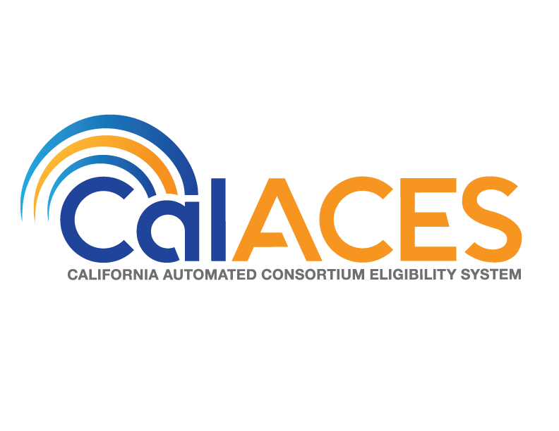
JPA Board of Directors and
Member Representatives Meetings
June 22, 2018

Slide 2
Index
Slide Description | Slide Numbers
Procedural Items for JPA Member Representatives and Board Meetings | 4
JPA Member Representatives Action Items | 5-9
Select/Introduce Representative of the State | 10-11
JPA Board of Directors Action Items | 12-17
LRS Replica to the AWS Cloud Proof of Concept | 18-27
JPA Board of Directors Action Items Continued | 28-29
Annual Audit Findings | 30-31
CalACES/CalSAWS Planning Update | 32-36
CalSAWS Requirements Gathering | 37-42
Overview of CalSAWS Governance and Next Steps | 43-47
M&O Application and Operations Update | 48
SAWS Upcoming Activities | 49
M&O Application and Operations Update Continued | 50-55

Slide 3
Index Continued
Slide Description | Slide Numbers
2018 Conference Planning | 56-57
Public Comment | 58
Adjourn Meeting | 59

Slide 4
Agenda
CalACES JPA Board Chair, Scott Pettygrove, will call the meeting to order.
Scott will provide the Public with an opportunity to speak on items not on the agenda.
CalACES Executive Director, John Boule, will confirm quorum of the CalACES JPA Board of Directors and JPA Member Representatives.

Slide 5
Member Representatives
Action Items

Slide 6
JPA Member Representatives
Action Items
  The CalACES Executive Director will present the nomination slate from the Regional Nomination conference calls, gather any further nominations from the floor, and proceed to elect the JPA Board of Directors for those Regions for the period of July 1, 2018 through June 30, 2019.
  The CalACES Executive Director will introduce the Directors appointed by Regions 2 and 8 for the period of July 1, 2018 through June 30, 2019.

Slide 7
JPA Board of Directors
Nomination Slate
Region 1 Susan von Zabern
Region 3 Sanja Bugay
Region 4 Kathy Harwell
Region 5 Scott Pettygrove
Region 6 Jennifer Vasquez
Region 7 Shelby Boston
Appointments
Region 2 CaSonya Thomas
Region 8 Brandon Nichols
Roxana Molina
Antonia Jimenez
Michael Sylvester

Slide 8
JPA Member Representatives
Action Items
  The CalACES Executive Director will present the nomination slate from the Regional Nomination conference calls, gather any further nominations from the floor, and proceed to elect the Project Steering Committee for those Regions for the period of July 1, 2018 through June 30, 2019.
  The CalACES Executive Director will introduce the Project Steering Committee members appointed by Regions 2 and 8 for the period of July 1, 2018 through June 30, 2019.

Slide 9
Project Steering Committee
Nomination Slate
Region 1 Rocio Aguiniga
Region 3 Cindy Uetz
Region 4 Brian Taing
Region 5 Mary Ellen Arana
Region 6 Erma Thurman
Region 7 Debbie Walsh
Appointments
Region 2 Gilbert Ramos
Region 8 Corey Hanemoto
Winna Crichlow
Luther Evans Jr.
Amy Alvarado

Slide 10
Introduce State Representative
Informational Items

Slide 11
Introduce State Representative
Pursuant to the JPA Agreement Article II, section 2.04 (b) the State shall have the right to select a representative to serve on the Board as the representative of the State.
Introduce Director of OSI, Dan Kalamaras, as the representative of the State

Slide 12
JPA Board of Directors
Action Items Continued

Slide 13
JPA Board of Directors
Action Items
Pursuant to the JPA Agreement, Article III, Section 3.01, the Board of Directors shall elect from among its Directors, a Chair and Vice-Chair.
  Seek nominations and creation of slate for Board of Directors Chair and Vice-Chair for the period July 1, 2018, through June 30, 2019.
  Proceed to elect the Chair and Vice-Chair for the period of July 1, 2018, through June 30, 2019.

Slide 14
JPA Board of Directors
Action Items
Approve the Minutes of the May 24, 2018, JPA Regular Board Meeting

Slide 15
JPA Board of Directors
Action Items
Authorize completion of Signature/Fund Custodian Authorization Form 04-7691-000 required by San Bernardino County Auditor-Controller/Treasurer/Tax Collector for Fiscal Year 2018/19 for the following staff:
  CalACES JPA Chair
  CalACES JPA Vice-Chair
  CalACES Executive Director, John Boule
  CalACES North Project Director, Thomas Hartman
  CalACES North Deputy Director, Karen Rapponotti
  CalACES South Project Director, Hayward Gee
  CalACES South Deputy Director, Dorothy Avila
***For further detail please refer to the agenda and/or executive summary***

Slide 16
JPA Board of Directors
Action Items
Approve Memorandum of Understanding between the California Automated Consortium Eligibility System (CalACES) and California Department of Social Services (CDSS) to provide Supplemental Nutrition Assistance Program (SNAP) recipient data retained by CalACES.

Slide 17
JPA Board of Directors
Action Items
Approve updating the CalACES Legal Services RFP Evaluation Committee by replacing Executive Director, John Boule, and Legal Counsel, Phebe Chu, with two new members.

Slide 18
LRS Replica to the AWS Cloud
Proof of Concept
Informational Items

Slide 19
LRS Replica to the AWS Cloud
Proof of Concept
Background and Goals
Consortium Planning Team selected Amazon Web Services (AWS) as the Cloud provider
  AWS is the market leader for cloud
  AWS has innovative technologies
  AWS is price competitive
  AWS is on the appropriate State procurement lists
  AWS services meet necessary Security standards, such as FedRAMP
Consortium Planning Team provided Accenture with a set of Requirements for the CalACES Cloud Enablement Project - Proof of Concept (“POC”).
  Set up a working replica of LRS production code and data in a non-production AWS Cloud environment (“LRS Replica”)
  Determine through performance testing if the LRS Replica can meet the LRS performance service levels and, if successful, test simulated CalACES (2x) and CalSAWS (3.3x) transaction volumes.
  Determine the time required for the LRS Replica to recover from failures and compare to current SLAs.
  Develop a roadmap for how to scale the AWS Cloud implementation of LRS/CalACES to support CalACES and CalSAWS volumes.
  Target 6 months, beginning July 2018, to conduct POC.

Slide 20
Why Cloud? What if Walmart had elastic parking lots?
LRS Replica to the AWS Cloud
Proof of Concept
Typical Walmart Parking Lot Footprint
750,000 sf
Typical Walmart Retail Footprint
250,000 sf
  11K stores, 27 countries
  1 billion in real estate square footage ($250B replacement value)
  Retail footprint = 1.5x Manhattan, Parking lot footprint = Tampa Florida
  10K car visits per day, per Superstore
  Peak Traffic: Black Friday, Weeks Before/After Xmas

Slide 21
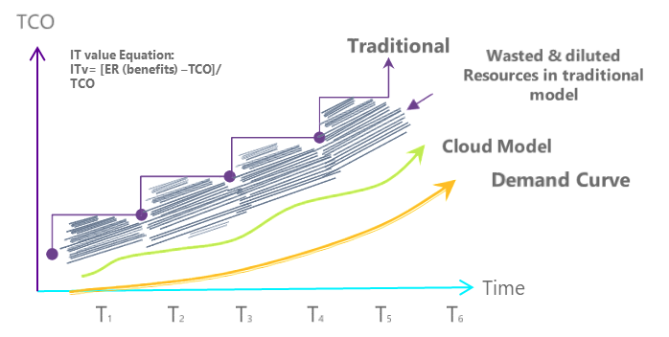
Why Cloud? Pay for usage… not what you think you need
LRS Replica to the AWS Cloud
Proof of Concept
Old Way
New Way
Scalability | Low | Nearly infinite
Elasticity | Low | High
Unit costs | High | Low
Time to value | Weeks to Months | Seconds
Automation | Low | Very High
Technology Standardisation | Low | High
Ability to customise | High | Low
Technology currency | Low - Costly and time consuming | High
Easiness to configure | Low | High
Pricing | Fixed | Consumption based
Contract commitment | Years | Seconds to years (e.g. Reserved Instances)
T&Cs negociability | High | Low
“In cloud, we no longer provision for the peak – we provision for the demand.”

Slide 22
LRS Replica to the AWS Cloud
Proof of Concept
Phased Approach to POC
3.3 times LRS volumes of data and transactions
LRS
2 times LRS volumes of data and transactions
CalACES
CalSAWS

Slide 23
LRS Replica to the AWS Cloud
Proof of Concept
Scope
Initial Setup Phase
Establish connectivity and review security protocols
Setup environment, copy data, document configuration, and Gate Review
Test Phase One (LRS Size)
Enlarge data set to CalACES size for Test Phase Two
Automated (regression) testing using existing tools and manual functional testing
Determine recovery time for the failure of the primary database and a disaster
Test batch window completion time at LRS size and transaction volume (1x)
Use existing LRS performance test scripts for online response times at LRS size and transaction volume (1x)
Gate Review
Test Phase Two (CalACES Size)
Enlarge data set to CalSAWS size for Test Phase Three
Test batch window completion time at CalACES size and transaction volume (2x)
Use existing LRS performance test scripts for online response times at CalACES size and transaction volume (2x)
Gate Review
Test Phase Three (CalSAWS Size)
Test batch window completion time at CalSAWS size and transaction volume (3.3x)
Use existing LRS performance test scripts for online response times at CalSAWS size and transaction volume (3.3x)
Gate Review
Preparation of LRS Application Re-Platform Roadmap Phase
Roadmap containing recommendations to optimize the LRS Application for the AWS Cloud.

Slide 24
LRS Replica to the AWS Cloud
Proof of Concept
POC Outputs
As built documentation:
Technical Architecture Overview
Infrastructure Technical Architecture
Network Technical Architecture and Topology
Database Technical Architecture
Online Performance Test Results in the LRS Monthly Performance Reporting format (as appropriate) at applicable sizes/volumes
Test batch window completion times at applicable sizes/volumes
LRS Application Re-Platform Roadmap
Recommended changes, based on results from prior phases, that may be needed to help optimize performance and availability of the LRS Application Software in the AWS Cloud.
Recommended schedule associated with the proposed changes.
High-level estimate for the effort associated with the proposed changes.

Slide 25
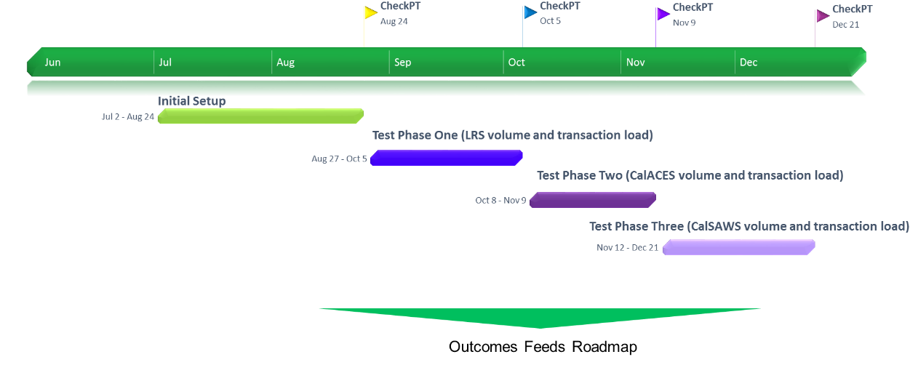
LRS Replica to the AWS Cloud
Proof of Concept
Timeline

Slide 26
LRS Replica to the AWS Cloud
Proof of Concept
AWS and Accenture Team
AWS
Accenture
Database/Storage Specialists
AABG
Accenture
AWS
Business
Group
Database/Storage Specialists
AWS Architecture Expertise
Journey to Cloud Expertise
Experience with State of California
Local Team w/ Deep Skills in LRS
AABG combines the resources, technical expertise and industry knowledge of Accenture and AWS, all through a single team.
Contractor POC Leadership:
CalACES Technology Lead – Scot Bailey
CalACES Cloud Enablement Lead – Luz Esparza
CalACES Cloud Enablement Lead Engineer (AABG) – David Stanton
CalACES Cloud AWS Enablement Lead (AWS) – Malini Saxena
Due to the subject matter experts and higher than normal percentage of senior resources, the blended bill rate for this work is slightly higher than normal.
Over 1,000 hours in the POC estimate are to be performed by AWS.

Slide 27
LRS Replica to the AWS Cloud
Proof of Concept
Costs
Services rate: Blended $200/hour
Skilled and specialized resources
Senior, experienced resources
Relatively small team
In addition to consulting services it is necessary to increase network bandwidth for the POC and the total cost for six months is $13,375, making the total amendment $3,010,575.
The Consortium has separately budgeted for AWS compute resources acquired through the California Department of Technology and some additional software.

Slide 28
JPA Board of Directors
Action Items

Slide 29
JPA Board of Directors
Action Items Contd.
Approve Accenture LRS Amendment No. Ten and authorize the addition of funding to the FY 18/19 CalACES Project Budget
Approve delegation of authority to the CalACES Executive Director to obtain services through the California Department of Technology from Amazon Web Services (AWS) in an amount not to exceed $500,000 to move a replica of LRS to the AWS cloud, subject to review by Legal Counsel.

Slide 30
Annual Audit Findings
Informational Items

Slide 31
Annual Audit Findings
C-IV Year Ending June 2017 Single Audit Report and Financial Statements
- performed by Vavrinek, Trine, Day & Co., LLP
Results: There were no audit findings and the auditors found no instances of non-compliance which could have had a direct and material effect on our financial statement amounts.
They further found that the financial statements “present fairly, in all material respects, the respective financial position of the governmental activities and the general fund,” of the Consortium. The auditors made no recommendations.
These documents are now available on the new CalACES Web Portal (CIT 0023-18).

Slide 32
CalACES/CalSAWS Planning Update
Informational Items

Slide 33

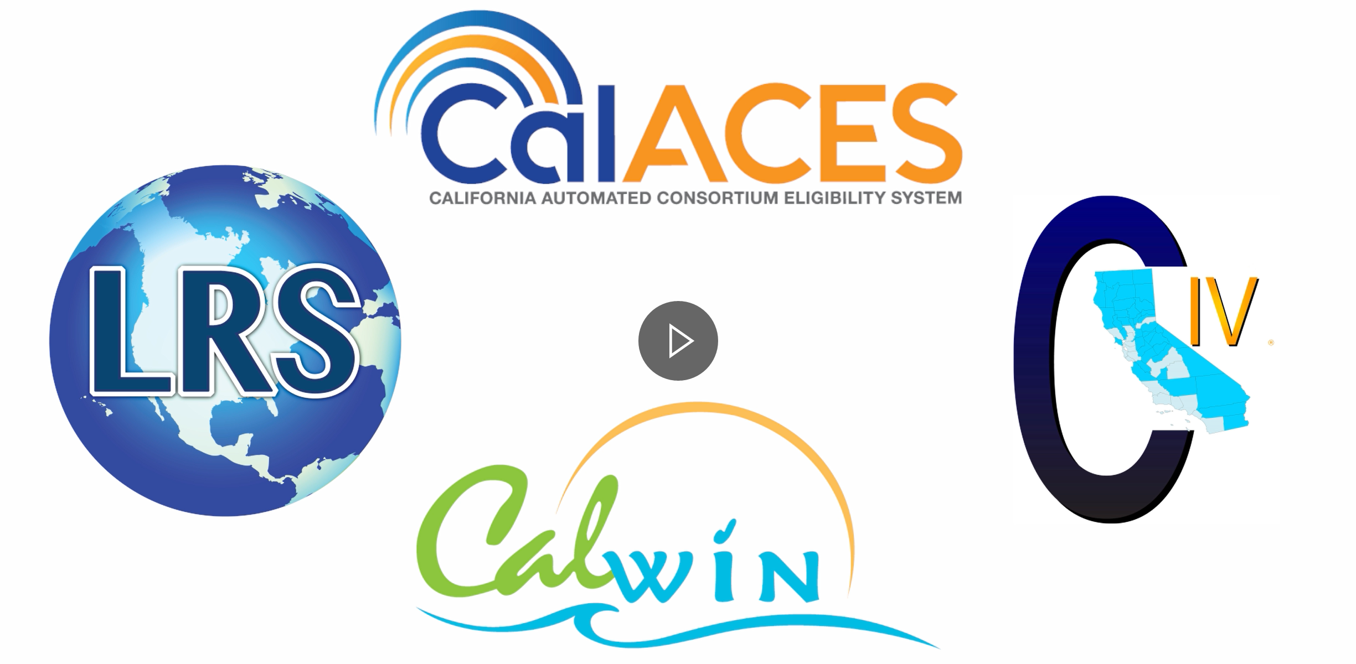

CalACES/CalSAWS
Planning Update: Overview
Overall Objective
  Planning effort working to develop roadmap of overall effort to consolidate to a single system, CalSAWS, on ~2023 timeline
  Builds upon the previous planning efforts for CalACES
Project Sponsors
  John Boule (CalACES)
  Diane Alexander (WCDS CalWIN)
Working Team
  CalACES
  WCDS
  OSI
  QA vendor & subcontractors
NOTE: All figures in this document are preliminary, to be validated and finalized

Slide 34
CalACES/CalSAWS
Planning Update: Initiatives
1
2
Technical Assessment
(Infrastructure, Database, Portal/Mobile, CalACES Ancillary)
Central Migration Planning (CalSAWS User Labs & Requirements Gathering Sessions, Data Migration Strategy, Review of CalACES requirements, Consolidated Requirements for CalSAWS, DD&I, M&O cost estimates)
3
4
CalWIN County Analysis
(Business Processes & Ancillary Systems)
Implementation Planning
(e.g., Procurement, Sequencing, Roadmap)
5
Implementation Efforts
(Moving a replica of LRS to the cloud)
NOTE: All figures in this document are preliminary, to be validated and finalized

Slide 35
CalACES/CalSAWS
Planning Update: Initiative Status (1/2)
1
2
Technical Assessment
Completed as of May 25
Central Migration Planning
In-progress
  CalSAWS end-state infrastructure hosted on Amazon Web Services on Government Cloud
  Migration path moves replica of LRS to cloud first
  CalSAWS portal to be based on YBN leveraging CalHEERS infrastructure; mobile application to be based on C4Yourself
  Most ancillary systems also consolidated due to linkages with core; few exceptions
  Validity of all 560 CalACES requirements tested; 503 could be considered as critical to go-live
  800+ comments, 6 weeks of User Labs; ~60% on CalWORKs, CalFresh, Medi-Cal
  30 new requirements; 13 modifications to CalACES requirements
  Data migration strategy for wave approach
  Cost analysis in-progress
NOTE: All figures in this document are preliminary, to be validated and finalized

Slide 36
CalACES/CalSAWS
Planning Update: Initiative Status (2/2)
3
4
5
CalWIN County Analysis (County visits completed; Analysis in-progress)
Implementation Planning
(To be kicked off)
Implementation Efforts
(Planning/TBD)
  ~10-15 additional core requirements (~2% incremental to existing requirements)
  Many CalWIN ancillary systems likely addressable by CalACES core and ancillary systems
  Significant innovations in ancillary systems to be retained (or potentially incorporated into CalSAWS)
  Development of baselined timelines for procurements, with approximate completion ~2023
  Analysis around procurement blocks, timeline and sequencing underway
  CalACES decided to conduct proof of concept of LRS to cloud; performance testing at 58-county volume levels
NOTE: All figures in this document are preliminary, to be validated and finalized

Slide 37
CalSAWS Requirements Gathering
Informational Items

Slide 38
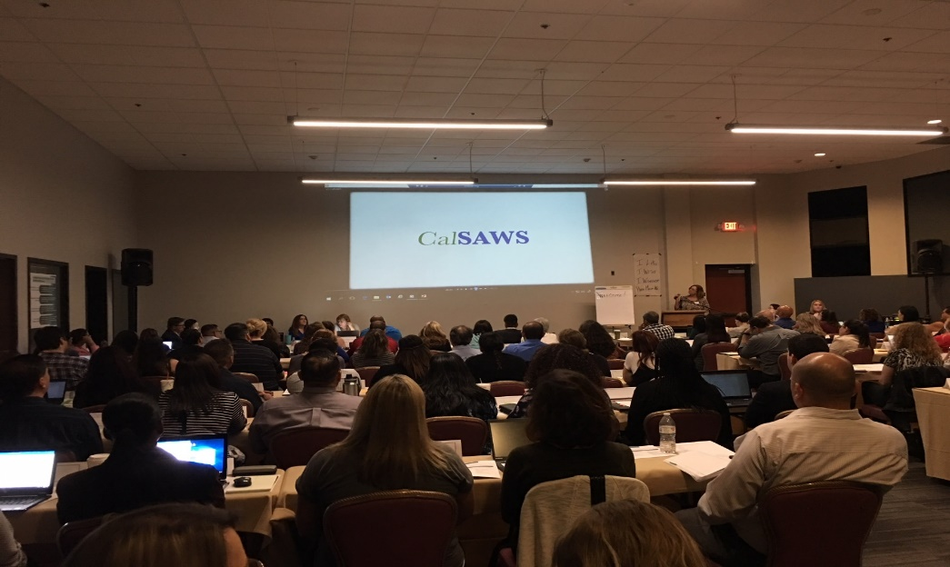
CalSAWS Requirements Gathering
CalSAWS Leadership Team Requirements Gathering Video
Featuring words from:
  Scott Pettygrove, Director of Merced County HSA and Chair of CalACES JPA
  Antonia Jimenez, Director of Los Angeles County DPSS and Vice-Chairperson of the CalACES JPA
  Bobby Cagle, Director of Los Angeles County DCFS
  Barry Zimmerman, Director of Ventura County HSA and Co-Chair of the CalWIN Board of Directors
  Ann Edwards, Director of Sacramento County DHA and Co-Chair of the CalSAWS Leadership Team

Slide 39
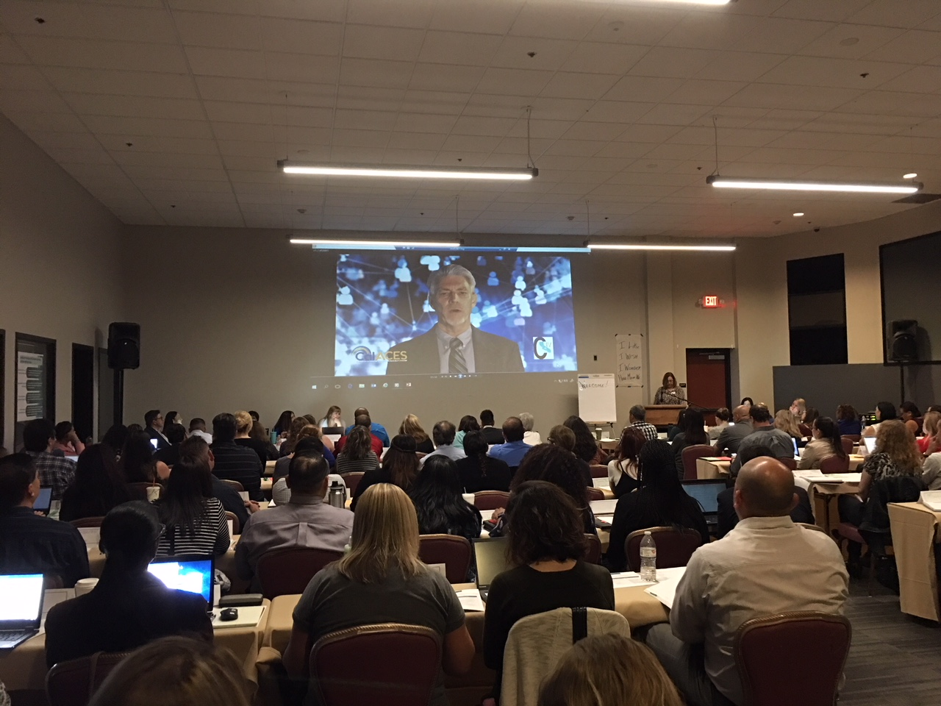
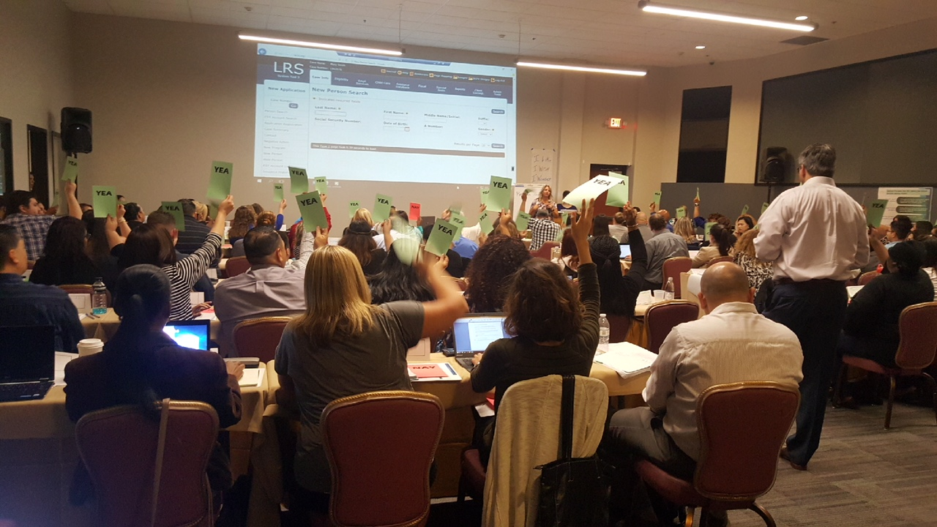
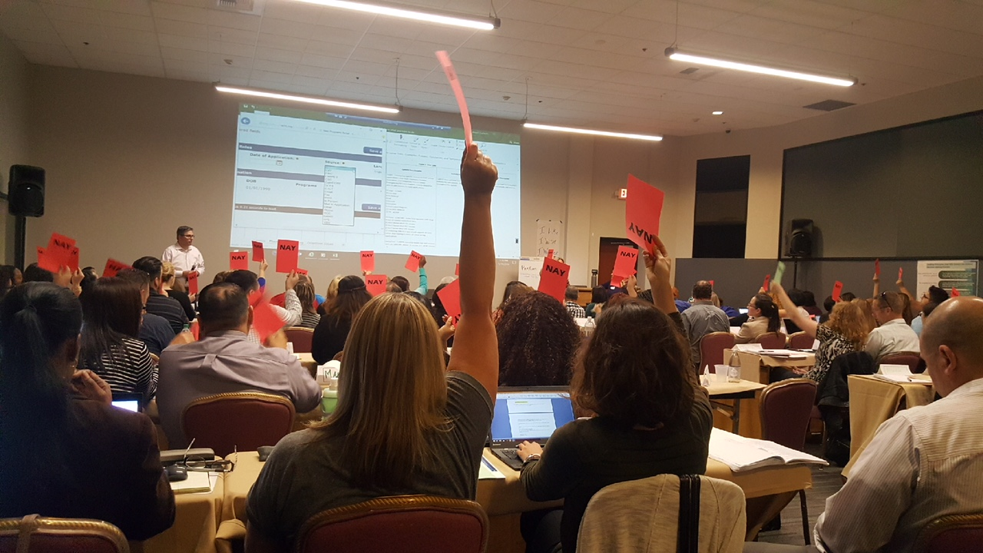
Overview of Weeks 1 to 4
Direct representative present
in Weeks 1, 2, 3, 4
Scope so far
Attendees
Week 1
Week 2
Week 3
Week 4
Week 1
Week 2
Week 3
Week 4
CalWORKs/ CalFresh
Medi-Cal/
CMSP/
CalFresh
Manage
Personnel
WTW/
Child Care/
Resource Databank
111
94
91
70
Counties represented (58)
State Partner Participation CDSS/DHCS

Slide 40
CalSAWS Phase 3
Weeks 1-5 – Combined Data
Modify Existing CalACES Requirement Existing Requirement updated to meet the needs of 58 Counties. | 24 | From [hide the “Use Office Address“] to [make "Use Office Address" configurable for the 58 counties]
New Migration Requirement A new requirement was needed to meet the needs of 58 Counties. | 54 | The CONTRACTOR shall list all of the EDBC reasons (hard or soft validations) prior to the EDBC Details at the Run EDBC Page and list all missing verifications and pages.
No New Requirement Comment/Functionality reviewed and discussed and determined no requirement needed. | 91 | CalACES EDBC results are not broken up into several windows, users are required to scroll.
Escalation Required Comment/Requirement required escalation | 2 | Super User Security Role Send Referrals via email directly from CalSAWS
Not Applicable Comment/Requirement was determined to be non-applicable | 29 | Journal entries in CalWIN could be viewed and printed vs. only one at time in CalACES
Total | 200

Slide 41
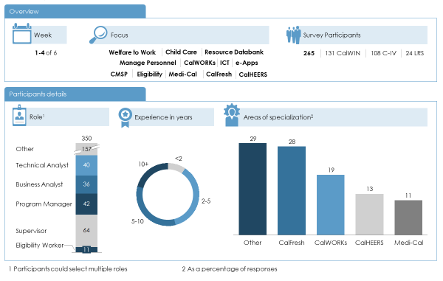
Survey Overview
Weeks 1 to 4

Slide 42
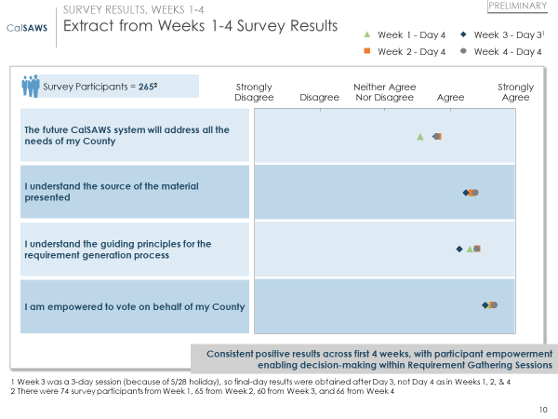
Survey Results Weeks 1-4

Slide 43
Overview of CalSAWS Governance
Compelling Reasons to Establish the 58-county CalSAWS JPA
  Provides a formal structure to effectively support administrative, legal and financial processes for 58 counties
  Facilitates full integration of the18 CalWIN counties into CalSAWS decisions sooner, ensuring that decisions made will work for all counties
  The 18 CalWIN counties can ensure their input is officially considered in PSC and committees as changes are packaged and made to the destination system (LRS)
  The JPA structure can help manage a single design even with multiple production systems
  Planned procurements (OCAT, FCED, others) could be conducted by the JPA without the need for additional agreements and approvals
  Existing contracts would be assigned to the JPA and all contracts would be managed by the JPA
  Fewer interim governance processes/MOUs needed (Shared Services MOU)
  A 58-county JPA with a single voice can speak with authority to the State and Federal program sponsors when influencing policy and driving investment in innovation and new technologies

Slide 44
CalSAWS Governance:
Guiding Principles
Principles Driving Regional Models:
  Achieving Acceptable Balance in: Number of Regions, Geography, Persons Counts
  Ensure county voices are heard in regional representative model
  Ensure county groupings make sense: proximity, similar demographics, established relationships, programs
  Ensure region size/number of counties is manageable: Adjust Regional Project Manager level of support as appropriate
  Fully integrated 58-county regional model

Slide 45
CalSAWS Proposed Governance Model
Del
Norte
Region | # Counties | Votes | Person Counts | %
1 | 12 | 2 | 2,414,850 | 15.12%
2 | 13 | 1 | 1,036,114 | 6.49%
3 | 14 | 1 | 453,998 | 2.84%
4 | 11 | 2 | 2,611,495 | 16.35%
5 | 7 | 3 | 4,874,957 | 30.53%
6 | 1 | 3 | 4,576,752 | 28.66%
Total | 58 | 12 | 15,968,166 | 100%
Siskiyou
Modoc
Trinity
Shasta
Lassen
Humboldt
Tehama
Plumas
Mendocino
Glenn
Butte
Sierra
Yuba
Nevada
Lake
Colusa
Sutter
Placer
Based on the CWDA eligibility regions
Voting is structured as:
  3 votes for regions over 4 million PC
  2 votes for regions over 2 million PC
  1 vote for regions less than 2 million PC
To take action must have a minimum of:
  5 regions
  7 votes
To appeal an item, a minimum of 2 regions must call for a full Board vote at the next meeting. To carry, the item requires a minimum of 7 votes and 4 regions.
Due to large numbers of counties in many regions, may need multiple RPMs.
Sonoma
Yolo
El Dorado
Alpine
Napa
Amador
Solano
Sacramento
Calaveras
Marin
Contra
Costa
San
Joaquin
Tuolumne
San Francisco
Alameda
Mariposa
Mono
San Mateo
Santa
Clara
Stanislaus
Santa Cruz
Merced
Madera
San
Benito
Fresno
Inyo
Monterey
Tulare
Kings
San
Luis
Obispo
Kern
Santa
Barbara
San Bernardino
Ventura
Los
Angeles
Orange
Riverside
San
Diego
Imperial

Slide 46
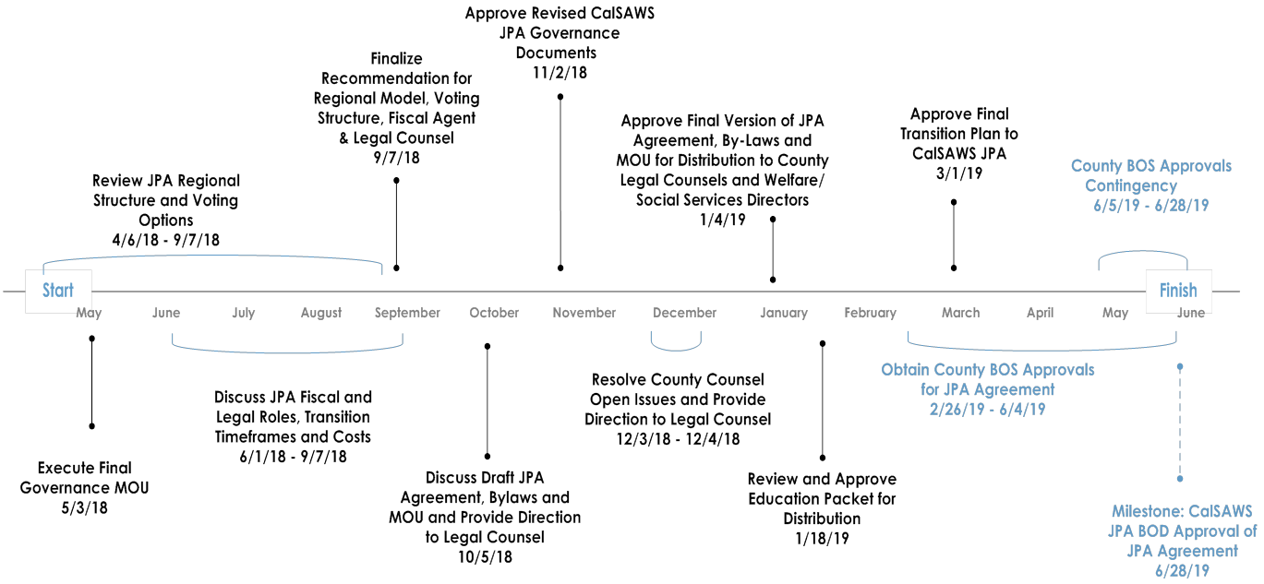
CalSAWS Governance Schedule
CalSAWS Leadership Tasks
Board & County Tasks

Slide 47
CalSAWS Governance:
Next Steps
For the CalSAWS Leadership Team and Legal Counsel:
  Continue to work through the details in support of a new 58-county JPA Agreement, Bylaws and MOU:
    Operations of Existing Legacy Systems
    Assignment of Contracts
    Fiscal Agent and Operating Mode
    Legal Counsel
    State Involvement
    Enterprise and Project Organizations
    Location of Organizations (currently split between North and South)
    Transfer of Assets
  Establish and educate County Counsel Workgroup
  Prepare informational packet and conduct “roadshows/webcasts” to help educate county counsels and Welfare Directors
  Prepare Transition Plan

Slide 48
M&O Application and Operations Update
Please refer to your ‘Appendix’ for full version

Slide 49
SAWS Upcoming Activities

Slide 50
Policy Implementation
Diaper Bill Update
Phase I (Implemented): CIV SCR 100986; LRS SCR 202085
Phase II (Development): CIV SCR 100305; LRS SCR 59192
The passage of AB 480 requires County Welfare Departments (CWD) to provide thirty dollars ($30) per month to CalWORKs Welfare to Work (WTW) recipients to assist with diaper costs for each child who is under 36 months of age. ACL 18-38 indicates individuals must have a qualifying child under 36 months of age and be a participant in the WTW program.
CDSS responded to the NOA CRPC on 6/11/18. The remaining question about overpayments will be addressed in a Q&A letter due out later this summer.
C-IV/LRS Update:
Phase I – Implemented the Need Category Other Supportive Services and a Need Type of Diaper Allowance. No State report or claiming changes were made in Phase I. Tracking issuance for claiming and reporting this phase is a manual process done by the county.
Phase II - Will implement an automated batch process that will automatically identify eligible cases and issue the appropriate number of $30 issuances per case. Phase II is tentatively scheduled for implementation in the evening on 8/17/18. The first month with full automation will September 2018.
  Modification to SAR7 and RE NOAs will include the language for Diaper Allowance.
  Automatically generate the NA 823 when Diaper Payment is approved or discontinued.
CalACES continues to discuss with the Committee, CWDA and CDSS on the approach for processing historical months.

Slide 51
Policy Implementation
SSI Cash Out
SB 845 SB Omnibus for Human Services
AB 1811 AB Omnibus for Human Services
The Legislative budget bills include agreement to fund the SSI (Supplemental Security Income) Cash Out initiative which would reverse California’s current law that prohibits SSI and/or SSP (State Supplementary Payment) recipients from receiving CalFresh benefits. This policy contains several components which will be implemented no later than August 1, 2019.
The SSI Cash Out applies to three groups of individuals and/or households.
Group 1 - SSI/SSP beneficiaries who are new CalFresh applicants who will no longer be precluded from CalFresh eligibility, as well as current CalFresh households who have an SSI/SSP member(s) who will be added to the case.
Group 2 - CalFresh households who have an excluded SSI/SSP member and as a result of this policy will experience a reduction in the CalFresh allotment.
Group 3 – CalFresh households who have an excluded SSI/SSP member and as a result of this policy will lose their eligibility to CalFresh benefits.
For groups 2 and 3, the legislature has agreed to hold these households harmless by supplementing their benefits via a new state-only program.
- Continued on Next Slide -

Slide 52
Policy Implementation
SSI Cash Out - Continued
SB 845 SB Omnibus for Human Services
AB 1811 AB Omnibus for Human Services
CDSS is working on the ACL for this policy change, which is scheduled for publication in August 2018. CalACES received a draft on 6/13/2018 for review.
On 6/20/2018, SAWS participated in a technical assistance meeting to discuss the policy, implementation strategy and timeline with CDSS and CWDA.
C-IV/LRS Update:
The C-IV/LRS teams are analyzing the draft ACL to document questions and system change requirements.
CIV SCR 101471
LRS SCR 203103

Slide 53
Policy Implementation
Item | Policy Effective Date | C-IV Status | LRS Status | Description – CalACES Implementation Effort
CalFresh Able-Bodied Adults without Dependents (ABAWDs) ACIN I-11-16 ACIN I-88-16 ACL 18-08 ABAWD Handbook | 1/1/2017 Fixed Clock 9/1/2018 Waiver Expires | SCR 7215 Phase II Analysis Release 19.01 | SCR 57971 Phase II Analysis Release 19.01 | Due to the California’s high unemployment rate, it’s anticipated that in 2018 only three counties (Santa Clara, San Mateo, and San Francisco) will be subjected to the ABAWD policy. Therefore, in September CDSS submitted another ABAWD waiver to exempt the remaining 55 counties through 2018. A response from FNS is pending. At Self Sufficiency in March, CDSS reported that they are still waiting to hear from FNS on the waiver approval. However, based on the unemployment numbers, they feel confident that the waiver will be approved. The ABAWD Handbook was published on 1/26/18. The ABAWD handbook is a living document and will be updated by CDSS as policy is decided upon. The critical items on which the State needs to provide direction are: NOAs/Forms, Exemptions including geographically waived areas, and the MEDS interface. In February CDSS kicked off the SAWS ABAWD Automation meetings. These meetings will address SAWS questions associated to automating the ABAWD policy. Considering the CalACES counties will continue to be on an ABAWD waiver until 9/1/2019, all the recent policy changes, and those that are in progress, the CalACES Project believes we need to move the ABAWD Phase II implementation to January 21, 2019. CDSS is in agreement with moving CalACES moving the ABAWD implementation to January 21, 2019. C-IV/LRS Implementation: The design team, consortium staff, and QA staff are working on documenting system changes and participating in the SAWS ABAWD Automation meeting with CDSS.

Slide 54
Policy Implementation
Item | Policy Effective Date | C-IV Status | LRS Status | Description – CalACES Implementation Effort
Long Term Funding for Emergency Caregivers with Placement of Children and NMD prior to RFA Approval Letter Pending | 7/1/2018 | SCR 101497 Analysis Release TBD | SCR Analysis Release TBD | The Legislature adopted a long-term solution to continue to provide caregivers with payment from the time of placement pending their completion of the Resource Family Approval (RFA) process. Beginning 7/1/2018, counties will be responsible for paying the 30% non-federal share of the TANF-EA payment for all new relative or Non Relative Extended Family Member (NREFM). For foster care cases not eligible to TANF–EA, the State will pay 70% share with general funds with the counties picking up the remaining 30% share. In 2018-19, this funding would be available to a family for up to six months based on specific conditions. Beginning July 1, 2019, new placements would be eligible for payment at the above sharing ratios for the first 90 days. Funding after 90 days becomes county-optional. There is no automatic mechanism to extend payments beyond those 90 days, but the statute directs CDSS to consider extending payments beyond 90 days if it determines that the RFA process cannot be completed within 90 days due to circumstances beyond the county’s control. Beginning 7/1/18, counties can no longer use ARC funds for new non federally eligible cases. For AB 110 cases, those cases could continue to receive ARC funds after 6/30/18 if specific conditions are met. CDSS: To track, claim, and report on the foster care cases that not eligible to TANF–EA, CDSS is going to request a new aid code from DHCS. The process of getting a new aid code can be lengthy; therefore, SAWS, CDSS, CWDA, and the counties are meeting to discuss an interim aid code that can be used until the new aid code is available. The next meeting is 6/20/18. C-IV/LRS Update: The project teams are doing analysis on the what system changes are need to account for the elimination of the use of ARC funding for new cases. We are also exploring an interim process for Non EA eligible cases.

Slide 55
Policy Implementation
Item | Policy Effective Date | C-IV Status | LRS Status | Description – CalACES Implementation Effort
Changes to CalFresh Reporting Requirements ACL 18-18 | 5/8/2017 | SCR 100532 Analysis Release TBD | SCR 54311 Analysis Release TBD | CDSS submitted a waiver to FNS to allow the CF 30 to be mailed along with another NOA. FNS approved a two year waiver, which is effective May 1, 2018 through April 30, 2020. The waiver allows California to maintain current practice of sending the notice of adverse action, either the 960X and 960Y, which means the CF 30 does not have to be mailed. However, all other policy in ACL 18-18 still applies. CDSS provided a draft ACL with the waiver conditions on 5/15/18. C-IV/LRS Update: The project teams continues to document the system change requirements for the other policy changes in ACL 18-18.
Notice of Action Requirements at Annual Renewal or Change in Circumstance Draft ACWDL received on 4/17/18 |  | SCR 100708 Analysis Release TBD | SCR 202724 Analysis Release TBD | In accordance with Federal Regulations, counties are required to send a Notice of Action to MAGI beneficiaries who have no change in their eligibility or level of benefits at annual renewal or when an eligibility determination at change in circumstance results in resetting the annual renewal date. In the draft ACWDL it state that SAWS must make all necessary programming changes to automate the use of the MAGI and Non-MAGI NOA snippet language included within this ACWDL no later than six months after the release of this ACWDL. The final ACWDL is pending. C-IV/LRS Update: The design team, consortium staff, and QA staff reviewed the draft ACWDL and provided comments to DHCS on 4/24/18.

Slide 56
2018 Conference Planning
Informational Items

Slide 57
2018 Conference Planning
Location: Norwalk, Los Angeles
Double Tree by Hilton Hotel
13111 Sycamore Drive
Norwalk, CA 90650
Dates: 10/31/2018 – 11/02/2018 (Wednesday – Friday)
Conference Registration must be paid by check.
Making Room Reservations:
  Go to www.LosAngelesNorwalk.Doubletree.com and make a reservation using the group code: CAC.
  Call (562) 863-5555 and ask for the CAC group rate.
Please keep in mind that all reservations must be made by:
October 1, 2018.

Slide 58
Public Comment
?
Are there any questions, concerns, or comments you would like to make at this time?

Slide 59
Adjourn Meeting
Scott Pettygrove will adjourn the meetings of the JPA Board of Directors and Member Representatives.

