Slide 1
January 24, 2020
JPA Member Representatives and
Board of Directors Meetings

Slide 2
Agenda
Call joint meeting of the Member Representatives and Board of Directors to Order.
Public Opportunity to speak on items NOT on the Agenda. Public comments are limited to no more than three minutes per speaker, except that a speaker using a translator shall be allowed up to six minutes.
Note: The public may also speak on any Item ON the Agenda by waiting until that item is read, then requesting recognition from the Chair to speak.
Confirmation of Quorum and Agenda Review.
Quorum of Member Representatives
Quorum of Board of Directors
Protocols
Agenda Review

Slide 3
JPA Board Action Items

Slide 4
Action Items
Approval of the Minutes and review of Action Items from the December 13, 2019 CalSAWS JPA Board of Directors meeting.

Slide 5
Action Items
5. Approval of the C-IV Accenture Amendment 106 package, which includes requests for:
Approval of C-IV Accenture Change Order CO–114 HVP
Approval of C-IV Accenture Change Order CO-115 Cal-OAR
Approval of C-IV Accenture Change Order CO-116 Medi-Cal Full Scope Expansion
Approval of Accenture Amendment 106 (includes references to Change Order CO-114 HVP, Change Order CO-115 Cal-OAR, Change Order CO-116 Full Scope Medi-Cal Expansion, and updates to Extension Two Cost Schedules and Exhibit A)

Slide 6
Action Items
6. Approval of LRS Accenture Base Agreement Amendment 18, which includes requests for:
Updates to the Base Agreement including:
  Updates to the Total Maximum Contract Sum for HVP, Cal-OAR, Medi-Cal Full Scope Expansion

Slide 7
Action Items
Approval of LRS Accenture Base Agreement Amendment 19, which includes (contingent upon Federal Approval) requests for:
Updates to the Base Agreement including:
Addition of Exhibit Z (CalSAWS Imaging Project)
Updates to Exhibit X (CalSAWS M&O Extension) including:
  Addition of Schedule 13 for the CalSAWS Imaging Project
Updates to the Total Maximum Contract Sum for the CalSAWS Imaging Project
Approval of LRS First Data Amendment 3 package, which includes requests for:
  Additional Staff Augmentation for CalWIN

Slide 8
Action Items
9. Approval of C-IV First Data Amendment 67 package, which includes requests for:
Approval of Change Order CO-056 Cal-OAR
Approval of Change Order CO-057 HVP
Approval of Amendment 67 (includes references to Change Order CO-056 and Change Order CO-057)
Approval of ClearBest Change Order 02, which includes requests for:
Additional Project Management consulting services

Slide 9
Member Representatives Action Item

Slide 10
Member Representatives Action Item
SFY 2020/21 – CalSAWS JPA Administrative Budget
Member Consortium County JPA Costs | CalSAWS Admin Costs 7/1/20 - 6/30/21
 | 58 Member
Insurance Services* | $79,860
External Financial Audit* | $32,053
SOC 1 Internal Audit Services* | $101,479
San Bernardino ATC Accounting Services ⁽¹⁾ | $553,118
San Bernardino Financial System Data - FTP | $5,000
Consortium Conferences & Fees | $10,000
TOTAL | $781,510
¹ SB ATC = total costs are estimated at $553,118/year ($46,093+/- a month, projections are based on hourly rate and estimated hours)
* Estimates based on FY 2019/20 budget plus 10%

Slide 11
Member Representatives Action Item
SFY 2020/21 – CalSAWS JPA Administrative Budget

Slide 12
Action Items
11. Approval of the Administrative Budget for Unfunded Costs for FY 20/21.
Review Administrative Budget Line Items

Slide 13
Member Representatives Informational Items

Slide 14
CalSAWS Budget Status
Governor’s Budget

Slide 15
CalSAWS Budget Status
January Governor’s Budget
No issues were identified with the project budgets for CalSAWS, CalWIN, or CalACES
One premise issue was identified with the Brown Tapia Settlement funding of $834K, which was shifted to SFY 2020/21 and will require an update in the May Revise to retain a portion in the current year
Other premise items were included as expected, but will now require shifts to next fiscal year as part of the May Revise (e.g. Shared Applications Forms Revisions, FCED)
New premise items for the Budget Year (SFY 2020/21) were identified:
  CalWORKs Income Exemptions (AB 807)
  CalWORKs Child Support Pass-Through to Families (SB 337)
  CalFresh Public Assistance Cases Tracking
  Undocumented 65+ Full Scope Expansion
  CalWORKs Apparent Eligibility

Slide 16
M&O Application and Policy Update

Slide 17
Policy Update
Homeless Assistance – Remove 16 Consecutive Day Requirement
Policy Effective Date & State Policy Reference | C-IV/LRS Status | CalWIN Status | Implementation Details
TBD SB 80 ACL 19-118 | SCRs CIV-105386; CA-211293 New Release TBD | PPM #52113- Design Release TBD | SB 80 repealed the rule that the 16 days of temporary HA benefits must be used on consecutive days and instead authorizes families to receive 16 cumulative days of temporary HA benefits within a 12-month period. CalSAWS Update: This change does not impact the C-IV System. However, a system change is required for LRS. A CIT for an interim process is in progress. CalSAWS County Business Impact: Unknown pending design completion for SCRs CIV-105386 and CA-211293. CalWIN Update: Proposal opened, pending design. CalWIN County Business Impact Unknown pending finalization of policy. -

Slide 18
Policy Update
Able-Bodied Adults Without Dependents (ABAWD)
Policy Effective Date & State Policy Reference | C-IV/LRS Status | CalWIN Status | Implementation Details
1/1/2017 Fixed Clock 8/31/2019 Waiver Expires ACIN I-11-16 ACIN I-88-16 ACL 18-08 ABAWD Handbook ACL 19-93 ABAWD Handbook 2.0 | SCRs CIV-7215; CA-57971 Phase II Implemented Release 19.09 SCRs CIV-103743 CA-207637 Phase III Design Release 20.09 | PPM #46539- Implemented 8/2018 PPM #47411- Implemented 8/2018 PPM #51360- Implemented 8/19 PPM #52397- Design R60 (2/20) PPM# 53992- New | FNS is working with the Western Region to discuss planning and preparation for the publication of the final rule on ABAWDs. FNS did not provide any information specific to what changes will be implemented in the final rule, but they did share that the Administration still has a December release date on the rulemaking calendar. When released, a relatively aggressive implementation timeline may be required by States. FNS mentioned that this timeline could be as little as 60-90 days from release of the final rule. This means that States could be expected to be in compliance as early as March 2020. California may be required to submit an updated waiver request under new waiver criteria. FNS has confirmed that our current waiver will be valid until final approval of the new waiver is received. If this is the case, CDSS will take the lead on submitting an updated waiver and will keep impacted counties in the loop. CDSS encourages counties to begin planning for implementation, but would limit these activities to planning that can occur ahead of a final rule as additional details will only come to light once the rule is finalized. -Continued on Next Slide-

Slide 19
Policy Update
Able-Bodied Adults Without Dependents (ABAWD)
Policy Effective Date & State Policy Reference | C-IV/LRS Status | CalWIN Status | Implementation Details
1/1/2017 Fixed Clock 8/31/2019 Waiver Expires ACIN I-11-16 ACIN I-88-16 ACL 18-08 ABAWD Handbook ACL 19-93 ABAWD Handbook 2.0 | SCRs CIV-7215; CA-57971 Phase II Implemented Release 19.09 SCRs CIV-103743 CA-207637 Phase III Design Release 20.09 | PPM #46539- Implemented 8/2018 PPM #47411- Implemented 8/2018 PPM #51360 Implemented 8/19 PPM #52397 Design R60 (2/20) | Alameda, Contra Costa, Marin, San Francisco, San Mateo, and Santa Clara are the counties that have implemented the ABAWD policy. The remaining counties are on waiver until 8/31/20 . The ABAWD Handbook version 2.0 was published on 9/12/19. CalSAWS Update: Provide a list of the ABAWD population to the counties Schedule an onsite functionality click through for counties Provide existing system training materials – Job aids and functional presentation. Finalize the design for Phase III changes. CalSAWS County Business Impact: Train staff on changes to system functionality. -Continued on Next Slide-

Slide 20
Policy Update
Able-Bodied Adults Without Dependents (ABAWD)
Policy Effective Date & State Policy Reference | C-IV/LRS Status | CalWIN Status | Implementation Details
1/1/2017 Fixed Clock 8/31/2019 Waiver Expires ACIN I-11-16 ACIN I-88-16 ACL 18-08 ABAWD Handbook ACL 19-93 ABAWD Handbook 2.0 | SCRs CIV-7215; CA-57971 Phase II Implemented Release 19.09 SCRs CIV-103743 CA-207637 Phase III Design Release 20.09 | PPM #46539- Implemented 8/2018 PPM #47411- Implemented 8/2018 PPM #51360 Implemented 8/19 PPM #52397 Design R60 (2/20) PPM# 53992- New | CalWIN Update: •ABAWD functionality enabled for Alameda and Contra Costa as of 9/1/2019. •Suppress the FX60 transactions until new criteria for starting the ABAWD time clock is programmed. •Modify CalWIN to start the ABAWD time clock for non-exempt ABAWD individuals. Run special job to re-transmit FX20 and FX60 MEDS transactions once change is implemented. CalWIN has opened one proposal for the new Federal Rule changes and anticipates others to support the new changes. CalWIN County Business Impact Counties will not have ABAWD information in MEDS when FX60 is suppressed. Receiving ABAWD counties will have to obtain Countable/Consecutive clock information from sending counties for ICTs.

Slide 21
Status of CalSAWS Schedule Adjustment

Slide 22
Schedule Adjustment
The details
Let’s review from a non technical perspective…

Slide 23


Here’s where we started…
LRS Today
AWS Cloud
eICT, eHIT, State, and Federal interfaces
Central Print
Help Desk 1/2
Help Desk 3
Contact Center
LRS Today includes:
Cloud
Print, Help Desk, Contact Center
YBN Portal
Interfaces
Program functionality and supporting tools
22,000 system users
4.5 million served
Core Application
YBN
Imaging (LRS)
Task Management
Child Care
Employment
Services
Refugee Assistance
Lobby
Mgmt
CMSP
M&E
CalWORKs
Foster Care
CAPI
CalFresh
KinGAP
AAP
MediCal
GA/GR (LRS)
EA
LRS Tech Foundation
Data Lake

Slide 24
You are here…
Current Systems Migration
C-IV
LRS
CalWIN
eICT, eHIT, State, and Federal interfaces
AWS Cloud
Central Print
Central Print
Help Desk 1/2
Help Desk 3
Help Desk 1/2
Help Desk 3
Contact Center
Contact Center
Core Application
18,000 system users
4.8 million served
22,000 system users
4.5 million served
Core Application
C4Yourself
Task Management
MyBenefitsCalWIN
Employment
Services
30,000 system users
6.4 million served
Child Care
Employment
Services
Refugee Assistance
Imaging
Child Care
CalWORKs
Refugee Assistance
M&O
CalWORKs
EA
M&O
CalFresh
EA
Lobby
Mgmt
CalFresh
AAP
Lobby
Mgmt
Ancillary
Systems
(Non-Core)
MediCal
AAP
MediCal
CAPI
KinGAP
CAPI
KinGAP
CMSP
M&O
Foster Care
CMSP
M&E
GA/GR
Foster Care
C-IV Tech Foundation
CalWIN Tech Foundation
2021 – 2023
C-IV and CalWIN
Migrate to LRS to
become CalSAWS
Comparison of the three SAWS – Similar, but different…

Slide 25


Our future State
Including the outcome of Functional Design Sessions
AWS Cloud
eHIT, State, and Federal interfaces
Expanded Central Print
Help Desk 1/2
Help Desk 3
Contact Center Integration
57-County GA/GR
58-County Task Management
CalSAWS
Expanded Application
Non-State Forms
APIs
70,000 system users
15.7 million served
Analytics
FCED
OCAT
Consolidated Imaging
Converted Ancillary Systems (Core)
Core Application
Ancillary Systems (Non-Core)
Statewide Portal
Child Care
Employment
Services
Refugee Assistance
Lobby
Mgmt
CMSP
M&E
Legend
CalWORKs
Foster Care
CAPI
Data Lake
CalFresh
KinGAP
AAP
Existing
New/Expanded
MediCal
GA/GR (LA)
EA
Expanded LRS Tech Foundation
The finalized Functional Design Scope has added to CalSAWS house and requires a schedule adjustment to in order to fit it in before Go Live events.

Slide 26
Revised CalSAWS DD&I Project Schedule
Overview
Develop a project schedule that:
Allows the 39 C-IV Counties to cutover to CalSAWS in September 2021
Provides CalSAWS functionality, including new requirements defined by the Functional Design Sessions, that meets the current business needs of the C-IV Counties
Allows for the development and implementation of additional capabilities needed for the CalWIN Counties after C-IV counties go-live
Incrementally builds out the CalSAWS requirements for the 57 counties, minimizing any throw away code
Completes CalWIN Counties rollout no later than December 2023
Assumptions:
Imaging will begin work in January, 2020 (pending JPA approval)
All other work begins in March, 2020 for the new scope required by the Functional Design Sessions and Foster Care
No changes to the LRS Agreement end date

Slide 27
Revised CalSAWS DD&I Project Schedule
Revised Schedule
The following slide highlights a revised project schedule that assumes:
The 39 C-IV Counties cutover to CalSAWS in September 2021 (no change to this date)
  There would be no functional release during this cutover month
  There would be no technical release during the month after cutover
A phased approach, where appropriate, for the outstanding Functional Design Session scope:
  Focus on implementing requirements needed by the C-IV Counties to align CalSAWS functionality with current C-IV functionality prior to cutover (referred to as “Phase 1”)
  Phase in other features/functions needed by the CalWIN counties that may also be used by C-IV counties and LA County in the future. These would be developed and implemented prior to CalWIN UAT (referred to as “Phase 2”)

Slide 28
Revised CalSAWS DD&I Project Schedule
Revised Schedule continued
Impacts to CalWIN Implementation Dates:
Shifts the first CalWIN wave from January 2022 to October 2022. All subsequent waves are adjusted accordingly
  No changes to the number of CalWIN waves was contemplated or requested at this time
  Adjustment to the timing of the second wave to avoid a cutover in a holiday month e.g. (November, December)

Slide 29
Revised CalSAWS DD&I Project Schedule
Schedule

Slide 30
Revised CalSAWS DD&I Project Schedule
Functional Area Overview
The following slides will provide additional details for:
58 County Imaging
Task Management
Non State Forms
GA/GR
APIs
Ancillary Systems Conversions
Analytics: BIP/State Report Replatforming
Foster Care

Slide 31
Our future State
Imaging
AWS Cloud
eHIT, State, and Federal interfaces
Expanded Central Print
Help Desk 1/2
Help Desk 3
Contact Center Integration
57-County GA/GR
58-County Task Management
CalSAWS
Expanded Application
Non-State Forms
APIs
70,000 system users
15.7 million served
Analytics
FCED
OCAT
Consolidated Imaging
Converted Ancillary Systems (Core)
Core Application
Ancillary Systems (Non-Core)
Statewide Portal
Child Care
Employment
Services
Refugee Assistance
Lobby
Mgmt
CMSP
M&E
Legend
CalWORKs
Foster Care
CAPI
Data Lake
CalFresh
KinGAP
AAP
Existing
New/Expanded
MediCal
GA/GR (LA)
EA
Expanded LRS Tech Foundation
Implement a consolidated Imaging Solution for 58 Counties.

Slide 32
Revised CalSAWS DD&I Project Schedule
Functional Area Overview: 58 County Imaging
Category | Description
Phase 1 | Deploy integrated imaging solution to the 39 C-IV Counties at go-live LA County continues to use EDMS interface (already integrated with CalSAWS)
Phase 2 | Deploy the integrated imaging solution to LA County prior to the CalWIN Wave 1 cutover Deploy the integrated imaging solution to each CalWIN County at their respective CalSAWS Cutover
Dependencies | Integration with task management and APIs

Slide 33
Our future State
58-County Task Management
AWS Cloud
eHIT, State, and Federal interfaces
Expanded Central Print
Help Desk 1/2
Help Desk 3
Contact Center Integration
57-County GA/GR
58-County Task Management
CalSAWS
Expanded Application
Non-State Forms
APIs
70,000 system users
15.7 million served
Analytics
FCED
OCAT
Consolidated Imaging
Converted Ancillary Systems (Core)
Core Application
Ancillary Systems (Non-Core)
Statewide Portal
Child Care
Employment
Services
Refugee Assistance
Lobby
Mgmt
CMSP
M&E
Legend
CalWORKs
Foster Care
CAPI
Data Lake
CalFresh
KinGAP
AAP
Existing
New/Expanded
MediCal
GA/GR (LA)
EA
Expanded LRS Tech Foundation
Implement unified 58-County Task Management Solution in CalSAWS.

Slide 34
Revised CalSAWS DD&I Project Schedule
Functional Area Overview: Task Management
Category | Description
Phase 1 | Core CalSAWS requirements to create a unified task management approach, inclusive of C-IV tasks and automated actions, along with integration with the 58 counties imaging solution (Releases 20.09-21.03)
Phase 2 | Additional capabilities (needed for the CalWIN counties and that will be available for all counties) will be implemented post C-IV cutover (Releases 21.05-22.01)
Dependencies | Integration with imaging. Downstream impacts to both conversion and training

Slide 35
Our future State
Non-State Forms
AWS Cloud
eHIT, State, and Federal interfaces
Expanded Central Print
Help Desk 1/2
Help Desk 3
Contact Center Integration
57-County GA/GR
58-County Task Management
CalSAWS
Expanded Application
Non-State Forms
APIs
70,000 system users
15.7 million served
Analytics
FCED
OCAT
Consolidated Imaging
Converted Ancillary Systems (Core)
Core Application
Ancillary Systems (Non-Core)
Statewide Portal
Child Care
Employment
Services
Refugee Assistance
Lobby
Mgmt
CMSP
M&E
Legend
CalWORKs
Foster Care
CAPI
Data Lake
CalFresh
KinGAP
AAP
Existing
New/Expanded
MediCal
GA/GR (LA)
EA
Expanded LRS Tech Foundation
Implement a single set of Non-State Forms for 58 Counties.

Slide 36
Revised CalSAWS DD&I Project Schedule
Functional Area Overview: Non State Forms
Category | Description
Phase 1 | Non State Forms in English and Spanish (Releases 20.11-21.05)
Phase 2 | Non State Forms in 13 threshold languages (Releases 21.07-22.07)
Dependencies | An approved English version of a form is required prior to obtaining translations

Slide 37
Our future State
58-County General Assistance/General Relief
AWS Cloud
eHIT, State, and Federal interfaces
Expanded Central Print
Help Desk 1/2
Help Desk 3
Contact Center Integration
57-County GA/GR
58-County Task Management
CalSAWS
Expanded Application
Non-State Forms
APIs
70,000 system users
15.7 million served
Analytics
FCED
OCAT
Consolidated Imaging
Converted Ancillary Systems (Core)
Core Application
Ancillary Systems (Non-Core)
Statewide Portal
Child Care
Employment
Services
Refugee Assistance
Lobby
Mgmt
CMSP
M&E
Legend
CalWORKs
Foster Care
CAPI
Data Lake
CalFresh
KinGAP
AAP
Existing
New/Expanded
MediCal
GA/GR (LA)
EA
Expanded LRS Tech Foundation
Implement GA/GR functionality to meet the needs of 58 Counties.

Slide 38
Revised CalSAWS DD&I Project Schedule
Functional Area Overview: GA/GR
Category | Description
Phase 1 | Implement C-IV managed and non managed solution Generate the GA 237 for the 39 counties Send GA transactions to MEDS (Releases 20.11-21.03)
Phase 2 | Implement CalWIN Counties rules and integrate with GA Correspondence service (Releases 21.05-22.01)
Dependencies | Downstream impacts to both conversion and training
No changes to the LA County GA/GR program already integrated with the CalSAWS system

Slide 39
Our future State
Application Programming Interfaces (APIs)
AWS Cloud
eHIT, State, and Federal interfaces
Expanded Central Print
Help Desk 1/2
Help Desk 3
Contact Center Integration
57-County GA/GR
58-County Task Management
CalSAWS
Expanded Application
Non-State Forms
APIs
70,000 system users
15.7 million served
Analytics
FCED
OCAT
Consolidated Imaging
Converted Ancillary Systems (Core)
Core Application
Ancillary Systems (Non-Core)
Statewide Portal
Child Care
Employment
Services
Refugee Assistance
Lobby
Mgmt
CMSP
M&E
Legend
CalWORKs
Foster Care
CAPI
Data Lake
CalFresh
KinGAP
AAP
Existing
New/Expanded
MediCal
GA/GR (LA)
EA
Expanded LRS Tech Foundation
Implement APIs in order to meet county data needs.

Slide 40
Revised CalSAWS DD&I Project Schedule
Functional Area Overview: APIs
Category | Description
Phase 1 | Implement APIs related to task management and imaging (Releases 20.11-21.01)
Phase 2 | All other APIs (Releases 21.03-22.01)
Dependencies | Integration with task management and imaging
Functional Design Sessions were targeted at the 18 CalWIN Counties

Slide 41
Our future State
Conversion for Ancillary Systems
AWS Cloud
eHIT, State, and Federal interfaces
Expanded Central Print
Help Desk 1/2
Help Desk 3
Contact Center Integration
57-County GA/GR
58-County Task Management
CalSAWS
Expanded Application
Non-State Forms
APIs
70,000 system users
15.7 million served
Analytics
FCED
OCAT
Consolidated Imaging
Converted Ancillary Systems (Core)
Core Application
Ancillary Systems (Non-Core)
Statewide Portal
Child Care
Employment
Services
Refugee Assistance
Lobby
Mgmt
CMSP
M&E
Legend
CalWORKs
Foster Care
CAPI
Data Lake
CalFresh
KinGAP
AAP
Existing
New/Expanded
MediCal
GA/GR (LA)
EA
Expanded LRS Tech Foundation
Convert current Ancillary Systems into the Core CalSAWS.

Slide 42
Revised CalSAWS DD&I Project Schedule
Functional Area Overview: Ancillary Systems Conversion
Category | Description
Phase 1 | N/A
Phase 2 | N/A
Dependencies | Extracts from source legacy systems by the counties in accordance with the target schema and conversion team schedule
Functional Design Sessions were targeted at the 18 CalWIN Counties for the following systems: Collections, Fraud, and QA/QC

Slide 43
Our future State
Analytics – Reports Replatforming
AWS Cloud
eHIT, State, and Federal interfaces
Expanded Central Print
Help Desk 1/2
Help Desk 3
Contact Center Integration
57-County GA/GR
58-County Task Management
CalSAWS
Expanded Application
Non-State Forms
APIs
70,000 system users
15.7 million served
Analytics
FCED
OCAT
Consolidated Imaging
Converted Ancillary Systems (Core)
Core Application
Ancillary Systems (Non-Core)
Statewide Portal
Child Care
Employment
Services
Refugee Assistance
Lobby
Mgmt
CMSP
M&E
Legend
CalWORKs
Foster Care
CAPI
Data Lake
Existing
New/Expanded
CalFresh
KinGAP
AAP
MediCal
GA/GR (LA)
EA
Expanded LRS Tech Foundation
Replatform Business Intelligence and Reports into updated Analytics Platform.

Slide 44
Revised CalSAWS DD&I Project Schedule
Analytics – Reports Replatforming
Category | Description
Management Dashboards Old Platform: OBIEE | Moving all dashboards to use a “data lake” After a Proof-of-Concept based on 5 different reports, have developed a re-platform approach and estimating model. We are planning 8 analytics releases for CalSAWS dashboards, management and state reports prior to September 2021.
Management Reports Old Platform: BI Publisher
State Reports Old Platform: BI Publisher
Currently working through incorporating known requirements/changes to the reports within the analytics releases.

Slide 45
Our future State
Foster Care Eligibility Determination (FCED)
AWS Cloud
eHIT, State, and Federal interfaces
Expanded Central Print
Help Desk 1/2
Help Desk 3
Contact Center Integration
57-County GA/GR
58-County Task Management
CalSAWS
Expanded Application
Non-State Forms
APIs
70,000 system users
15.7 million served
Analytics
FCED
OCAT
Consolidated Imaging
Converted Ancillary Systems (Core)
Core Application
Ancillary Systems (Non-Core)
Statewide Portal
Child Care
Employment
Services
Refugee Assistance
Lobby
Mgmt
CMSP
M&E
Legend
CalWORKs
Foster Care
CAPI
Data Lake
CalFresh
KinGAP
AAP
Existing
New/Expanded
MediCal
GA/GR (LA)
EA
Expanded LRS Tech Foundation
Complete functionality to interface in CARES for Foster Care Eligibility Determination.

Slide 46
Revised CalSAWS DD&I Project Schedule
Functional Area Overview:
Foster Care
Category | Description
Phase 1 (Final solution is not confirmed) | Update CalSAWS with additional data collection elements, eligibility rules, NOAs, State forms, reports, and fiscal processing One way, inbound interface with CWS.
Phase 2 | Integration with CWS-CARES System
Dependencies | Timing of the CWS-CARES System go-live. Downstream impact on training

Slide 47
Revised CalSAWS DD&I Project Schedule
Other Consortium Decision Points
Decision | Description
58 County Portal Solution | Procurement pending. If the new 58 County portal is not available by September 2021, C4Yourself would need to be integrated with CalSAWS for the 39 C-IV Counties. YBN is already integrated with the CalSAWS system.
58 County Contact Center Solution | Pending Consortium decision on the solution. If the new 58 County Contact Center solution is not available by September 2021, integrate the C-IV Counties AWS Connect Contact Center solution with CalSAWS. The LA County Contact Center is already integrated with the CalSAWS system.

Slide 48
Revised CalSAWS DD&I Project Schedule
Other Consortium Decision Points
Decision | Description
Central Print solution | Procurement pending for central print services for 56 of 58 counties. If the central print solution is not operational by September 2021, integrate existing C-IV Central Print services with the CalSAWS system LA County Central Print Services are already integrated with the CalSAWS system

Slide 49
Revised CalSAWS DD&I Project Schedule
Status
Reviewed with JPA on 12/13/2019
Reviewed with PSC on 12/19/2019
Discussed with State Partners on 1/7/2020
Reviewed with CMS on 1/8/2020
Reviewed with CalWIN Counties at WCDS Subcommittee meeting on 1/10/2020
Completed draft budget analysis
Completed review of draft estimates
Completed draft Amendment package review
Submitted Amendment packet to OSI for review on 1/8/2020

Slide 50
Revised CalSAWS DD&I Project Schedule
Next Steps
Respond to State questions on Amendment package
Respond to Federal questions on the schedule change and amendment package
Begin preparing IAPDU and necessary briefing materials

Slide 51
CalSAWS Procurement Update
Mobile/Portal
CalWIN OCM & Training
Central Print

Slide 52
CalSAWS Statewide Portal/Mobile Application
Timeline
Timeline
Procurement Event | Date
Released RFP | November 4, 2019
Conducted Bidder’s Conference Sacramento County Department of Human Assistance | November 20, 2019 10:30am - 12:00pm
Published RFP Addendum 1 Based on 14 Vendor Questions and Answers | November 26, 2019
Published RFP Addendum 2 and Responses to 141 Vendor Questions | December 12, 2019
Published RFP Addendum 3 Based on Advocate Recommendations | January 9, 2020
Contractor Proposal Due Date | January 22, 2020
Evaluate Proposals and Prepare Vendor Selection Report | January 23 – April 21, 2020
Consortium Issues Notice of Intent to Award | April 22, 2020
Contract Negotiations | April 27 – May 5, 2020
State, Federal and JPA Board of Directors Approval of Agreement | May 7 – August 7, 2020
Start Date of Statewide Portal/Mobile App Vendor | August 10, 2020
Portal/Mobile App Go-Live | September 2021

Slide 53
CalWIN Training, OCM & Implementation Support
Timeline
Procurement Event | Date
Released RFP | December 17, 2019
Conducted Bidder’s Conference Sacramento County Department of Human Assistance | January 7, 2020
Bidder Questions Due | January 7, 2020
Consortium Response to Bidder Questions by | January 24, 2020
Release RFP Addendum 1 Based on CalSAWS Schedule | January 27, 2020
Bidder Questions Due | February 4, 2020
Consortium Response to Bidder Questions by | February 12, 2020
Contractor Proposal Due Date | March 23, 2020
Evaluate Proposals and Prepare Vendor Selection Report | March 24 – July 16, 2020
Consortium Issues Notice of Intent to Award | July 17, 2020
Contract Negotiations | July 21 – 31, 2020
State, Federal and Consortium JPA Board of Directors Approval of Agreement | August 5 – October 30, 2020
Planned Start Date of CalWIN Contractor | November 2, 2020

Slide 54
Central Print Procurement
Timeline
Procurement Event | Date
Develop Requirements and RFP | January 21 – March 19, 2020
Consortium RFP Review and Approval | March 20 – April 1, 2020
State RFP Review and Approval | April 2 – 20, 2020
Federal RFP Review and Approval | April 21 – June 22, 2020
RFP Release | June 23, 2020
Bidder’s Conference | July 1, 2020
Contractor Proposal Due Date | August 21, 2020
Evaluate Proposals and Prepare Vendor Selection Report | August 24 – October 23, 2020
Consortium Issues Notice of Intent to Award | October 26, 2020
Contract Negotiations | October 28 – November 4, 2020
State, Federal and Consortium JPA Board of Directors Approval of Agreement | November 6, 2020 – February 12, 2021
Planned Start Date of Central Print Contractor | February 20, 2021

Slide 55
CalSAWS Staffing Update

Slide 56
CalSAWS Staffing Update
CIT 0084-19 Recruitment of CalSAWS Project Staff Extended to Friday Dec. 20, 2019
Project Management Office (PMO)
  Fiscal/Contract Manager (1 long-term)
  Fiscal/Contract Analyst (2 long-term)
  PMO Analysts (2 long-term)
Common Services/PMO
  Procurement Manager (1 long-term)
  Procurement Analysts (2 long-term)
  Procurement Analysts (2 limited-term through January 2023)
Technical & Operations
  Cloud Analyst (1 long-term)
  Conversion Analyst (4 limited-term through January 2023)
Application Development & Test
  Release Coordinator (1 long-term)
  Release Coordinator (1 limited-term through January 2023)
Policy, Design & Application Development
  Business Analysts (4 limited-term through September 2021 or January 2023 depending on specific assignment)
Customer Engagement
  Implementation Manager (1 limited-term through January 2023)
  Implementation Coordinators (3 limited-term through January 2023)
  Trainers (3 limited-term through January 2023)

Slide 57
CalSAWS Staffing Update
Applicants as of December 20, 2019
Team | Position | Applicants
Policy, Design, Governance and Application Development | Business Analyst | 19
Application Development | Release Coordinator | 16
Customer Engagement | Trainer | 23
 | Implementation Manager | 11
 | Implementation Coordinator | 15
Technical Operations | Cloud Analyst | 11
 | Conversion Analyst | 15
PMO/Common Services | Fiscal/Contract Analyst | 10
 | Procurement Analyst | 9
 | PMO Analyst | 12
 | Fiscal/Contract Manager | 8
 | Procurement Manager | 5
 | Total | 154
Note: 69 individual candidates applied for multiple positions

Slide 58
CalSAWS Staffing Update
Next Steps
Complete Candidate Interviews and Finalize Selections
Notify Directors and Receive Director Confirmation
Notify Candidates
Candidates Accept/Reject
Candidates Transition

Slide 59
Overview of OCAT

Slide 60
Our future State
Updated OCAT
AWS Cloud
eHIT, State, and Federal interfaces
Expanded Central Print
Help Desk 1/2
Help Desk 3
Contact Center Integration
57-County GA/GR
58-County Task Management
CalSAWS
Expanded Application
Non-State Forms
APIs
70,000 system users
15.7 million served
Analytics
FCED
OCAT
Consolidated Imaging
Converted Ancillary Systems (Core)
Core Application
Ancillary Systems (Non-Core)
Statewide Portal
Child Care
Employment
Services
Refugee Assistance
Lobby
Mgmt
CMSP
M&E
Legend
CalWORKs
Foster Care
CAPI
Data Lake
CalFresh
KinGAP
AAP
Existing
New/Expanded
MediCal
GA/GR (LA)
EA
Expanded LRS Tech Foundation
Updated OCAT functionality

Slide 61
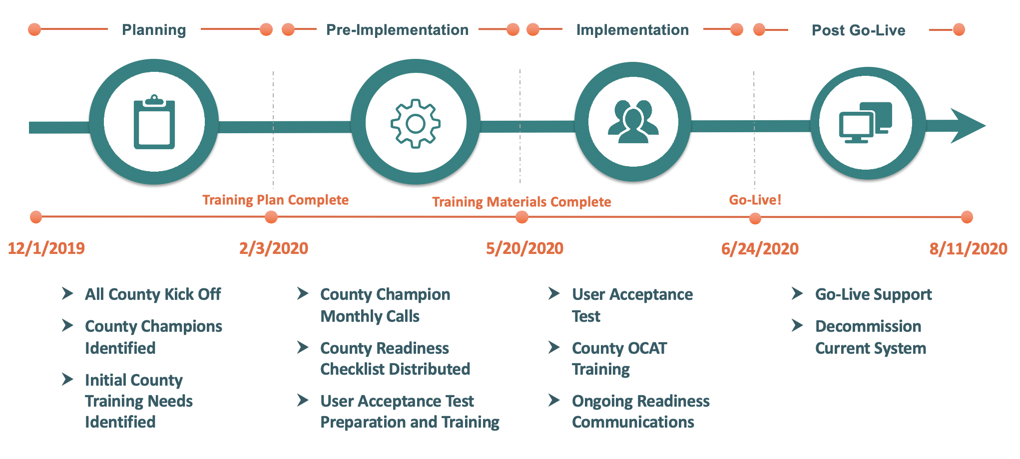
OCAT Upcoming Training and Implementation
High-level schedule and activities

Slide 62
OCAT Training Methods
Types of trainings that will be offered
# | Type | Description | Audience
1 | Webinar Training | Interactive web-based live meeting with system overview and interactive Q&A. | CalSAWS Consortium Staff and County Champions
2 | Video Demos (self-paced) | Recorded walkthroughs of modular OCAT demos ranging from 5 - 30 minutes in length. Demos focus on changes from the old system and cover end-to-end system processes. | All OCAT Users
3 | Desk Guides | Step by step guides explaining how to perform various tasks within OCAT. Intended to be read in parallel with using the OCAT training environment. | All OCAT Users
4 | Hands-on Practice | Live access to the OCAT training environment with mock data. | All OCAT Users

Slide 63
CalSAWS Conference
Westin San Diego
June 24-26, 2020

Slide 64
CalSAWS 2020 Annual Conference
Westin San Diego – June 24-26, 2020
Requires Quorum of the JPA Board, Member Representatives, and PSC
Registration
  RSVP Required (Form attached)
  No Registration Fee
  Hotel Block – Use link on registration form
Wednesday, June 24, 2020
  Travel Day
  Evening Social Event (Not part of the conference.)
Thursday, June 25, 2020 (7:00 a.m. – 5:00 p.m.)
  Registration/Continental Breakfast
  CalSAWS JPA Board Meeting
  CalSAWS Member Representatives Meeting
    JPA Board Elections
    PSC Elections
  Lunch
  Project Presentations
  Dinner (6:00 p.m. – 8:00 p.m.)
Friday, June 26, 2020 (8:00 a.m. – 12:00 p.m.)
  County-to-County Presentations

Slide 65
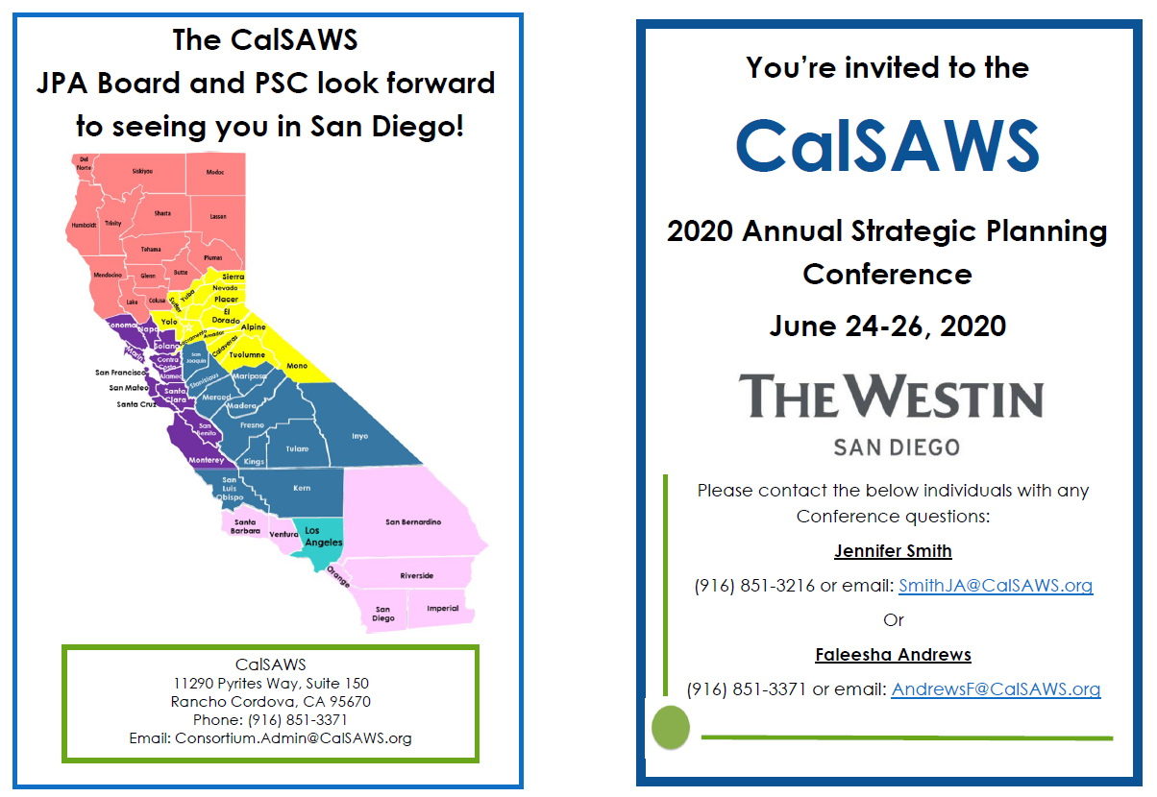
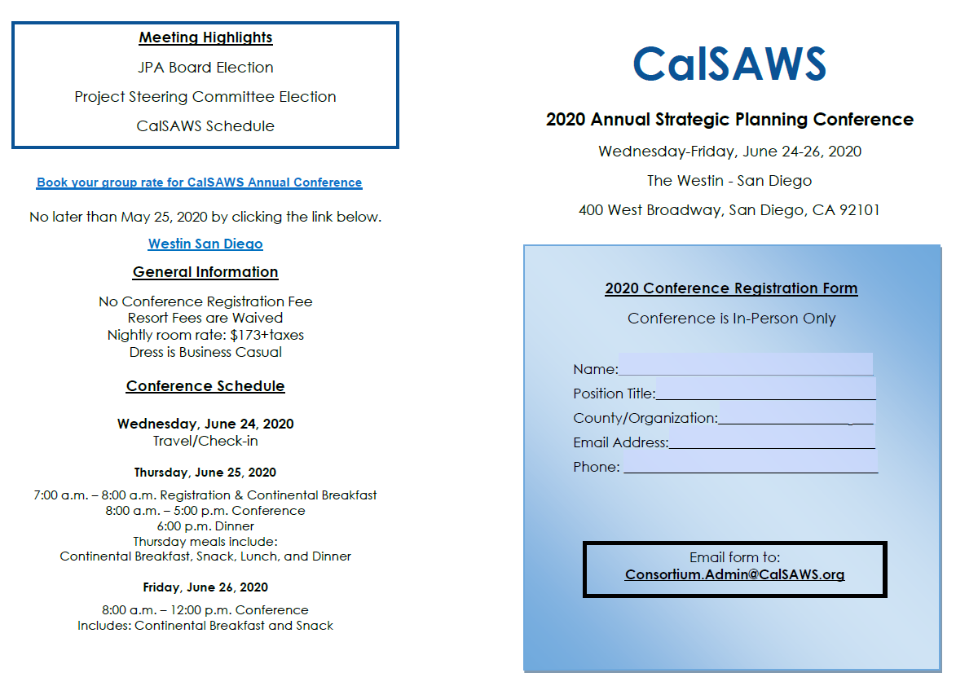
CalSAWS 2020 Annual Conference
Registration Form
PDF Fill-in Registration form is included with the meeting materials
Return to Consortium.Admin@CalSAWS.org by May 22, 2020
Book hotel room by using the link to the Westin San Diego within the registration form or here, by May 25, 2020.

Slide 66
Adjourn joint meeting of the CalSAWS Member Representatives and JPA Board of Directors

