Slide 1


CalSAWS
CalSAWS and BenefitsCal Readiness Summary
Implementation Readiness Dashboard
May 2021
The Implementation Readiness Dashboard presents a high-level view of Project Readiness in the form of a stop light indicator for the previous and current reporting period. Readiness statuses are presented for each Readiness Area. The status of each Readiness Area is determined by timely Milestone completion (see Key below). Project Milestones are identified by project team leads and CalSAWS Project leadership. More detail on C-IV Migration and BenefitsCal progress can be found in the Implementation Readiness Packet. The information reflects data as of May 7, 2021.
*An Implementation Readiness Milestone is a critical-path activity for the C-IV Migration and BenefitsCal Go-Live in September 2021.
Area | Category | CalSAWS | BenefitsCal | Comments
Application | Design | C | C
 | Development | G | G
 | System Test | G | G
 | User Acceptance Test | G | G
 | Usability Test | N/A | G
Integration | Design | C | C
 | Development | G | G
 | System Test | G | G
 | Interface Partner Test | G | G
Technical | Infrastructure | G | NS
 | Security Testing | G | G
 | Performance Testing | G | G
Conversion | Conversion Readiness | G | NS
 | Converted Data Test | G | G
Training | Training Plan | C | G
 | Training Materials | G | G
 | Training Delivery | G | NS
Implementation | Service Desk | C | NS
 | System Operations | G | G
 | Prod Deployment Plans | G | G
Change | Communications | G | G
 | Partner Readiness (County, etc.) | N/A | NS
NS | Not Started | G | On Schedule | Y | <14 Days Late | R | >=14 Days Late | C | Complete

Slide 2
Key Project Milestones/Tasks
Key Open Readiness Risks
Milestone/Task | Status | Target Start Date | Target End Date | Percent Complete
Application Development and System Test | Complete | 3/14/2019 | 1/25/2021 | 100%
BenefitsCal Phase 1 Design Complete | Complete | 12/1/2020 | 3/26/2021 | 100%
Converted Data Test | Complete | 7/13/2020 | 4/30/2021 | 100%
CalSAWS and BenefitsCal UAT County Preparation Begins | In Progress | 3/18/2021 | 5/21/2021 | 74%
Mock Conversions | In Progress | 5/3/2021 | 8/27/2021 | 15%
Training – Install LMS, Load Courses, Test Reports | In Progress | 9/3/2019 | 9/24/2021 | 54%
Implementation Readiness Preparation | In Progress | 4/6/2020 | 9/27/2021 | 66%
State and C-IV County Interface Testing | Not Started | 6/1/2021 | 7/30/2021 | 0%
Batch Performance Testing | Not Started | 7/1/2021 | 7/30/2021 | 0%
User Acceptance Test (UAT) | Not Started | 6/14/2021 | 9/3/2021 | 0%
Training Support | Not Started | 7/5/2021 | 9/24/2021 | 0%
C-IV County Go-Live | Not Started | 9/27/2021 | 9/27/2021 | 0%
Implementation Support | Not Started | 9/28/2021 | 11/5/2021 | 0%
State Report County Support | Not Started | 9/27/2021 | 10/31/2023 | 0%
Risk No. & Level | Risk Summary | Status
226 High | COVID-19 relief efforts may impact CalSAWS DD&I schedule. | The priority for the CalSAWS Project is responding to emergency and policy updates related to COVID-19. ​ The SAWS will provide feedback on approach and timelines.
231 High | Delay of Web Browser compliance may impact users who do not use MS Internet Explorer | AEM meets the basic requirement of rendering forms in HTML5 and providing compatibility with Chrome and Edge browsers. Validation completed with all identified types of forms and threshold languages.
236 High | The scaling of Analytics Dashboards for 58 Counties may have an impact on system performance | Action Item #1: In Progress Action Item #2: Complete Action Item #3: In Progress Action Item #4: Not Started
237 High | The scaling of Batch for 58 Counties may have an impact on system performance | Continue to monitor the trend analysis of batch performance tuning efforts in CalSAWS.
208 Medium | CalHEERS release readiness delays may negatively impact CalSAWS delivery timelines, slowing critical updates to counties | Will continue to collaborate with the CalHEERS team as they transition to a new M&O vendor focusing on potential release impacts.
235 Medium | The BenefitsCal Project Release 1.0 may be delayed due to integration with the CalSAWS Interface | BenefitsCal phase 1 is split into two releases. Release 1 functionality equals/exceeds what is currently available in C4Yourself and deploying with the CalSAWS C-IV cutover in September 2021.
241 Medium | If production services/operations are not expanded to support 58 counties, CalSAWS may not be ready to support a multi-county and multi-vendor production environment | Assessed current processes & procedures to determine next steps for production operations to support multi-county, multi-vendor set of services and implement outcomes prior to the C-IV cutover.
Project Milestones/Tasks and Issues/Risks
Late Project Milestones/Tasks
There are no Late Project Milestones/Tasks as of April 2021.

Slide 3
County Readiness Summary
Quick Links to County Checklists
Area | Status | Counties
Application | G | 39 of 39 counties
Technical | G | 39 of 39 counties
Conversion | G | 39 of 39 counties
Training | G | 39 of 39 counties
Implementation | G | 39 of 39 counties
Change | G | 39 of 39 counties
Click the links below to view the detailed checklist for your county:
Alpine
Amador
Butte
Calaveras
Colusa
Del Norte
El Dorado
Glenn
Humboldt
Imperial
Inyo
Kern
Kings
Lake
Lassen
Madera
Marin
Mariposa
Mendocino
Merced
Modoc
Mono
Monterey
Napa
Nevada
Plumas
Riverside
San Benito
San Bernardino
San Joaquin
Shasta
Sierra
Siskiyou
Stanislaus
Sutter
Tehama
Trinity
Tuolumne
Yuba
County Readiness
NS | Not Started | G | On Schedule | Y | <14 Days Late | R | >=14 Days Late
Top County Readiness Issues and Risks
No. | Summary | Risk/Issue Level | Due Date | Remediation Plan
 | None identified as of April 2021.
*Web Portal access is required
Questions?
Contact your Regional Manager, IPOC, or TPOC for more insight on each readiness area.

Slide 4
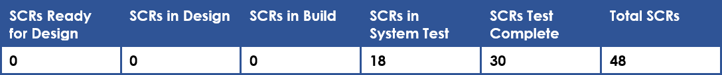
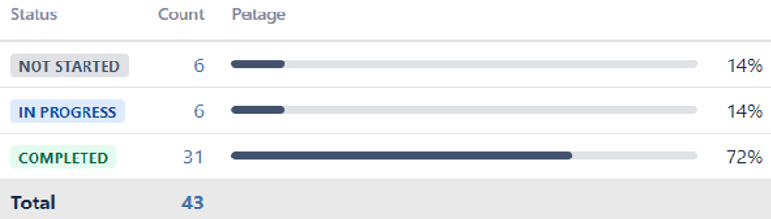
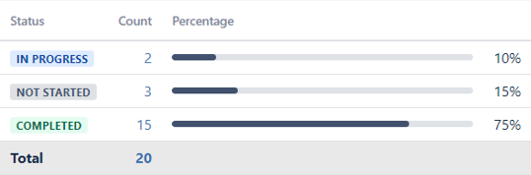
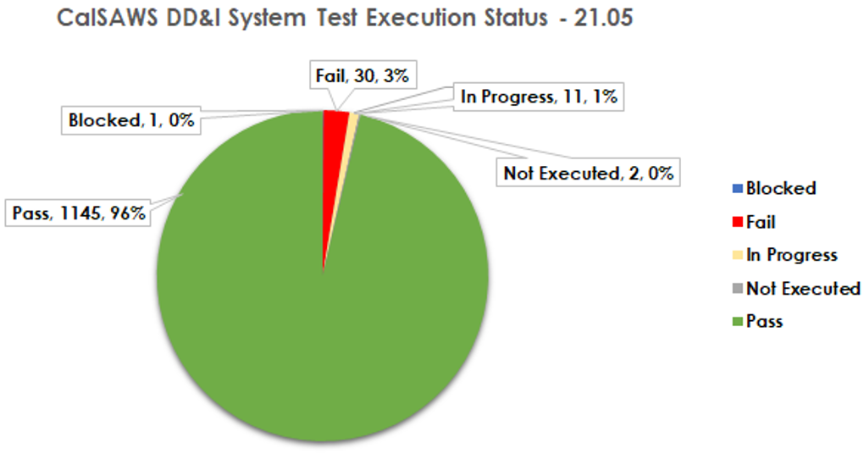
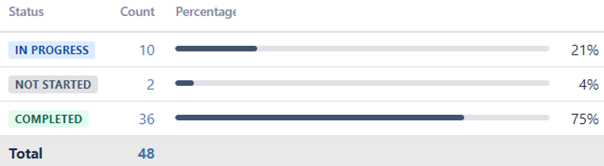
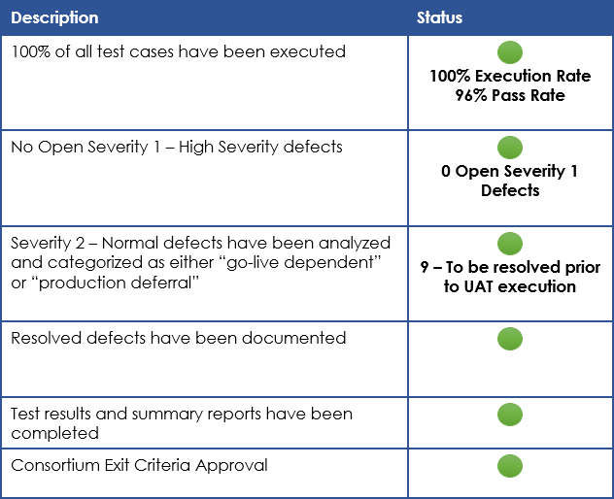
Application Readiness
Conversion Readiness
Technical Readiness
Design | Complete
Key Dates:
Mock Conversion #1 Part B: 05/10/2021 – 05/14/2021
Mock Conversion #2 Part A: 06/09/2021 – 06/10/2021
Mock Conversion #2 Part B: 06/13/2021 – 06/16/2021
Golden Data Set #4 Ready: 05/20/2021
Cutover 1A: 08/28/2021 – 08/29/2021
Cutover 1B: 09/23/2021 – 09/27/2021
Security Test | On Schedule
Start Date: 11/05/2019
End Date: 09/24/2021
Development | On Schedule
Performance Test | On Schedule
Start Date: 05/01/2019
End Date: 09/24/2021
Conversion Readiness | On Schedule
System Test | On Schedule
Infrastructure | On Schedule
CalSAWS Readiness
Converted Data Test | On Schedule
Start Date: 12/30/2020
End Date: 04/30/2021
Extranet Enablement aims to build a future state of connectivity for all counties to access AWS hosted services. To date, 122 sites are complete (96%).
Release: 21.05
Start: 03/26/2021
End: 05/24/2021
Open Defects as of 05/07/2021: 142
Target Pass Rate: 75%
Actual Pass Rate: 96%
Status | Count | Percent
Completed | 122 | 96%
In Progress | 3 | 2%
On Hold | 2 | 2%
UAT | On Schedule
Key Dates:
Kickoff & Scenario Prep: 03/18/2021 – 04/16/2021
County Scenario Review: 4/19/21 – 5/21/21
UAT Orientation: 06/07/2021
CalSAWS UAT Execution Start: 06/14/2021
CalSAWS UAT Execution End: 09/03/2021
SD-WAN is Software-Defined Wide Area Network and is essentially a virtual WAN architecture that supports organizations to securely connect users to applications. All 133 sites are complete (100%).

Slide 5
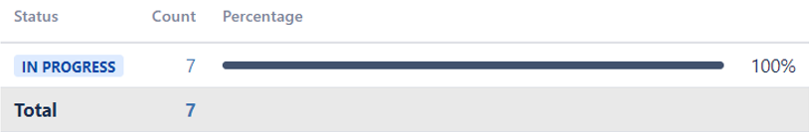
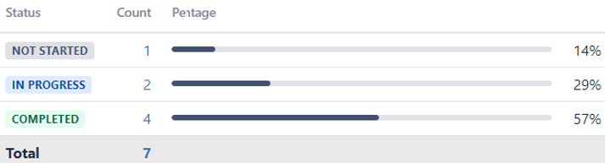
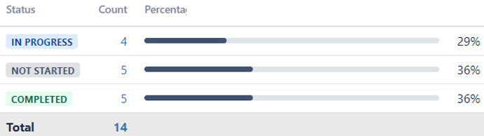
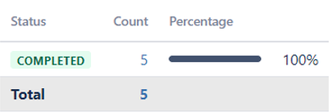
Integration Readiness
Implementation Readiness
Design | Complete
Service Desk | Complete
Start Date: 01/27/2021
End Date: 03/10/2021
Start Date: 01/01/2021
End Date: 04/30/2021
Prod Deployment Plans | On Schedule
Sandbox usage:
25 counties in Apr 2021
Avg of 20 counties/mo.
Development | On Schedule
System Test | On Schedule
Start Date: 02/25/2021
End Date: 06/11/2021
Start Date: 04/26/2021
Start Date: 07/16/2021
Interface Partner Test | On Schedule
Systems Operations | On Schedule
Testing in progress with MEDS, EBT, Child Support Interface, CalWIN eICT, & CalHEERS. | Start Date: 03/01/2021 End Date: 08/27/2021
Start Date: 12/01/2019
End Date: 08/27/2019
CalSAWS Readiness
Training Readiness
Change Readiness
Training Plan | Complete
Communications | On Schedule
Start Date: 05/04/2020
End Date: 09/06/2021
Type | Current Progress | Total Planned
Infographics | 8 | 9+
News Blasts | 3 | 4
Demo Videos | 6 | 6+
Targeted Topics | 10 | 10
CNC Meetings | 6 | 11
Just-in-Time Demos | 0 | 5
Training Delivery | On Schedule
Start Date: 09/03/2019
End Date: 09/17/2021
Training Materials | On Schedule
Training Material Type | Number of Training Materials | Design | Build | Test | Complete
Web-based Trainings (WBTs) | 29 | 2 | 26 | 0 | 1
Quick/Reference Guides | 69 | 12 | 9 | 0 | 48
Start Date: 01/01/2019
End Date: 08/01/2021
Partner Readiness | On Schedule
See County Readiness

Slide 6
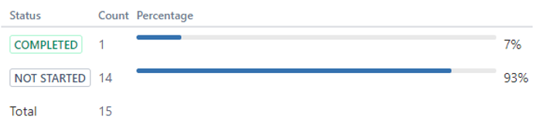
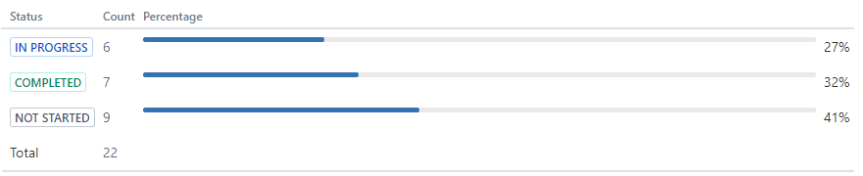
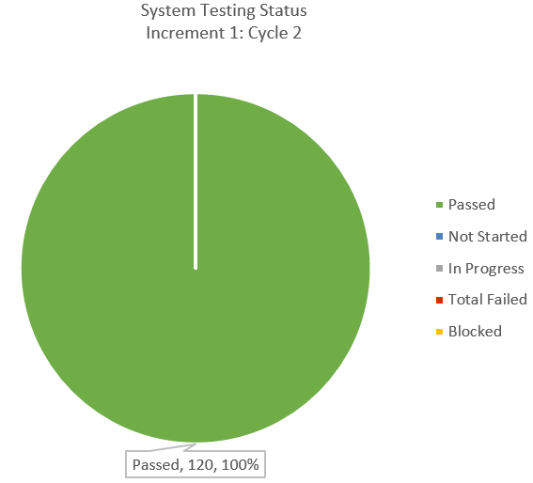
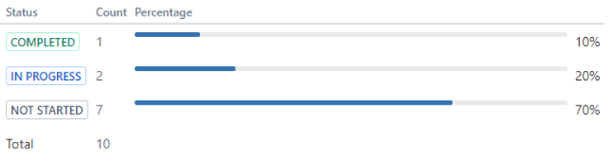
Application Readiness
Conversion Readiness
Design | Complete
Conversion Readiness | Not Started
End Date: 03/10/2021
End Date: 09/27/2021
Converted Data Test | On Schedule
End Date: 07/16/2021
Development | On Schedule
End Date: 06/11/2021
BenefitsCal Readiness
Technical Readiness
System Test | On Schedule
UAT | On Schedule
Security Testing | On Schedule
Key Dates:
Kickoff and Scenario Preparation: 03/18/2021 – 04/16/2021
County Scenario Review: 04/20/2021 – 05/02/2021
UAT Orientation: 06/07/2021
CalSAWS UAT Execution Start: 6/14/2021
CalSAWS UAT Execution End: 09/03/2021
Target End Date: 08/06/2021
Usability Test | On Schedule
Performance Testing | On Schedule
Release: 1
Start: 03/01/2021
End: 10/31/2021
Target Pass Rate: 90%
Actual Pass Rate: 100%
End Date: 09/03/2021
End Date: 09/03/2021
Infrastructure | Not Started
End Date: 09/24/2021

Slide 7
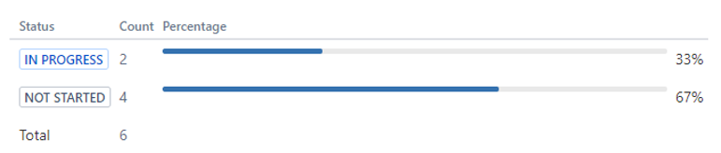
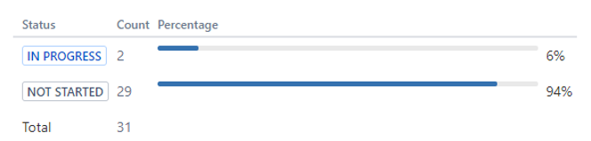
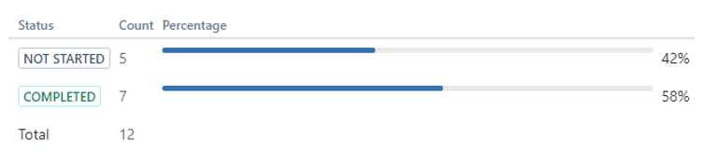
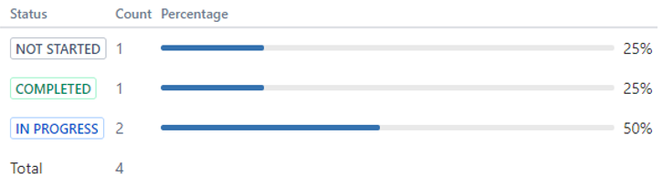
Integration Readiness
Change Readiness
Implementation Readiness
Design | Complete
Communications | On Schedule
Service Desk | Not Started
End Date: 03/10/2021
End Date: 09/20/2021
End Date: 09/10/2021
Prod Deployment Plans | On Schedule
End Date: 09/27/2021
Development | On Schedule
Partner Readiness | Not Started
System Operations | On Schedule
End Date: 06/11/2021
End Date: 09/20/2021
End Date: 09/03/2021
BenefitsCal Readiness
Training Readiness
System Test | On Schedule
Training Plan | On Schedule
Training Delivery | Not Started
End Date: 07/16/2021
End Date: 05/28/2021
End Date: 09/17/2021
Interface Partner Test | On Schedule
Training Materials | On Schedule
End Date: 07/16/2021
End Date: 07/30/2021

