Slide 1


CalSAWS
Implementation Readiness Dashboard
June 2021
CalSAWS, BenefitsCal, & Central Print Readiness Summary
Area | Category | CalSAWS | BenefitsCal | Central Print
Application | Design | C | C | N/A
 | Development | C | G | N/A
 | System Test | G | G | N/A
 | User Acceptance Test | G | G | N/A
 | Usability Test | N/A | G | N/A
Integration | Design | C | C | C
 | Development | G | G | NS
 | System Test | G | G | NS
 | Interface Partner or Connectivity Test | G | G | NS
Technical | Infrastructure | G | NS | N/A
 | Security Testing | G | G | N/A
 | Performance Testing | G | G | N/A
Conversion | Conversion Readiness | G | G | N/A
 | Converted Data Test | C | G | N/A
Operational | Fulfillment Platform Software | N/A | N/A | G
 | Print Centers | N/A | N/A | G
 | Supplies | N/A | N/A | G
Training | Training Plan | C | C | N/A
 | Training Course and Materials | G | G | NS
 | Training Delivery | G | G | NS
Implementation | Service Desk | C | NS | NS
 | System Operations | G | G | NS
 | Prod Deployment Plans | G | G | N/A
Change | Communications | G | G | N/A
 | Partner Readiness (County, etc.) | N/A | NS | N/A
The Implementation Readiness Dashboard presents a high-level view of Project Readiness in the form of a stop light indicator for the previous and current reporting period. Readiness statuses are presented for each Readiness Area. The status of each Readiness Area is determined by timely Milestone completion (see Key below). Project Milestones are identified by project team leads and CalSAWS Project leadership. More detail on C-IV Migration, BenefitsCal, and Central Print progress can be found in the Implementation Readiness Packet. The information reflects data as of June 4, 2021.
*An Implementation Readiness Milestone is a critical-path activity for the C-IV Migration, BenefitsCal, Central Print Go-Live in September 2021.
NS | Not Started | G | On Schedule | Y | <14 Days Late | R | >=14 Days Late | C | Complete

Slide 2
Key Project Milestones/Tasks
Key Open Readiness Risks
Milestone/Task | Status | Target Start Date | Target End Date | Percent Complete
Application Development and System Test | Complete | 3/14/2019 | 1/25/2021 | 100%
BenefitsCal Phase 1 Design Complete | Complete | 12/1/2020 | 3/26/2021 | 100%
Converted Data Test | Complete | 7/13/2020 | 4/30/2021 | 100%
CalSAWS and BenefitsCal UAT County Preparation Begins | Complete | 3/18/2021 | 5/21/2021 | 100%
Batch Performance Testing | In Progress | 5/10/2021 | 7/30/2021 | 49%
State and C-IV County Interface Testing | In Progress | 6/1/2021 | 7/30/2021 | 10%
Mock Conversions | In Progress | 5/3/2021 | 8/27/2021 | 74%
Training – Install LMS, Load Courses, Test Reports | In Progress | 9/3/2019 | 9/24/2021 | 65%
Implementation Readiness Preparation | In Progress | 4/6/2020 | 9/27/2021 | 74%
User Acceptance Test (UAT) | Not Started | 6/14/2021 | 9/3/2021 | 0%
Training Support | Not Started | 7/5/2021 | 9/24/2021 | 0%
C-IV County Go-Live | Not Started | 9/27/2021 | 9/27/2021 | 0%
Implementation Support | Not Started | 9/28/2021 | 11/5/2021 | 0%
State Report County Support | Not Started | 9/27/2021 | 10/31/2023 | 0%
*There are no Late Project Milestones/Tasks as of June 2021.
Risk No. & Level | Risk Summary | Status
226 High | COVID-19 relief efforts may impact CalSAWS DD&I schedule. | CalSAWS is anticipating another one-time grant for CalWORKs in July. The Project will also be updating MC RE dates as an initial step as DHCS works through the policy for when the PHE is lifted.
231 High | Delay of Web Browser compliance may impact users who do not use MS Internet Explorer | Two Tech SCRs have been drafted for 21.07 to support the current plan based on the assumption Adobe will resolve these issues soon. ​
236 High | The scaling of Analytics Dashboards for 58 Counties may have an impact on system performance | Action Item #1: In Progress Action Item #2: Complete Action Item #3: In Progress Action Item #4: Not Started
237 High | The scaling of Batch for 58 Counties may have an impact on system performance | Continue to monitor the trend analysis of batch performance tuning efforts in CalSAWS.
248 High | C-IV Converted Image transfer for documents scanned prior to 02/28/2021 is at risk of not finishing prior to go live. | The Project is re-initiating the transfer of images, reducing load sizes, maximizing output thresholds, and re-tuning the export scripts with experts at AWS and Hyland. UAT test efforts are not impacted. At minimum for go live in September, the most recent 7 months of scanned images will be loaded into CalSAWS. The read only version of C-IV will continue to contain all images for further mitigation of this risk.
208 Medium | CalHEERS release readiness delays may negatively impact CalSAWS delivery timelines, slowing critical updates to counties | CalHEERS production releases have been delivered timely for the preceding 12 months. However, due to the planned CalHEERS Cloud migration and the CalHEERS discussion of a potential 09/2021 release, this item will continue to require monitoring.
235 Medium | The BenefitsCal Project Release 1.0 may be delayed due to integration with the CalSAWS Interface | Deloitte will provide new build by June 7 to support closeout of findings prior to the start of UAT June 14. Starting June 14, QA Independent Test and UAT will be staggered to focus on components of application.
241 Medium | If production services/operations are not expanded to support 58 counties, CalSAWS may not be ready to support a multi-county and multi-vendor production environment | Assessed current processes & procedures to determine next steps for production operations to support multi-county, multi-vendor set of services and implement outcomes prior to the C-IV cutover.
Project Milestones/Tasks and Issues/Risks

Slide 3
County Readiness Summary
Quick Links to County Checklists
Area | Status | Counties
Application | G | 39 of 39 counties
Technical | G | 39 of 39 counties
Conversion | G | 39 of 39 counties
Training | G | 39 of 39 counties
Implementation | G | 39 of 39 counties
Change | G | 39 of 39 counties
Click the links below to view the detailed checklist for your county:
Alpine
Amador
Butte
Calaveras
Colusa
Del Norte
El Dorado
Glenn
Humboldt
Imperial
Inyo
Kern
Kings
Lake
Lassen
Madera
Marin
Mariposa
Mendocino
Merced
Modoc
Mono
Monterey
Napa
Nevada
Plumas
Riverside
San Benito
San Bernardino
San Joaquin
Shasta
Sierra
Siskiyou
Stanislaus
Sutter
Tehama
Trinity
Tuolumne
Yuba
County Readiness
NS | Not Started | G | On Schedule | Y | <14 Days Late | R | >=14 Days Late
Top County Readiness Issues and Risks
No. | Summary | Risk/Issue Level | Due Date | Remediation Plan
*There are no Issues and Risks as of June 2021.
*Web Portal access is required
Questions?
Contact your Regional Manager, IPOC, or TPOC for more insight on each readiness area.

Slide 4

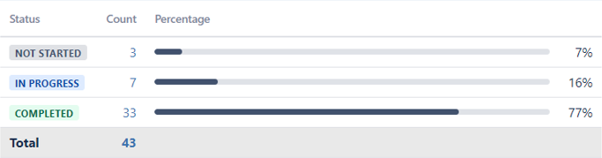
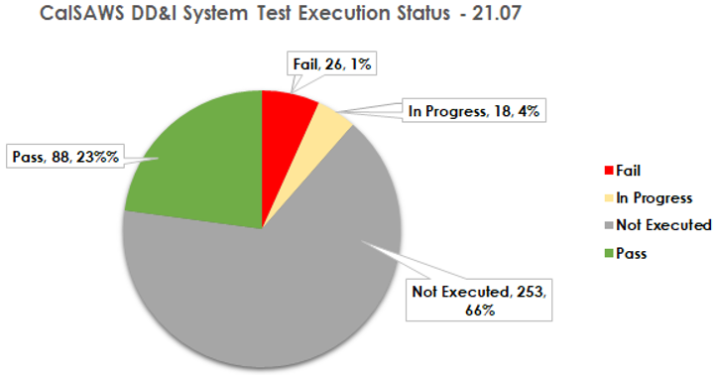
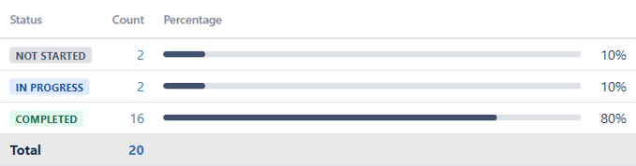
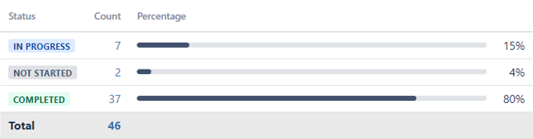
Application Readiness
Conversion Readiness
Technical Readiness
Design | Complete
Key Dates:
Mock Conversion #2 Part A: 06/09/2021 – 06/10/2021
Mock Conversion #2 Part B: 06/13/2021 – 06/16/2021
Golden Data Set #5 Ready: 06/21/2021
Cutover 1A: 08/28/2021 – 08/29/2021
Cutover 1B: 09/23/2021 – 09/27/2021
Security Test | On Schedule
Start Date: 11/05/2019
End Date: 09/24/2021
Development | Complete
Performance Test | On Schedule
Start Date: 05/01/2019
End Date: 09/24/2021
System Test | On Schedule
Conversion Readiness | On Schedule
Infrastructure | On Schedule
CalSAWS Readiness
Release: 21.07
Start: 05/28/2021
End: 07/26/2021
Open Defects as of 06/04/2021: 66
Target Pass Rate: 13%
Actual Pass Rate: 23%
Extranet Enablement aims to build a future state of connectivity for all counties to access AWS hosted services. To date, 122 sites are complete (96%).
UAT | On Schedule
Converted Data Test | Complete
Status | Count | Percent
Completed | 122 | 96%
In Progress | 3 | 2%
On Hold | 3 | 2%
Key Dates:
UAT Orientation: 06/07/2021
CalSAWS UAT Execution Start: 06/14/2021
CalSAWS UAT Execution End: 09/03/2021
Start Date: 12/30/2020
End Date: 04/30/2021

Slide 5
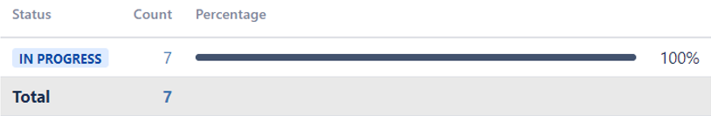
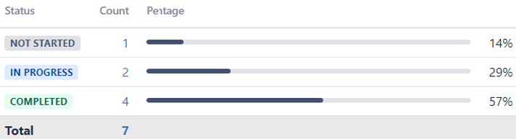
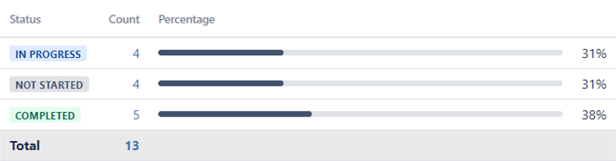
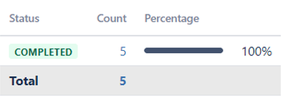
Integration Readiness
Implementation Readiness
Design | Complete
Start Date: 01/27/2021 | End Date: 03/10/2021
Service Desk | Complete
Start Date: 01/01/2021
End Date: 04/30/2021
Prod Deployment Plans | On Schedule
Sandbox usage:
Average of
23 logins
per week
for May 2021.
Development | On Schedule
Start Date: 02/25/2021 | End Date: 06/11/2021
System Test | On Schedule
Start Date: 04/26/2021 | End Date: 07/16/2021
Interface Partner Test | On Schedule
Start Date: 03/01/2021 | End Date: 08/27/2021
Systems Operations | On Schedule
Start Date: 12/01/2019
End Date: 08/27/2019
CalSAWS Readiness
Testing in progress with MEDS, EBT, Child Support Interface, CalWIN eICT, & CalHEERS.
Training Readiness
Change Readiness
Training Plan | Complete
Communications | On Schedule
Start Date: 05/04/2020 | End Date: 09/06/2021
Training Delivery | On Schedule
Start Date: 09/03/2019
End Date: 09/17/2021
Type | Current Progress | Total Planned
Infographics | 11 | 9+
News Blasts | 3 | 4
Demo Videos | 6 | 6+
Targeted Topics | 10 | 10
CNC Meetings | 7 | 11
Just-in-Time Demos | 1 | 5
Training Materials | On Schedule
Training Material Type | Number of Training Materials | Design | Build | Complete
Web-based Trainings (WBTs) | 29 | 1 | 20 | 8
Quick/Reference Guides | 73 | 1 | 1 | 71
Start Date: 01/01/2019
End Date: 08/01/2021

Slide 6
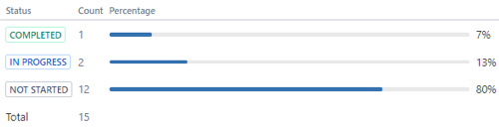
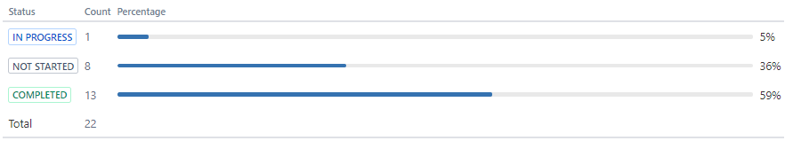
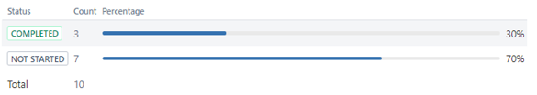
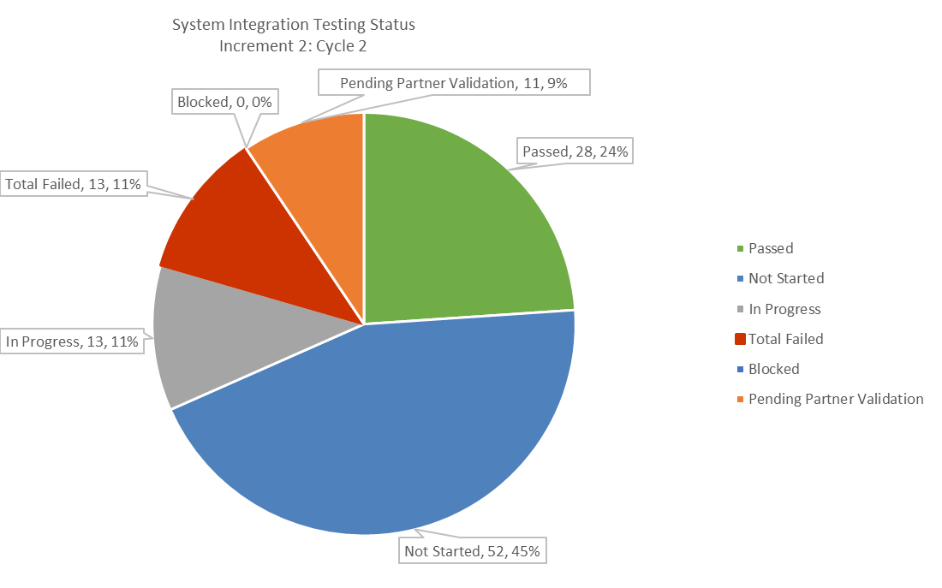
Application Readiness
Conversion Readiness
Design | Complete
Conversion Readiness | On Schedule
End Date: 03/10/2021
End Date: 09/27/2021
Development | On Schedule
End Date: 06/11/2021
Converted Data Test | On Schedule
Technical Readiness
Security Testing | On Schedule
BenefitsCal Readiness
End Date: 08/06/2021
System Test | On Schedule
UAT | On Schedule
Key Dates:
Kickoff and Scenario Preparation: 03/18/2021 – 04/16/2021
County Scenario Review: 04/20/2021 – 05/02/2021
UAT Orientation: 06/07/2021
CalSAWS UAT Execution Start: 6/14/2021
CalSAWS UAT Execution End: 09/03/2021
Performance Testing | On Schedule
End Date: 09/03/2021
Usability Test | On Schedule
Increment: 2
Cycle: 2
Start: 05/28/2021
End: 07/16/2021
Target Pass Rate: 60%
Actual Pass Rate: 68%
End Date: 09/03/2021
Infrastructure | Not Started
End Date: 09/24/2021

Slide 7
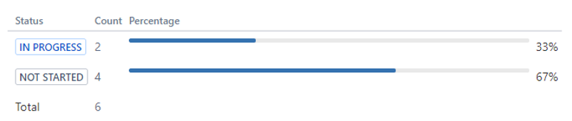

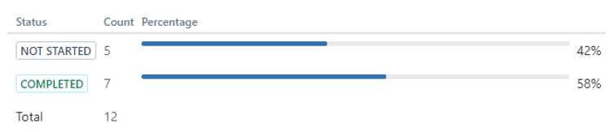
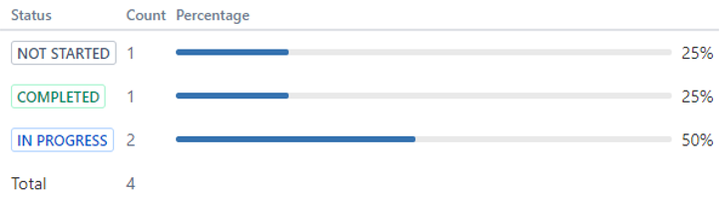
Integration Readiness
Change Readiness
Implementation Readiness
Design | Complete
Communications | On Schedule
Service Desk | Not Started
End Date: 03/10/2021
End Date: 09/20/2021
End Date: 09/10/2021
Prod Deployment Plans | On Schedule
End Date: 09/27/2021
Development | On Schedule
Partner Readiness | Not Started
System Operations | On Schedule
End Date: 06/11/2021
End Date: 09/20/2021
End Date: 09/03/2021
BenefitsCal Readiness
Training Readiness
System Test | On Schedule
Training Plan | Complete
Training Delivery | On Schedule
End Date: 07/16/2021
End Date: 05/28/2021
End Date: 09/17/2021
Interface Partner Test | On Schedule
Training Materials | On Schedule
End Date: 07/16/2021
End Date: 07/30/2021

Slide 8
Fulfillment Platform Software Readiness
Integration Readiness
Print Centers Readiness
Requirements | On Schedule
Start Date: 04/16/2021 | End Date: 06/30/2021
Design | Complete
Start Date: 04/16/2021 | End Date: 06/07/2021
Existing Print Centers Equipment Installed | On Schedule
Start Date: 06/01/2021 | End Date: 07/15/2021
Specifications | On Schedule
Start Date: 04/16/2021 | End Date: 06/30/2021
Development | Not Started
Start Date: 06/08/2021 | End Date: 07/30/2021
New Printer Center Established | On Schedule
Start Date: 04/16/2021 | End Date: 07/30/2021
Configuration | Not Started
Start Date: 07/01/2021 | End Date: 8/26/2021
Test | Not Started
Start Date: 08/01/2021 | End Date: 08/27/2021
Production Testing | Not Started
Start Date: 08/05/2021 | End Date: 08/25/2021
The Fulfillment Platform is a Software as a Service (SaaS) integrated set of automation tools that assists with the workflow in the Print Centers and provides preprocessing and workflow management for all three Print Centers.
This readiness area identifies:
Configuration parameters for the Fulfillment Platform and executes on loading of the configurations.
Fulfillment Platform users and adding those users.
Connectivity Test | Not Started
Start Date: 07/15/2021 | End Date: 07/30/2021
This readiness area completes the design and development of the interface connectivity and print file parameters with the CalSAWS Application Maintenance Vendor.
During each phase, the interface and file formats needed to receive input for print and mail services are established and/or verified with the CalSAWS Application Maintenance Vendor.
The print centers readiness area is intended to enhance two of the Primary/Backup Print Centers that are in operation today and establish a new third Print Center.
Central Print Readiness
Existing Print Center Activity | Status
Establish Network Connectivity | On Schedule
Extend the Fulfilment Platform | On Schedule
Perform Equipment Replacement | On Schedule
Activity | Status
Existing Documentation Review —Print file documents by CalSAWS. | On Schedule
Design Meetings — Design and review meetings to discuss and create the design for file transfer and print jobs. | On Schedule
New Print Center Activity | Status
Equipment Purchase/Setup | On Schedule
Component Testing | On Schedule
Activity | Status
Configuration Meetings — discuss print job configurations to be loaded into the Fulfillment Platform as rules for creating job work orders. | On Schedule

Slide 9
Supplies Readiness
Training Readiness
Implementation Readiness
Requirements | On Schedule
Start Date: 04/16/2021 | End Date: 07/30/2021
Training Course | Not Started
Start Date: 07/01/2021 | End Date: 08/15/2021
Service Desk | Not Started
Start Date: 08/15/2021 | End Date: 09/22/2021
Inventory | On Schedule
Start Date: 04/16/2021 | End Date: 07/30/2021
Training Delivery | Not Started
Start Date: 08/15/2021 | End Date: 09/22/2021
System Operations | Not Started
Start Date: 08/28/2021 | End Date: 09/30/2021
Supplies readiness relates to obtaining the correct envelopes, paper and inserts for production printing as needed for each phase.
This readiness activity includes verifying the volume and content of the planned print with the CalSAWS Application Maintenance Vendor and verifying supply items.
Training readiness relates to providing training on the Central Print portal to counties in each implementation phase. The portal is available for counties to obtain status on printing and postage balances.
This readiness activity includes developing the training course and delivering the training related to county portal usage.
This readiness activity results in creation of the CalSAWS printing solution’s operational processes.
Central Print Readiness
Determination of Supplies | Status
Envelope design — Determine specifications by obtaining sample envelopes and print files of each correspondence type | On Schedule
Fonts — Gather information on any new fonts if applicable | On Schedule
Paper type — Obtain information on paper type(s) in use | On Schedule
Preprinted inserts — Automate the process if possible, or obtain inventory | On Schedule
Postage permits — Validate permit indicia needed | On Schedule
Activity | Status
Knowledge Transfer for Los Angeles County Print | On Schedule
Operations Procedures — This activity results in creation and documentation of Print Center procedures including File Receipt, Print, Insertion, USPS delivery, and more. | On Schedule
Activity | Status
Training Course — Develop training webinar course for county designated portal users | On Schedule

