Slide 1

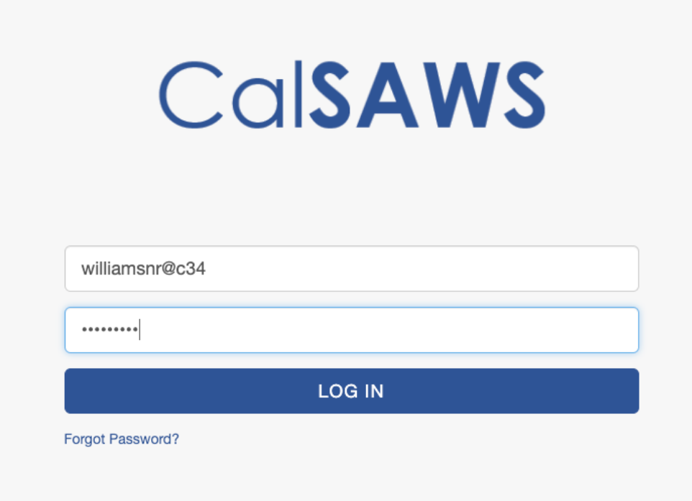
Logging into CalSAWS: Helpful Hints
First-Time Login
Ongoing Logins
If this is your first-time logging into CalSAWS, follow the instructions on the Login Page:
Enter your username (your County email) and CalSAWS password.
If you have previously accessed LMS, your username and password will be the same ones used for LMS.
If you forget your password, click the “Forgot Password” link after your CalSAWS credentials have been created.
Once you have logged into CalSAWS or LMS, follow the instructions on the Login Page:
Use your CalSAWS Credentials to login.
Tip: Remember to use your CalSAWS password. This may not match your previous CalWIN password.
Password Troubleshooting
Inactive Account
Expired Password
Your password will become Inactive if you have not logged into CalSAWS within 60 days of account activation. You will have to go through your County Help Desk to re-activate your account and reset your password.
Your password will Expire if it is not updated every 60 Days. You will receive an email notification reminder to reset your password 15, 5, 4, 3, 2, and 1 day(s) prior to password expiration.
Forgotten Password
If you forget your password, click the “Forgot Password” link after your CalSAWS credentials have been created.
https://web.calsaws.net/
For any questions or issues, please contact your County Help Desk

