Slide 1
August 18, 2022
CalWIN Wave-1 County Preparation Phase Kickoff

Slide 2
County Prep Phase Overview
County Prep Packet
County Prep Support Structure & Schedule
County Prep Metrics and Tracking

Slide 3
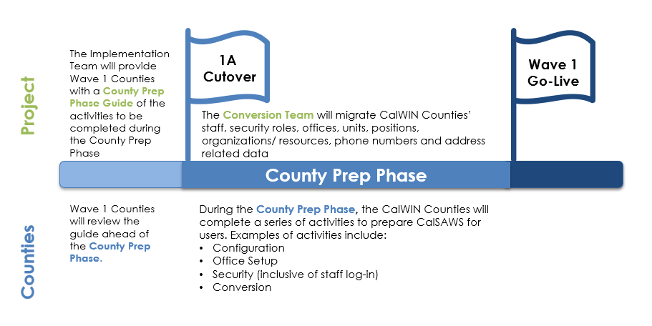
County Prep Phase Timeline
The County Prep Phase occurs 6 weeks prior to CalSAWS Go-Live for Wave 1 Counties, September 19-October 31. This phase allows for Counties to access the CalSAWS Production environment and complete the activities listed in the County Prep Phase Packet. Case data will NOT be included with 1A Cutover.

Slide 4
County Prep Phase Packet
Purpose & Organization
The County Prep Phase Packet was distributed to Wave 1 Counties on August 5th 2022 in CIT 0216-22.
The purpose of the County Prep Phase Packet is to prepare the CalWIN Counties for the activities to be completed during the County Prep Phase (the 6 weeks leading up to go-live).
The intent is for CalWIN Counties to review and understand the instructions for required and optional activities that need to be completed during County Prep Phase.
The 43 County Prep Activities are listed by subcategory:
Access (1)
Appointment Management (2)
Automated Action (4)
Readiness for BenefitsCal (6)
Caseload Management (1)
System Configuration (7)
Correspondence (2)
Fiscal (6)
GA/GR (3)
IEVS (1)
Lobby Management (2)
Medi-Cal (1)
Security (1)
Task Management (6)

Slide 5
County Prep Overview
Activity Designations
All County Prep activities are assigned a Level of Necessity, and a Priority.
Necessity
Required activities must be completed before go-live in order for the CalSAWS application to align with County business practices.
Required if Applicable activities are specific to optional system functionality and must be completed by Counties who opt-in.
Optional activities are additional configurations that counties can leverage but will not cause negative impacts if not completed by go live.
Priority
High priority activities are important for each county's ability to conduct their work to County specifications as of go-live.
Medium priority activities should be completed during the County Prep Phase but will have less impact on system usability than High Priority items.
Low Priority activities will not impede system functionality after go-live if not completed.

Slide 6
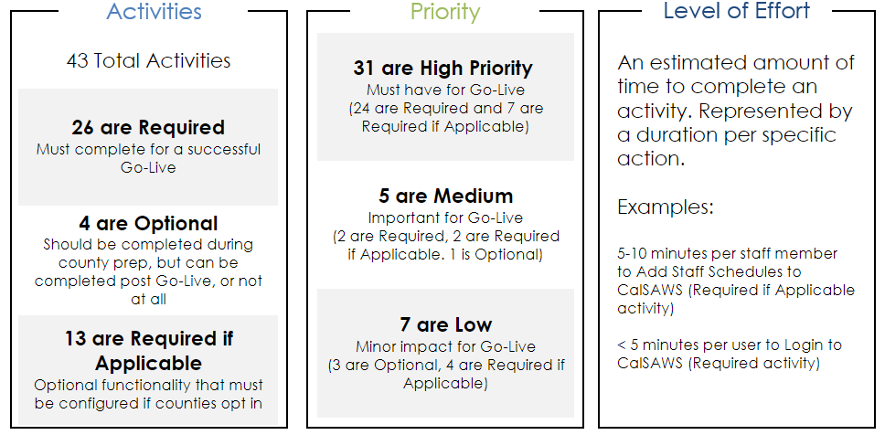
County Prep Phase Activities Overview
NOTE: As of 09/02/2022 two activities were added, and one was removed.
Notes:
There are 13 Required activities that are high priority and an additional 4 Required if Applicable activities that are high priority

Slide 7



County Prep Related Efforts
Configuration and Process Simulation
33 of the 41 County Prep activities are covered by the Configuration and Process Simulation efforts.
The worksheets and content of Configuration and Process Simulation will directly inform the activities you’ll be expected to complete during the County Prep Phase.
The associated CalSAWS Configuration Guide and CalSAWS Additional Configuration Guide are included with County Prep Materials and linked in the County Prep Packet.

Slide 8
County Prep Overview
Who’s Responsible
ALL CalSAWS Users are recommended to Login and confirm access to the CalSAWS Application within the first two weeks of the County Prep Phase. Logging in early will help avoid access-related bottlenecks leading up to and after go-live.
The County staff responsible for the completing the remaining County Prep Activities include:
  Primary, Technical and Implementation Points of Contact (PPOCs, TPOCs and IPOCs)
  County Administrators
  Security Administrators
  Other County Staff designated by Counties
Best practice is for the County Points of Contact who have been working on Process Simulation to be responsible for completing, or guiding other County staff in completing, the Configuration related activities.

Slide 9
County Prep Phase Packet Navigation & Activities

Slide 10
County Prep Phase Packet
Activity Components
Each activity in the County Prep Phase packet includes the following components:
Type, Priority, Necessity & Level of Effort bar
  Provides an at-a-glance view of the importance and level of effort for each activity.
Overview
  Describes the background information and the action to be taken
Page Location
  Guides the user to the appropriate page location in CalSAWS
Impact Analysis
  Explains how completing the activity or failure to do so impacts the usability of county specific configurations and functionality.
Instructions
  Details how to complete the activity.

Slide 11
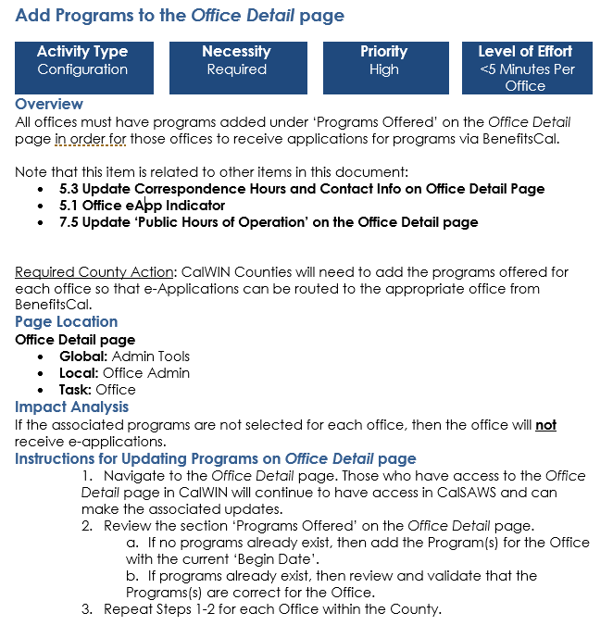
County Prep Phase Packet
Navigation & Examples of Activities
Quick overview of activity specs
References to other activities in the document that are related or use the same page
Where to find the relevant page
How to complete the activity

Slide 12
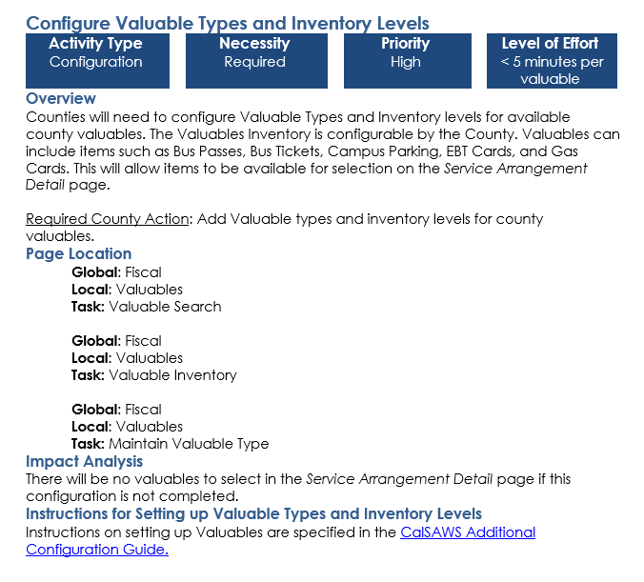
County Prep Phase Packet
Navigation & Examples of Activities
Some activities link to an auxiliary document for instruction. These are included in the County Prep Materials and are housed in the same Web Portal Location as the County Prep Packet.

Slide 13
County Prep Phase Packet
A Note on Security
The CalSAWS Project recognizes the importance of users having the appropriate access within the CalSAWS system, so an additional focused guide is being created to assist counties with configuring their county specific access rules, hereafter referred to as Application Security.
Counties are required to complete the Application Security configuration during the County Prep Phase along with the rest of the County Prep activities.
A separate kickoff event will be held to present the additional materials prior to the start of the County Prep Phase. The date will be announced in coming weeks so that Counties have time to prepare.

Slide 14
County Prep Support Structure & Schedule

Slide 15
County Prep Support Structure
Support Structure for County Prep Phase
Daily Debrief
05
Daily call 4:00 – 5:00 pm; reporting issues or progress towards resolution. County POCs, Project Security SMEs, Help Desk, Other County designated staff as appropriate, Implementation, TOSS/QA, Regional Managers, Implementation Team (facilitator)
Daily Debrief Call
County Prep Office Hours
04
County office hours 8:00am – 12:00pm for the first 2 weeks, 9:00am – 10:30am thereafter. Project SMEs, Implementation Team(facilitator)
Daily office hours
COUNTY PREP SUPPORT STRUCTURE
03
Help Desk Support
County Help Desk Support
Validation of CalSAWS credentials
PPOCs, IPOCs, TPOCs, Security Administrators, BPR Leads (Configuration)
County POC Support
02
May assist with users logging in. These will otherwise be the staff completing the activities
Self-Support Resources
01
County Prep Packet, Configuration Guides, Job Aids
Self-Support Resources
Notes:
Helpful to show the WHO and the Responsibility of whom in the meetings/support structures. Who is included in the Daily Debrief – who’s leading/facilitating and who is attending from a support structure + attending

Slide 16


County Prep Support
Daily Office Hours and Daily Debriefs
Daily Office Hours (Teams Call)
8:00am – 12:00pm 9/19 - 9/30
9:00am – 10:30am 10/3 - 10/27
For questions or issues with completing the County Prep Phase Activities, County Points of Contact can call the Project for additional support. Questions will be documented for follow up and trend analysis.
Daily Debrief (Teams Call)
4:00pm – 5:00pm
The Project will provide updates on challenges identified during office hours and resolutions, when applicable to County Points of Contact. The Project will report out on completion progress made on a weekly basis.

Slide 17
County Prep Support
Daily Office Hours and Daily Debriefs
Teams Call | Time | Purpose | County Audience | Project Attendees
Daily Office Hours | Mornings - 9/19 - 9/30 8:00am – 12:00pm 10/3 - 10/27 9:00am – 10:30 am | If there are questions/issues with completing the County Prep Phase Activities, Counties can call the Project for additional support | Security Administrators, PPOCs, IPOCs, TPOCs | Project Leads & Subject Matter Experts, Implementation Managers
Daily Debrief Call | Daily: 4:00 – 5:00 pm | The Project will provide updates on high-impact challenges (coming out of the office hours) and resolutions, when applicable. The Project will report out on progress made on a weekly basis (utilizing County Prep metrics and reporting). County stakeholders will share County experiences and escalate additional findings | County Stakeholders (IPOCs, TPOCs, PPOCs, others identified by the Counties) | Project Leadership, Project Leads, Implementation Managers, Regional Managers.

Slide 18
County Prep Support
Supporting the Wave 1 Counties
August
Su | Mo | Tu | We | Th | Fr | Sa
 | 1 | 2 | 3 | 4 | 5 | 6
7 | 8 | 9 | 10 | 11 | 12 | 13
14 | 15 | 16 | 17 | 18 | 19 | 20
21 | 22 | 23 | 24 | 25 | 26 | 27
28 | 29 | 30 | 31
September
Su | Mo | Tu | We | Th | Fr | Sa
 |  |  |  | 1 | 2 | 3
4 | 5 | 6 | 7 | 8 | 9 | 10
11 | 12 | 13 | 14 | 15 | 16 | 17
18 | 19 | 20 | 21 | 22 | 23 | 24
25 | 26 | 27 | 28 | 29 | 30
October
Su | Mo | Tu | We | Th | Fr | Sa
 |  |  |  |  |  | 1
2 | 3 | 4 | 5 | 6 | 7 | 8
9 | 10 | 11 | 12 | 13 | 14 | 15
16 | 17 | 18 | 19 | 20 | 21 | 22
23 | 24 | 25 | 26 | 27 | 28 | 29
30 | 31
County Prep Phase Packet Distribution
County Prep Phase Cutover 1A
Go-Live Event
County Prep Kickoff
County Prep Support:
Daily Office Hours
9/19/22 - 9/30/22 8:00 am – 12:00 pm
10/3/22 - 10/27/22 9:00am – 10:30am
Daily Debrief 4:00 – 5:00 pm
CalSAWS Go-Live Wave 1
County Prep Application Security Kickoff

Slide 19





County Prep Support
Daily Office Hours
Focused Subject Matter & General Sessions
County Help Desk* Ticket
For Login Issues & defects
Escalation Flow
CalSAWS End User
IPOCs/TPOCs/PPOCs
Security Administrator
Login activity Only
*Help Desk Tickets to be logged based on County Process​
IPOC – Implementation Point of Contact​
TPOC – Technical Point of Contact​
PPOC – Primary Point of Contact

Slide 20
Help Desk and Office Hours
When to use what
When to Submit a County Help Desk Ticket
When to Raise Questions through the Office Hours
Resources
Provided
When encountering issues logging in
When there are environment/ performance issues
When seeing a functional defect, if applicable
When there are questions completing the activities included in the County Prep Phase Packet
County Prep Phase Packet
County Prep Phase Kick-Off
Configuration Documentation
Notes:
When to submit a Help Desk ticket (County Help Desk)
When encountering issues logging in
When there are environment/performance issues
When seeing a functional defect, if applicable
When to dial into the Office Hours
When there are questions completing the activities included in the County Prep Phase Packet
Resources Provided:
County Prep Phase Packet
County Prep Phase Kick-Off
Configuration Documentation

Slide 21
County Prep Metrics & Tracking

Slide 22

County Prep Communications
Keeping Track of Challenges
Questions raised at the Daily Office Hours will be tracked to analyze trends and to ensure follow up and resolution to outstanding inquiries.
Challenges and Issue Resolutions will be reported on the Daily Debrief calls from 4:00-5:00pm.

Slide 23

County Prep Completion
Getting it Done
The CalSAWS Project will track the completion of each county’s County Prep Activities as part of Green Light and Readiness monitoring.
These Metrics will be reported weekly on the Debrief Call and will be included on the Readiness Dashboard and Packet.
As an optional tool to assist counties with tracking their own progress and to report back, we’ve included a simplified checklist of all the County Prep activities.

Slide 24
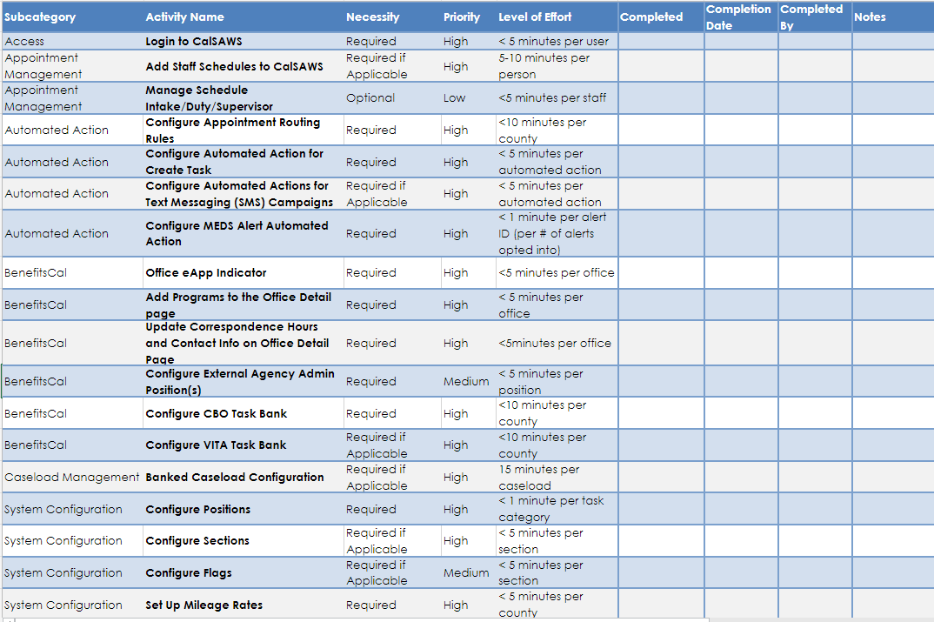
County Prep Completion
Optional Checklist Tool Preview

Slide 25

Questions?

