Slide 1
August 2022
Security Role Configuration

Slide 2
Security Role Overview
Security Role Configuration Guide
Security Role Configuration Template
Security Role Configuration Support
Q & A
CalSAWS | Security Role Configuration 2

Slide 3
What is a Security Role?
Defining Security Role
Impact Of Security Role
Need To Know
Every User MUST be assigned at least one Security Role to be able to access CalSAWS.
It is important that users have the correct assigned Security Role(s). This will ensure the appropriate level of access to pages and functions for their position.
When changes are made to a Security Role, Users must log out and log back in to CalSAWS, for the changes to take effect.
A Security Role is part of a Security Profile that defines how CalSAWS users, such as Eligibility Staff, access different Pages and Functions in the System.
To control the level of access a user has to data, you can select existing Security Roles, create new Security Roles, or change which Security Groups are assigned to each Role.
CalSAWS | Security Role Configuration 3
Notes:
Tags: approach, current state, future state, recommendation

Slide 4
CalSAWS Security Role Overview
Project Maintained - County Created
Security Roles are a collection of Security Groups
Project Maintained Security Roles:
29 Project Maintained Security Roles that serve as general roles for functions to be performed in CalSAWS.
County Security Roles:
Roles created by, and maintained by, the County to support individual County process.
Security Groups:
1498 individual Security Groups, assigned collectively, which create Security Roles. Additional Security Groups are added when additional pages or functionality are added to the system.
CalSAWS | Security Role Configuration 4

Slide 5
CalSAWS Project Maintained Security Roles
CalSAWS Project Maintained Roles
Child Care Staff | Hearings Staff
Child Care Supervisor | Hearings Supervisor
Clerical Staff | Help Desk Staff
Clerical Supervisor | Marketing Staff
Collections Staff | Marketing Supervisor
Eligibility Staff | Oversight Agency Staff
Eligibility Supervisor | Quality Assurance Staff
Employment Services Contracted Staff | Quality Assurance Supervisor
Employment Services Contracted Supervisor | Quality Control Staff
Employment Services Staff | Quality Control Supervisor
Employment Services Supervisor | RDB Staff
Executive | RDB Supervisor
Fiscal Staff | Special Investigations Staff
Fiscal Supervisor | Special Investigations Supervisor
 | View Only
29 Roles created by, and maintained by, the CalSAWS project. Each Role includes the Security Groups required to access the core pages and functions related to that Role.
Additional Security Groups may need to be added to a Project Maintained Role to provide desired access based on County process.
At the time of migration, the Project Maintained Security Roles will be available for selection.
Working with the Conversion team, Counties may select up to 5 Project Maintained Roles to be mapped to each User at Go-Live.
CalSAWS | Security Role Configuration 5

Slide 6
CalSAWS County Security Roles
CalSAWS allows each County to create unique Security Roles specific to their business needs.
County Security Roles can be updated when additional Security Groups are added to CalSAWS.
Security Groups included in Project Maintained Roles can easily be copied into a County Security Role.
Once County specific Security Roles are created, the resulting Security Role can be assigned to Staff on the Security Assignment Detail page.
It is important to create Roles that allow the correct level of User access to the System. Too little will create roadblocks, too much could allow rights to pages or functions that the User should not access.
CalSAWS | Security Role Configuration 6

Slide 7
CalSAWS Security Groups
There are 1498 individual Security Groups available in CalSAWS. Additional Security Groups are added when additional pages or functionality are added to the system.
Security Groups are combined to make-up Security Roles. Each Role includes the Security Groups required to access the core pages and functions related to that Role.
Additional Security Groups can be added to a User's profile, in addition to a Project Maintained Role, to provide desired access based on County process.
There are known Security Groups, that are related to specific functions, which are not currently included in an existing Project Maintained Role. A few examples of these Groups are related to Imaging, Foster Care, AAP, GA/GR, and Confidential. These Groups can be added to a County Security Role for assignment.
CalSAWS | Security Role Configuration 7

Slide 8
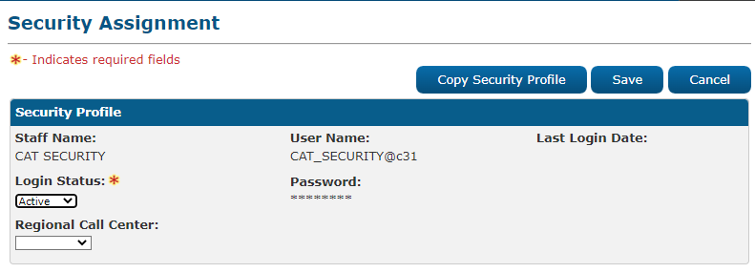
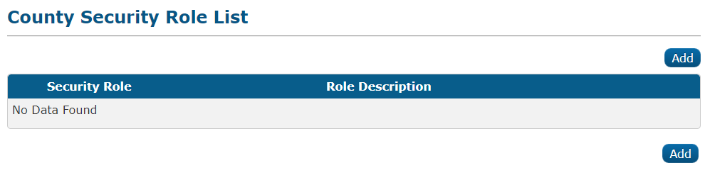
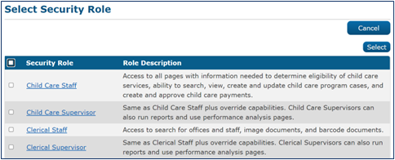
CalSAWS Security Configuration Guide
The CalSAWS Security Configuration Guide includes step-by-step instructions on how to create County Security Roles and how to assign Security Roles, including County Created and Project Maintained, to a User.
Examples of the level of detail provided in the Guide:
Security Assignment
Security Profiles
To Add a Security Role, on the Security Assignment page, Assigned Security Roles section:
Click the Add Security Role button.
Note: The Security Roles that are available at migration, are the Project Maintained Security Roles. Additional Security Groups may need to be added to a Project Maintained Role for a User to have needed system access.
The County Security Role List page displays Security Roles and Role Descriptions that have been defined by the County. From this page, Users with the appropriate Security Access Profile can view, edit, and add Security Roles.
To edit a Security Role, on the County Security Role List page:
Click the Edit button for the Security Role you would like to Edit.
To create a Security Role, on the County Security Role List page:
Click the Add button.
CalSAWS | Security Role Configuration 8

Slide 9
August 2022
Security Role Configuration Resources

Slide 10
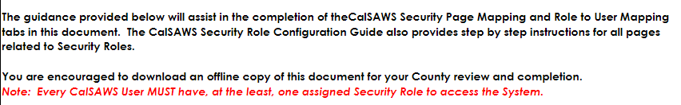
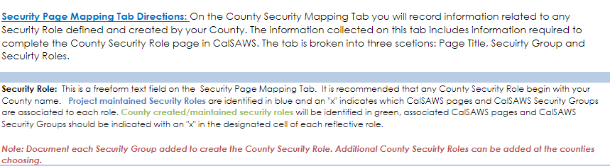
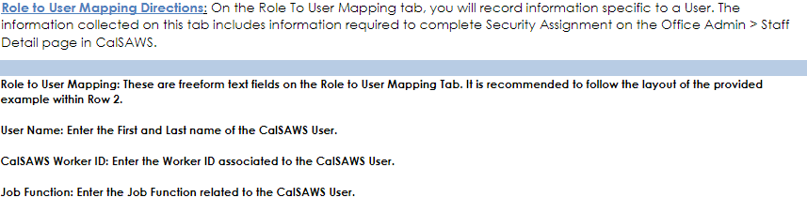
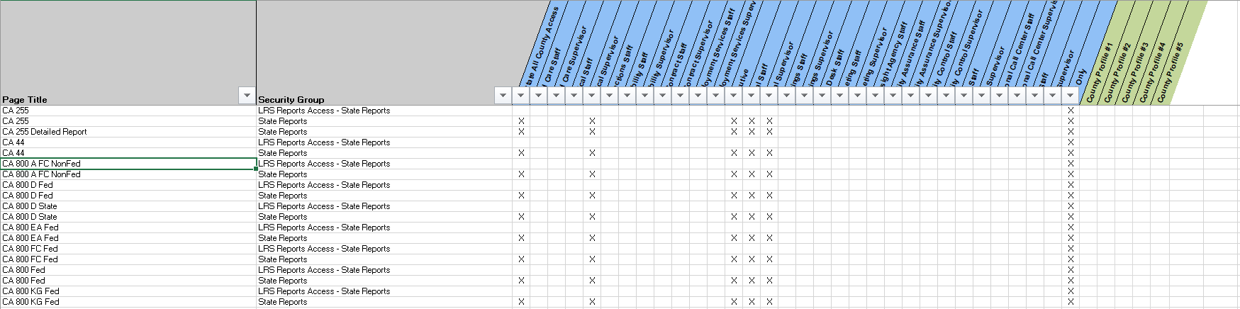
CalSAWS County Security Role Configuration Template​
The CalSAWS County Security Role Configuration Template is an optional worksheet provided to document County Security Role decisions.
The first tab of the worksheet provides instructions on how to complete the Security Page Mapping and Role to User Mapping tabs.
The Template captures County Security Roles and Role to User Mapping.
Example documentation has been provided.
Security Page Mapping Tab
Role to User Mapping Tab
CalSAWS | Security Role Configuration 10

Slide 11
August 2022
Security Role Configuration Support

Slide 12
CalSAWS Security Configuration Support
CalSAWS Configuration Working Sessions
CalSAWS County Prep Phase
Working Sessions will be scheduled with each County to discuss and document CalSAWS Configurations for defined elements, including Security.
All documentation will be provided to the County, in the form of the CalSAWS Security Configuration Guide and the Optional Configuration Template, to assist in updating CalSAWS with County specific Configurations.
Additional support will be provided in the County Prep phase.
CalSAWS | Security Role Configuration 12

Slide 13

Questions?
CalSAWS | Security Role Configuration 13

